Slide 1
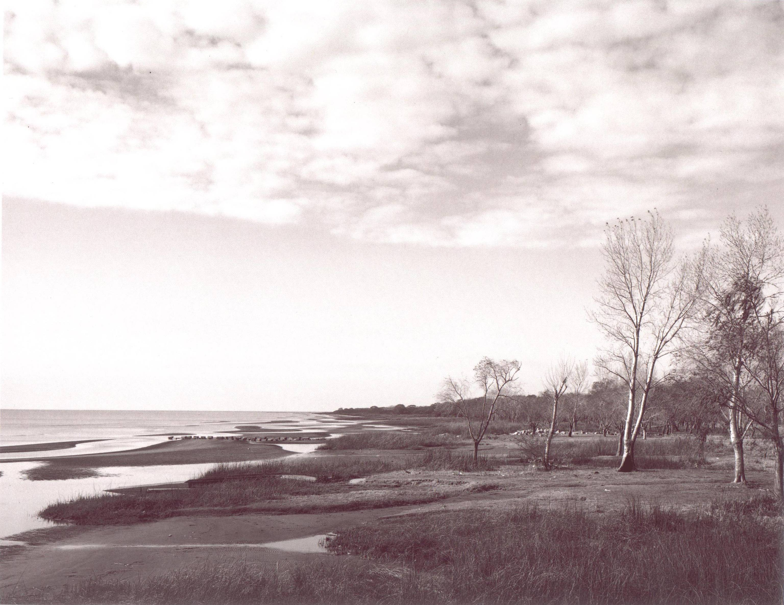



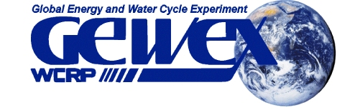
La Plata Basin (LPB)
Regional Hydroclimate Project
E. Hugo Berbery, co-chair for CLIVAR
Luiz Machado, co-chair for GEWEX
Scientific and Implementation Steering Group (SISG)

Slide 2
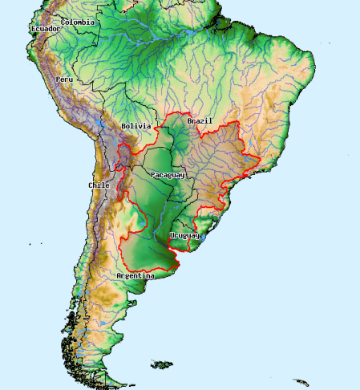
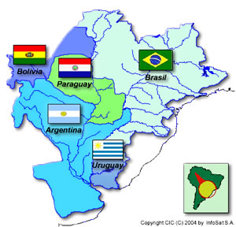

Slide 3
A Little Bit of History
1999-2004: A study group was formed to identify the hydroclimate science questions and priorities of the La Plata basin. This group, known as Platin, was formed with support from the CLIVAR and GEWEX Panels (both of WCRP).
2002-2004: The La Plata Basin (LPB) was accepted as a “Regional Hydroclimate Experiment” endorsed by GEWEX and CLIVAR.
2005-2015: LPB is now close to finishing its implementation plan; monitoring activities, a field experiment and modeling experiments are being planned.

Slide 4
La Plata Basin (LPB) main science questions:
What climatological and hydrological factors determine the frequency and spatial extent of floods and droughts?
How predictable is the regional weather and climate variability and its impact on hydrological, agricultural and social systems of the basin?
What are the impacts of global climate change and land use change on regional weather, climate, hydrology and agriculture? To what extent can their impacts be predicted?

Slide 5
Main research areas
* Improvement of hydrologic and climate models’ representation of land surface-atmosphere interactions
* Land surface contributions to hydroclimate predictive skill
* Development of coupled models at adequate resolutions for hydrologic purposes
* Better estimates of MCS precipitation
* Climate change scenarios (Vulnerability and adaptation)
* Impacts on the system’s hydrology

Slide 6



CLARIS - LPB
ACC
IAI - LPB
Ecosystems, Biodiversity,
LCLUC,
Water Resources
NASA
- Remote Sensing
- Capacity Building
- Decision support for water management and agriculture
Multiple Regional Projects

Slide 7
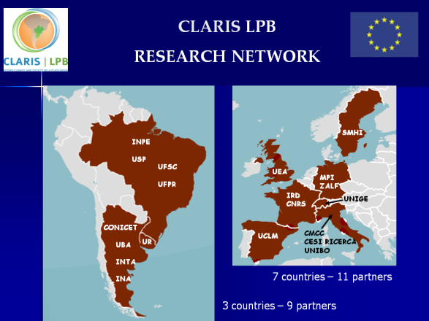


CLARIS LPB
Database
WG
Extremes
WG
Reg. Climate Models,
Reg. Downscaling
WG
Water resources
WG
Agriculture
VAMOS
Extremes
WG
CORDEX
TFRCD
(WCRP)
Stakeholders
WCRP’s DIG

Slide 8
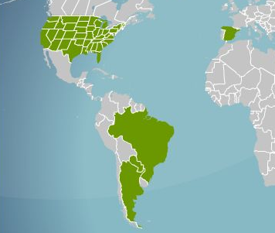
IAI
NASA
Land use
Rural development
Remote Sensing
Decision support for water management and agriculture
LCLUC
Ecosystems
Capacity Building
Capacity Building

Slide 9
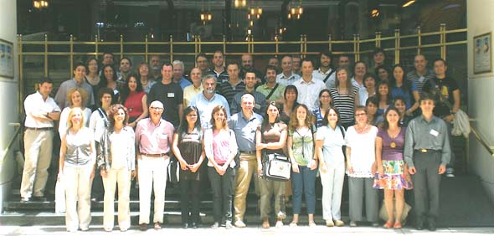
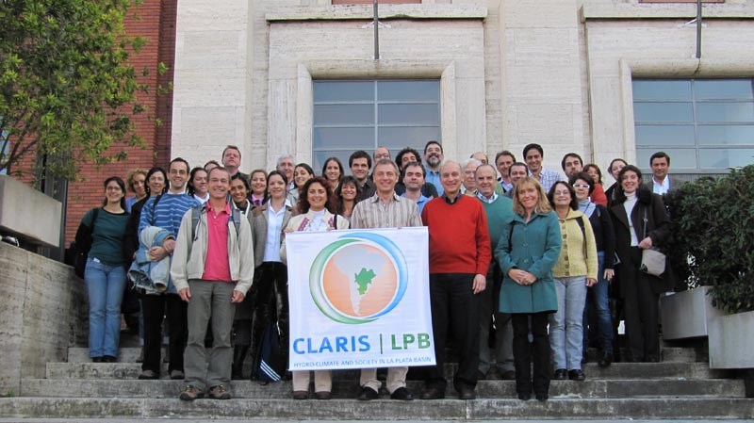
Meetings and workshops
CLARIS LPB
2008: 1st CLARIS LPB Plenary Meeting
2009: Workshop on Extremes
2009: Meeting on Regional Modeling
2009: Workshop on Water resources
2010: 2nd CLARIS LPB Plenary Meeting
Nov 2010: 3rd CLARIS LPB Plenary Meeting

Slide 10
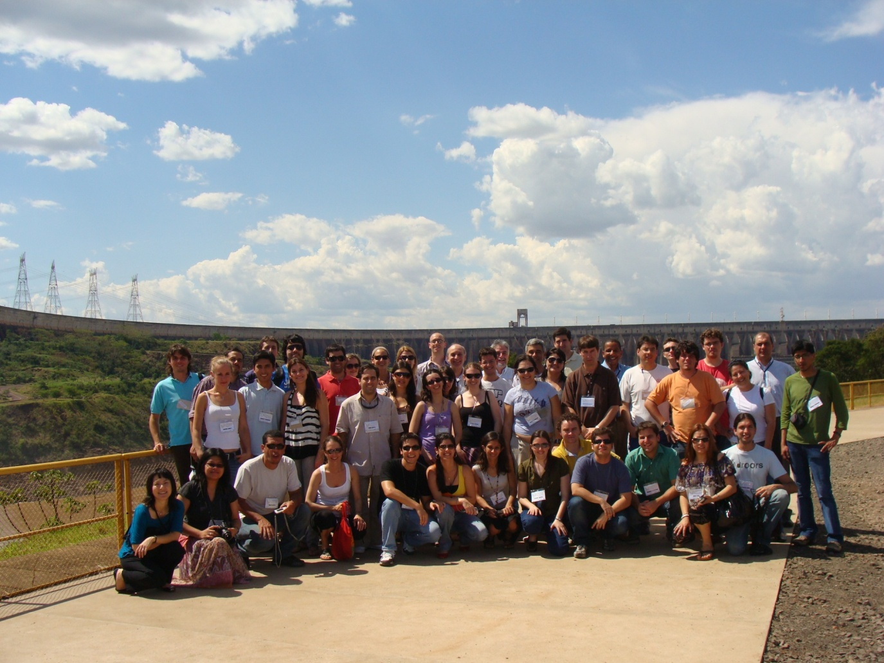
Meetings and workshops
IAI - LPB
2009: 1st IAI –LPB PIs + students meeting
2010: 2nd IAI –LPB PIs + students meeting
2009: Summer School on LCLU and LPB Hydroclimate
Summer school at Itaipu. 45 students fully funded

Slide 11
About the strategic questions
LPB Plans for the next 3 years:
  Climate changes scenarios and their impact on water resources and agriculture
  Extremes on LPB
  LCLUC impacts on LPB’s hydroclimate
Suggestions for the CEOP Panel:
- A Science Steering Group should be named
- Science workshops together with the CEOP meetings
Requirements for RHPs:
- That they contribute to the scientific objectives of CEOP (Variable, one size does not fit all).

Slide 12
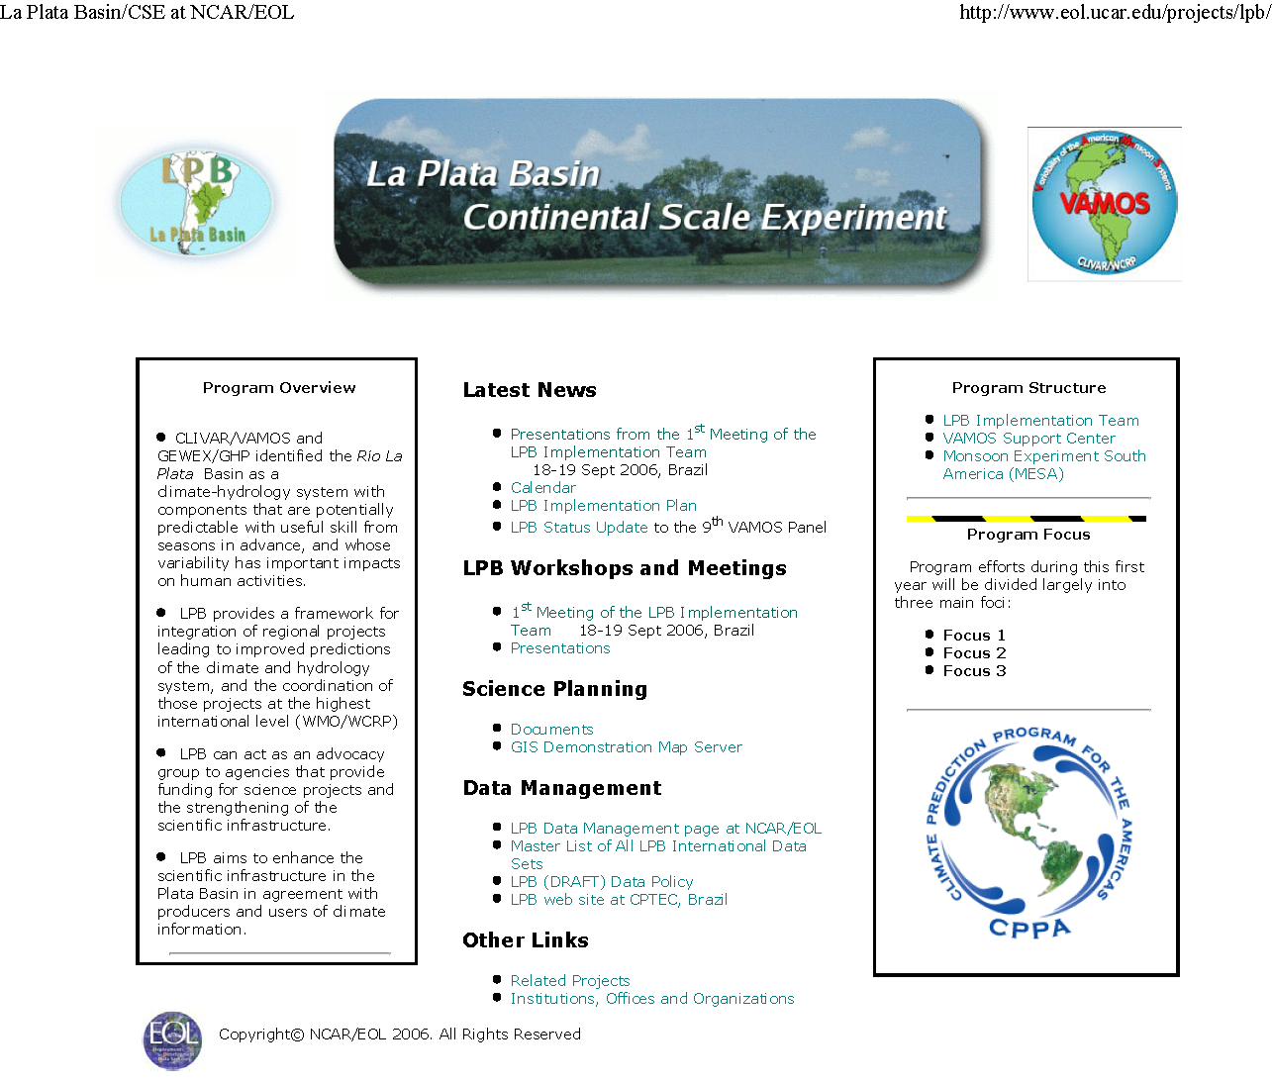
http://www.eol.ucar.edu/projects/lpb

Slide 13

Thanks...
Useful URLs
http://www.eol.ucar.edu/projects/lpb
http://www.cicplata.org
http://www.cptec.inpe.br/lpb
http://www.atmos.umd.edu/~berbery/lpb

