Slide 1
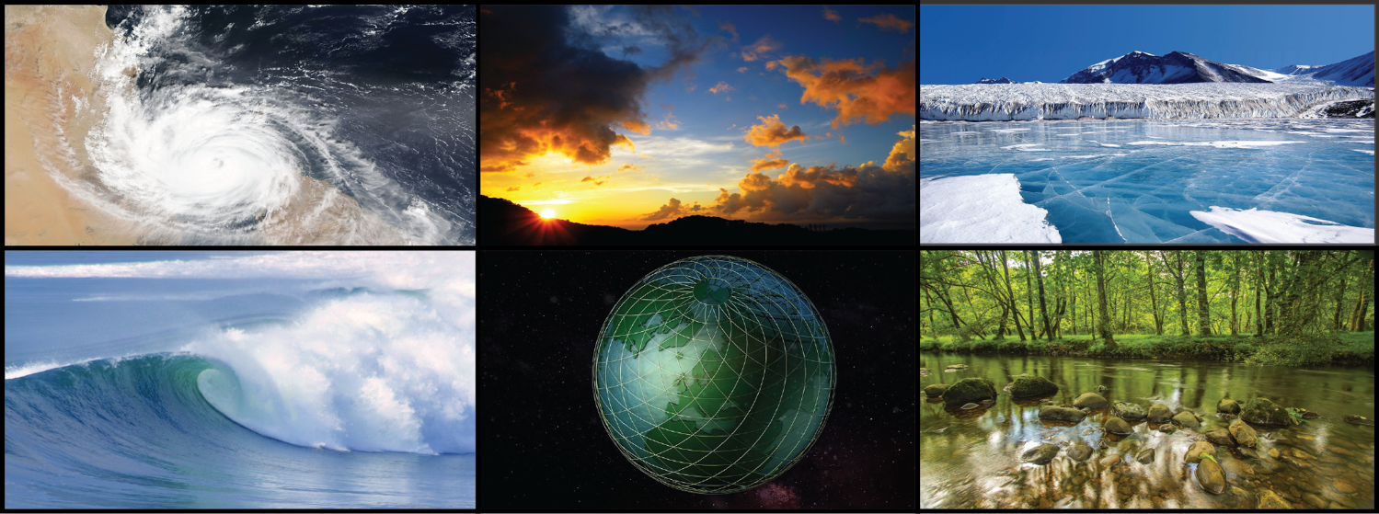
Regional information for Society (RifS)
A roadmap for policy-relevant climate research
Silvina Solman, Bruce Hewitson, Sara C. Pryor

Slide 2
What is RIfS about?
VISION
[New WCRP Core project] To understand, develop, and enhance the effective flow of relevant information among scientists, decision makers and society developing policy-relevant climate research
MISSION
Targeted research on regional climate information
Integrated with activities of other WCRP activities and initiatives
Augmented through external partnerships
Engaged with the climate services community
Connected with stakeholder communities
Enhanced construction, communication, and adoption of climate information by society.

Slide 3
WCRP Core Project: RifS
Where RIfS came from
May 2019: following JSC 41: Task Team on Regional Activities (TTRA)
Responding to the recognition that WCRP need stronger engagement with society
Early 2021, Interim Coordinating Group (ICG), and appointment of three RIfS co-chairs
Mandate to establish new core project, and engage community on designing science plan
2022, core implementation, and development of the RIfS science plan
Broad consultation process with community (self nominated to an open call)
Over 50 participants in 4 working groups in more than 10 science plan virtual meetings
The RIfS co-chairs have integrated the working group outputs as a living-document science plan, provisionally approved by the WCRP JSC in July 2022

Slide 4
The science plan
Three overarching CHALLENGES focused on the regional / decision scale
How to optimally identify, understand, and model the relevant climate processes and their interactions which are most critical to manage the socio-ecological risks at the decision scales within regions.
How to optimally integrate multiple lines of evidence from observations, understanding of physical climate processes, and data from dynamical and statistical regional and global models to inform society’s climate information needs.
How to best undertake engagement between stakeholders and the science community in different regional contexts to maximize the information benefit for the stakeholder and ensure that the user context is integrated into the design and execution of relevant climate research.

Slide 5
Current activities (2022) are focused on building conversations to establish linkages
My Climate Risk
Safe Landing Climates
RifS IPO
Digital Earths
Lighthouse regional activities
WCRP Academy
RifS
Scientific Steering Group (SSG)
External partnerships and stakeholders
Explaining and Predicting
External board
Allied WCRP Assembly
GEWEX
CORDEX IPO & SAT
CLIVAR
ESMO
WCRP Core Projects
Global Extremes Platform
SPARC
CLiC

Slide 6
Science Plan
Four CLUSTERS of research activities that are inter-related, co-dependent, overlapping
Regional climate understanding for climate projections (multi-decadal)
Regional climate understanding for climate predictions (seasonal to decadal)
Weather and climate extremes
Communication and Societal Engagement

Slide 7
WCRP Core Project: RifS
SCIENCE PLAN
A living document
Major QUESTIONS specific to each cluster’s foci
Examples research questions:
What model complexity is required to usefully represent regional climates and change?
How to reconcile and integrate multiple lines of evidence in providing regional climate information?
How can we best develop methods to attribute change in probability of observed extreme events?
How can we enable improved understanding of, and advance the dialogue with stakeholders?

Slide 8
WCRP Core Project: RifS
SCIENCE PLAN
A living document
Multiple proposed ACTIONS to address the cluster science questions
Example proposed actions:
Assess/qualify the reliability and uncertainty of predictions/projections for derivative parameters relevant to stakeholders.
Use the understanding of the regionally relevant multi-scale drivers of climate variability and change to reconcile the differences of data sources and so improve the signal-to-noise ratio
Develop and apply new metrics for the detection and characterization of extreme events in the contemporary climate
Understand how to assess user context and incorporate this into the design and communication of information

Slide 9
GEP
My Climate Risk
Safe Landing Climates
RifS IPO
Digital Earths
Lighthouse regional activities
WCRP Academy
RifS
Scientific Steering Group (SSG)
External partnerships and stakeholders
Explaining and Predicting
External board
Allied WCRP Assembly
GEWEX
CORDEX IPO & SAT
CLIVAR
ESMO
WCRP Core Projects
Global Extremes Platform
Co-Chairs
Xuebin Zhang
IPO
upcoming
SPARC
CLiC

Slide 10
Global weather and climate Extremes Platform Platform
GEP Implementation plans
Still early days … GEP needs and welcomes inputs
Annual GEP assessment: e.g. update annual assessment of extremes to support UNFCCC COP’s and global stock take
Indices development and research: e.g. regional and global analysis to provide input in-time for GEP annual assessment and IPCC AR7
Event attribution and compound events: e.g. methodological development and critical review
GEP is in the process of being established, plans being approved, etc.

Slide 11
CORDEX
My Climate Risk
Safe Landing Climates
RifS IPO
Digital Earths
Lighthouse regional activities
WCRP Academy
RifS
Scientific Steering Group (SSG)
External partnerships and stakeholders
Explaining and Predicting
External board
Allied WCRP Assembly
GEWEX
CORDEX IPO & SAT
CLIVAR
ESMO
WCRP Core Projects
Global Extremes Platform
Co-Chairs
Silvina Solman
Daniela Jacob
IPO
Iréne Lake
SPARC
CLiC

Slide 12
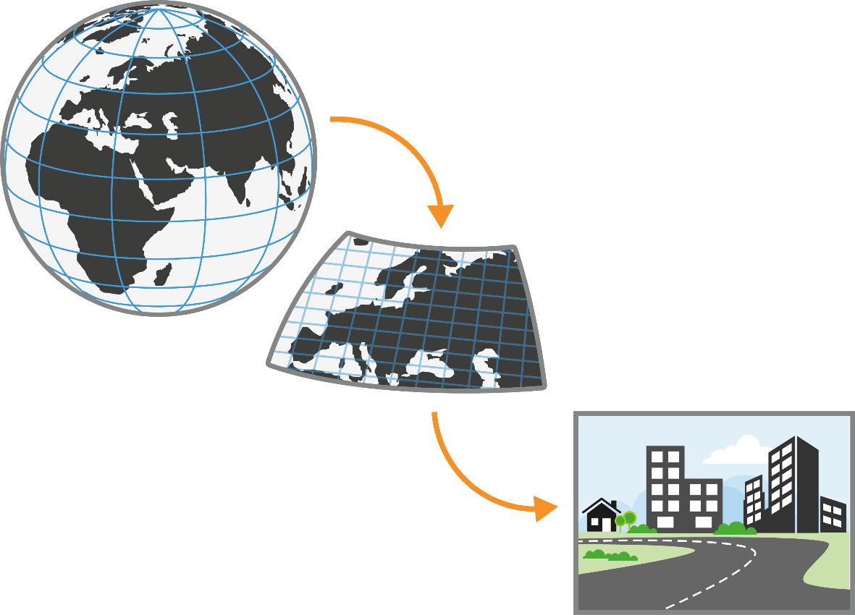
The chain from global to local - from data to knowledge to societal benefit -
Global Climate Model
Global collaboration
Regional/local climate phenomena and variability
Understanding/knowledge transfer/capacity development
Coordinated, easy to use, climate information for regions
Informed decisions
Regional Climate Model
12-25 km
CORDEX standard
Instruments
Flagship Pilot Studies (FPS)
Coordinated modelling efforts (RCMs&ESDs)
Capacity building activities
Very High Resolution
Convection Permitting Model
1-3 km

Slide 13
2022 - 2023 plans – opportunities to engage
Event | Purpose
AGU– committed | A RIfS sponsored session proposed and accepted … Session title is “Pathways to Provision of more Robust Regional Information for Society”
Conversations within WCRP – ongoing | RIfS co-chairs are initiating conversations with, and participating in meetings to explore collaboration and mutual interests – please contact if you see potential
RIfS IPO – call closed | An essential resource for RIfS that we hope will soon be established
Election of RIfS SSG – call open | Capacity for designing and implementing initial RIfS pilot projects and collaborations –call is open - please consider possible nomination
Webinar series – pending SSG appointment | A webinar discussion series on priority topics from the science plan –participation opportunities.
Workshop(s) – mixed | Plans are in development, news will be forthcoming

Slide 14
Final Remarks
RIfS is about REGIONS and better integrtated INFORMATION
for stakeholders, policy, and decision makers
based on sound science
1. There are clear points of connection around how to best use convection permitting modelling products for planning and adaptation at the various temporal scales (e.g from seasonal to multidecadal)
2. RIfS is in its establishment year, conversations NOW are needed
Notes:
Statistical and dynamical donwscaling methods.
ESD workshop coming up
compromise resolution/complexity/domain size?

