Slide 1
Variational Radar Data Assimilation for 0-12 hour severe weather forecasting
Juanzhen Sun
National Center for Atmospheric Research
Boulder, Colorado
sunj@ucar.edu

Slide 2
Outline
Background
- Motivation
- Radar observations and preprocessing
Basic concept of variational data assimilation
Variational Doppler Radar Analysis System (VDRAS)
- 4D-Var Framework
- Results from applications
WRF variational radar data assimilation
- 3D-Var
- 4D-Var

Slide 3
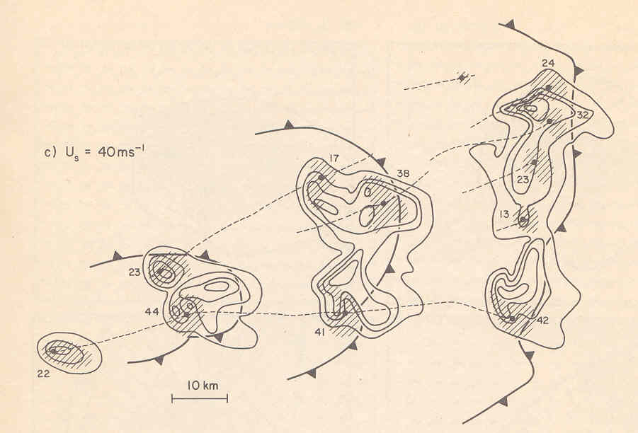
Cloud-scale modeling since 1960’s
Used as a research tool to study dynamics of moist convection
Initialized by artificial thermal bubbles superimposed on a single sounding
Rarely compared with observations
From Weisman and Klemp (1984)

Slide 4
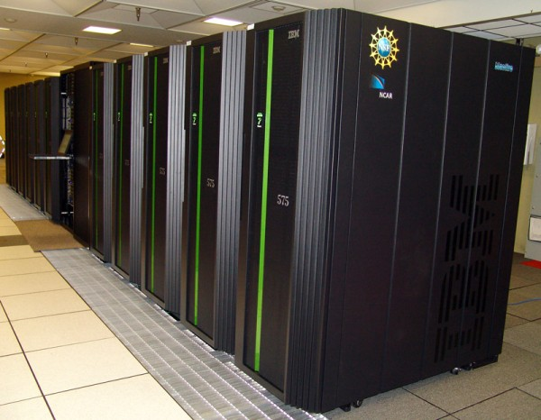
Lilly’s motivating publication (1990)
-- NWP of thunderstorms - has its time come?
Yes, it was time thanks to
NEXRAD network
Increasing computer power
Advanced DA techniques
Experience in cloud-scale modeling

Slide 5
Operational NWP: poor short-term QPF skill
0.1 mm hourly precipitation skill scores for Nowcast
and NWP averaged over a 21 day period
Current operational NWP can not beat extrapolation-based radar nowcast technique for the first few forecast hours.
One of the main reasons is that NWP is not initialized by high-resolution observations, such as radar.
From Lin et al. (2005)

Slide 6
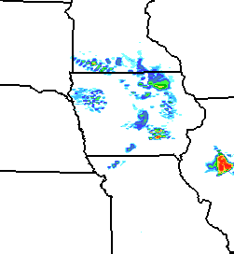
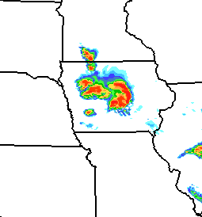
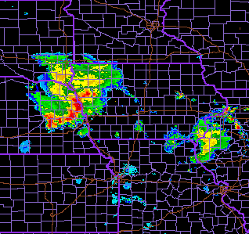
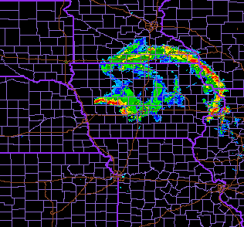
Example of model spin-up from BAMEX
6h forecast (July 6 2003)
12h forecast
Without high-resolution data assimilation:
A model can takes a
number of hours to
spin up.
Convections with
weak synoptic-scale
forcing can be missed.
Radar observation at 0600 UTC
at 1200 UTC
Graphic source:
http://www.joss.ucar.edu

Slide 7
Now the question
Can radar observations be assimilated into NWP models to improve short-term prediction of high impact weather?

Slide 8
Outline
Background
- Motivation
- Radar observations and preprocessing
Basic concept of variational data assimilation
Variational Doppler Radar Analysis System (VDRAS)
- 4D-Var Framework
- Results from some applications
WRF variational radar data assimilation
- 3D-Var
- 4D-Var

Slide 9
Characteristics of radar observations
(i.e.,WSR-88D)
• High spatial and temporal resolutions (1km x 1º
every 5-10 min.)
• Only radial velocity and reflectivity available
• Limited coverage – 50-100km in the clear-air
boundary layer and 200-250km when storms exist
Huge amount of data
In a storm mode, the estimate number of data is
~ 3 million/5 min from one radar

Slide 10
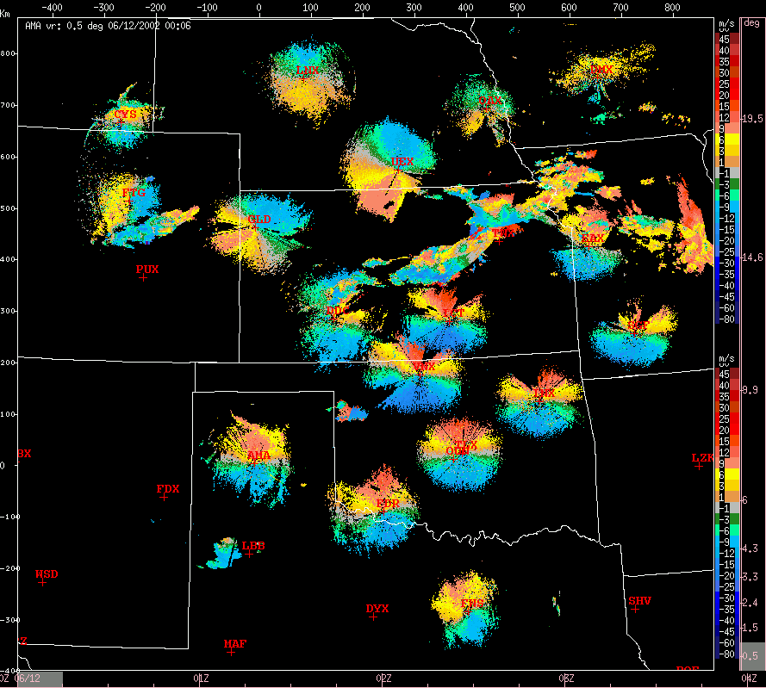
Key challenges for radar data assimilation
Handling large sets of radar data
Quality control
Retrieval of unobserved variables
Model error
- Quick nonlinear error growth of convection
Data voids between radars
Computation cost
Radial velocities from 20
WSR-88D radars

Slide 11
Objective of data assimilation
To produce a physically consistent estimate of the atmospheric flow on a regular grid using all the available information
Available information:
Background – previous forecast, climatology information,
or larger-scale analysis
-- on regular grid
Observations
-- irregularly distributed
3. Error statistics of the background and observations
Numerical model
Balance equations or constraints

Slide 12
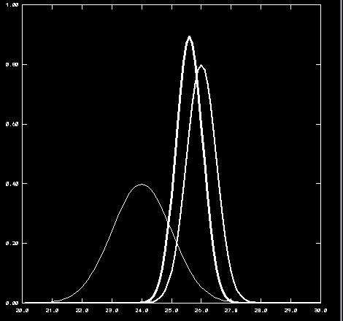
A simple example
- Following Talagrand (1997)
Assume two pieces of information T_{b}, T_{o}
with unbiased and uncorrelated
errors ζ_{b}, ζ_{o} and known variances
σ_{b}², σ_{o}²
final analysis, T_{a}
Observation
probability
Background
Background:
Observation:
Temperature
Question: What is the best estimate T_{a} of T^{t} ?

Slide 13
Two basic approaches
Direct solution approach:
The estimate (or analysis) T_{a} is a linear
combination of the two measurements:
Unbiased, minimum
variance, linear estimate:
Variational approach:
It can be shown that the above estimate T_{a} can be also
obtained by iteratively minimizing the following cost function
T_{a}
T_{b}

Slide 14
Generalization
Gain matrix
Direct solution approach [Kalman Filter (KF)]:
Analysis:
Innovation
Covariance:
Different approximation of B results in different techniques
Examples: Optimal interpolation (OI), Ensemble KF (EnKF)
Variational approach:
3D-Var, 4D-Var

Slide 15
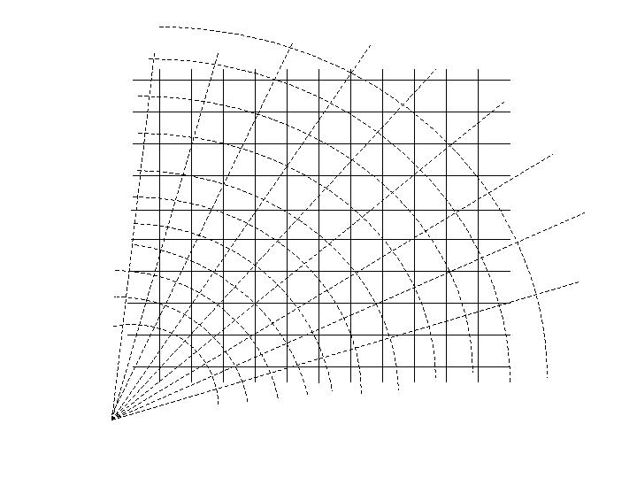
Comparing radar DA with conventional DA
Conventional DA
Radar DA
Obs. resolution ~ a few 100 km -- much poorer than model resolutions | Obs. resolution ~ a few km -- equivalent to model resolutions
Every variable (except for w) is observed | Only radial velocity and reflectivity are observed
Optimal Interpolation | Retrieval of the unobserved fields
Balance relations | Temporal terms essential
observation
model grid

Slide 16
Convective-scale DA
Objective
High-impact weather; QPF
- Short window, rapid update cycle
- High-resolution; convection-permitting
Major data source
  Radar data; satellite; mesonet
  - High resolution, but limited variables
Balance constraint
  Time tendency terms important
  - 4D schemes, flow-dependent covariance

Slide 17
Convective-scale balance
Horizontal momentum equation:
Take horizontal divergence:
convective scale balance?
geostrophic balance
nonlinear balance

Slide 18
Outline
Background
- Motivation
- Radar observations and preprocessing
Basic concept of variational data assimilation
Variational Doppler Radar Analysis System (VDRAS)
- 4D-Var Framework
- Results from some applications
WRF variational radar data assimilation
- 3D-Var
- 4D-Var

Slide 19
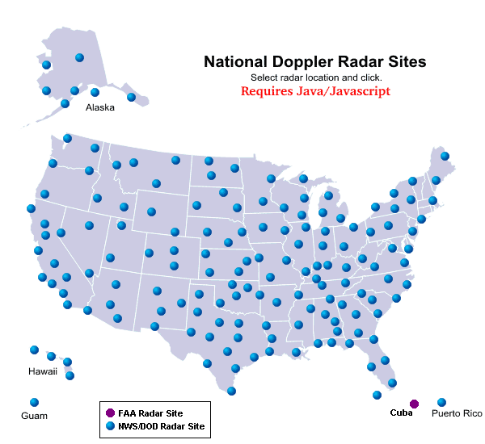
General description of VDRAS
VDRAS is a 4D-Var data assimilation system for high-resolution (1-3 km) and rapid updated (12 min) wind analysis
It was developed at NCAR as a result of several years of research and development
The main sources of data are radar radial velocity, reflectivity, and high-frequency surface obs.
A nonlinear cloud-scale model is used as the 4D-Var constraint with the full adjoint
It has been installed at more than 20 sites for various applications

Slide 20
History of VDRAS
Development milestones
1991: First version of VDRAS developed and successfully applied to simulated radar data (Sun et al 1991)
1997: Extended to a full troposphere cloud model (Sun and Crook 1997,1998)
2001: Applied to lidar data for convective boundary layer analysis (VLAS)
2005: Added the capability to cover multiple radars (Sun and Ying 2007)
2007: Coupling with mesoscale models (mm5 or WRF)
2008: Began to explore how to use VDRAS analysis to initialize WRF

Slide 21
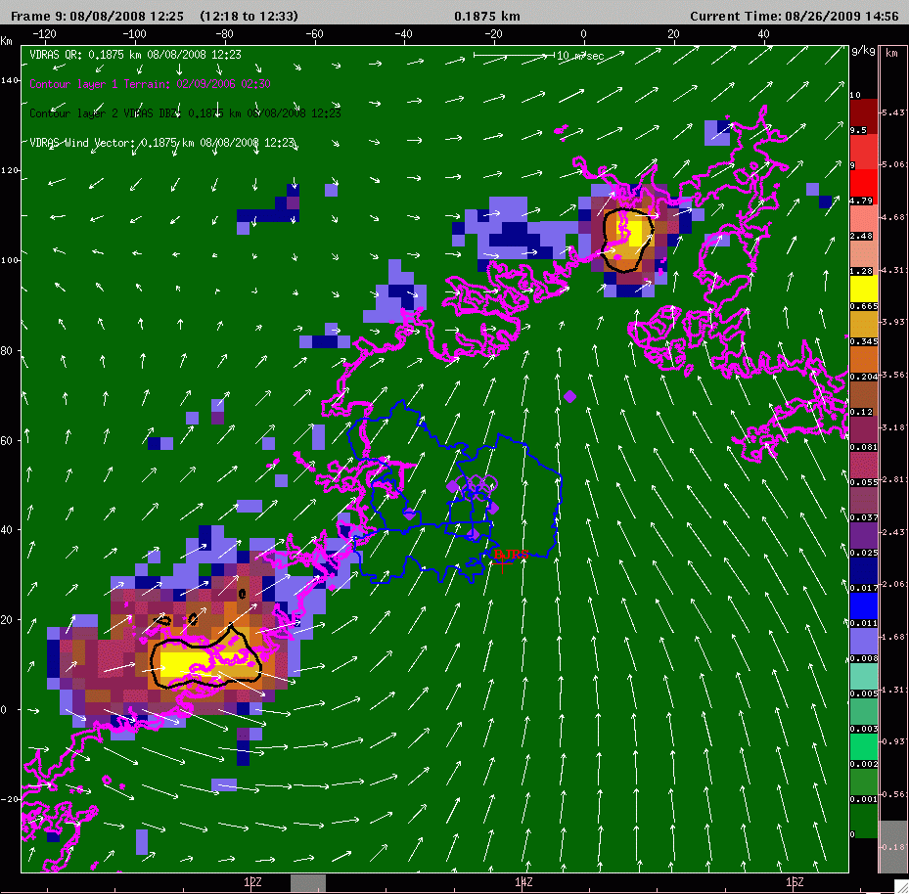
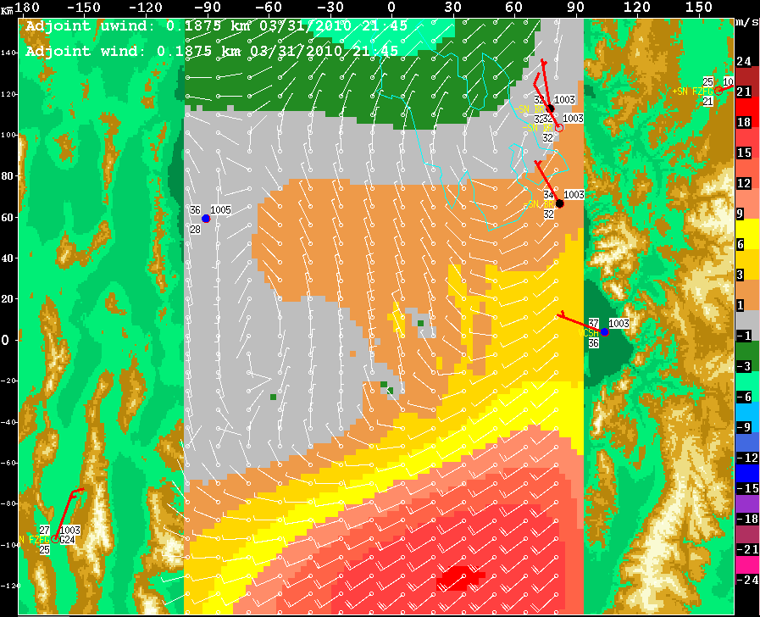
History of VDRAS cont…
Real-time installations
1998: Implemented at Sterling, NWS (Sun and Crook 2001)
2000: Installed at Sydney, Australia for the Olympics (Crook and Sun, 2002)
2000-2005: Field Demonstration for FAA aviation weather program
2003-now: Run for various mission agencies (US Army, NWS, DOD)
2006-2008: Real-time demonstration for Beijing Olympics 2008
2010: Real-time demonstration for Xcel Energy
Currently: NWS at Melbourne, Florida
NWS at Dallas, Texas
ATEC at Dugway, Utah
Beijing, China
Taipei, Taiwan

Slide 22
VDRAS analysis flow chart
Vr & Ref
(x,y,elev)
Mesoscale
model output
(netcdf)
Surface
obs.
VAD
analysis
Radar Preprocessing& QC
Background analysis
Cloud model &
adjoint
4DVar Radar
data assimilation
Last cycle
Analysis/forecast
Minimization
of cost function
Updated analysis
U, v, w, T, Qv, Qc, Qr

Slide 23
Cost Function
Background term
Observation term
Penalty term
v_{r}: radial velocity
Z: reflectivity in dBZ
x_{b}: background field
x₀: analysis field at time 0
F: Grid transformation
η: Observation erro
B: background error covariance;
modelled by recursive filter

Slide 24
Observation operators for radar
1. Variable transformation
Radial velocity
(x,y,z) analysis grid point; (x_{i},y_{i},z_{i}) radar location; r_{i} distance
between the two; v_{T} =v_{T}(q_{r}) particle fall velocity
Reflectivity
- A complex function of microphysics variables
- Simplified for warm rain and M-P DSD

Slide 25
Observation operators for radar
2. Mapping model grid to data grid
A sketch of the x-z plane
z2
■
Data grid
Model grid
z0
■
■
■
■
■
z1
■
radar

Slide 26
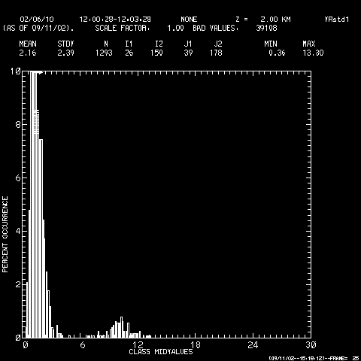
Doppler radar data preprocessing
Preprocessing Doppler radar data is an important procedure before assimilation.
It contains the following:
  Quality control
    To deal with clutter, AP, folded
    velocity, beam blockage, etc.
  Mapping
    Interpolation, smoothing, super-
    observation, data filling
  Error statistics
    Variance and covariance
Local Standard Deviation as an error estimator
Signal
Noise

Slide 27
Illustrative diagram for 4D-Var
Last iteration
•
•
Atmospheric State
•
°
First Iteration
0
5
10
TIME (Min)

Slide 28
How VDRAS analysis is produced with time
0 min
12 min
18 min
30 min
time
6-min Forward
Integration
4DVar
4DVar
KVNX
KDDC
KICT
KTLX
Cold start
Mesoscale analysis
as first guess
6-min Forecast
as first guess;
Mesoscale analysis
Output of u,v,w,div,qv,T’
Output of u,v,w,div,qv,T’
Model data
Sounding
VAD profile
Surface obs.
Model data
Sounding
VAD profile
Surface obs.

Slide 29
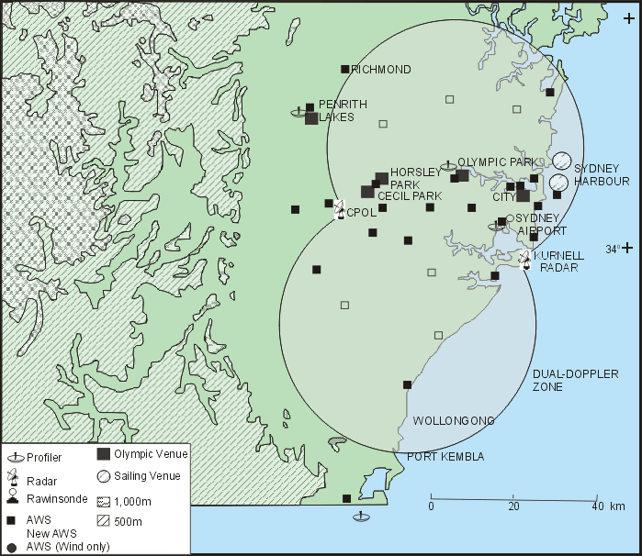
Sydney 2000

Slide 30
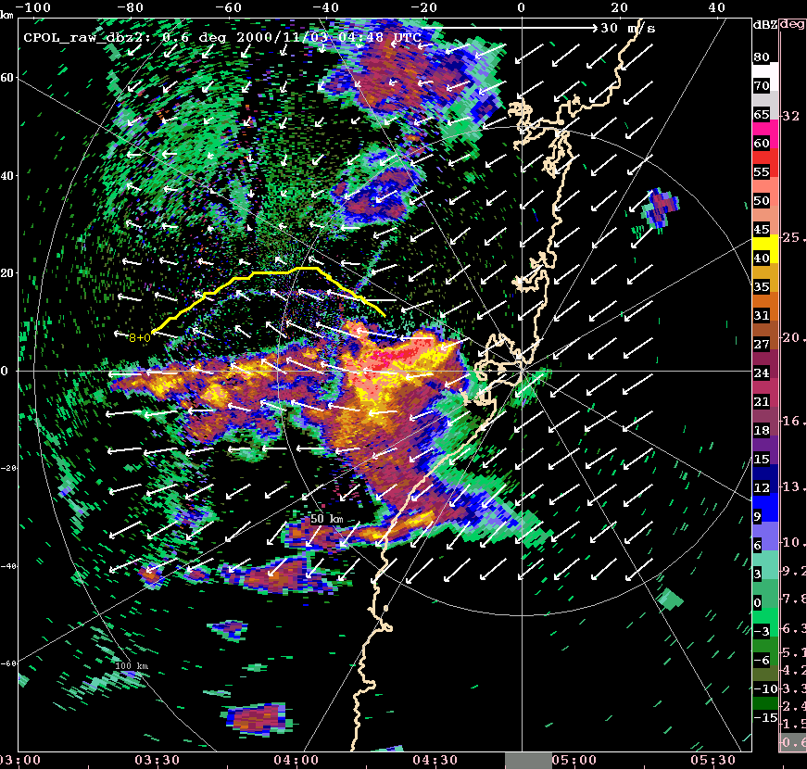
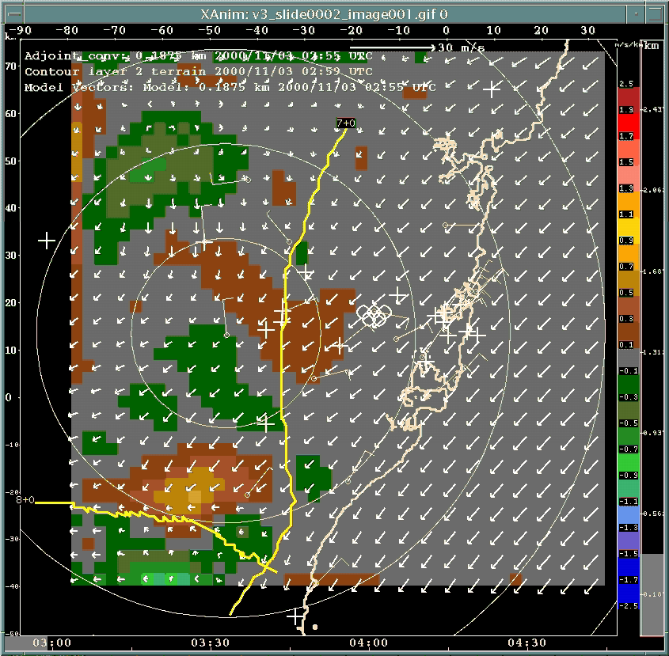
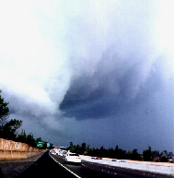
Sydney 2000
Tornadic hailstorm
November 3rd tornadic hailstorm event, left-moving supercell, clockwise rotating tornado.
gust front
sea breeze

Slide 31
Sydney 2000
Verification of VDRAS winds using aircraft data
(AMDARs)
Date | Mean vector difference | Mean vector
9/18/2000 | 2.1 m/s | 6.2 m/s
10/3/2000 | 3.5 m/s | 9.4 m/s
10/8/2000 | 2.6 m/s | 5.0 m/s
11/03/00 | 2.2 m/s | 5.0 m/s

Slide 32
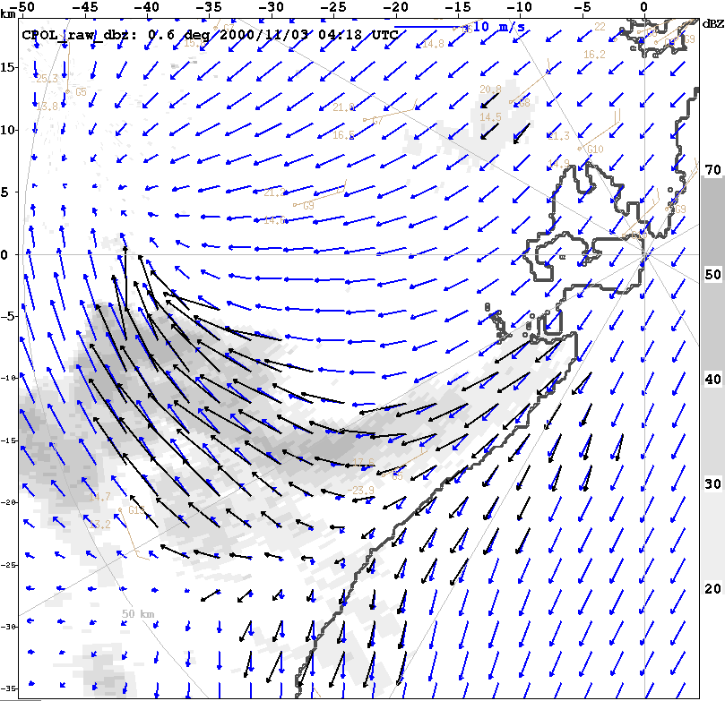
November 3rd, VDRAS-Dual Doppler comparison
Cpol
¼ of analysis domain
rms(u_{dual} – u_{vdras}) = 1.4 m/s
rms(v_{dual} – v_{vdras}) = 0.8 m/s
Kurnell

Slide 33
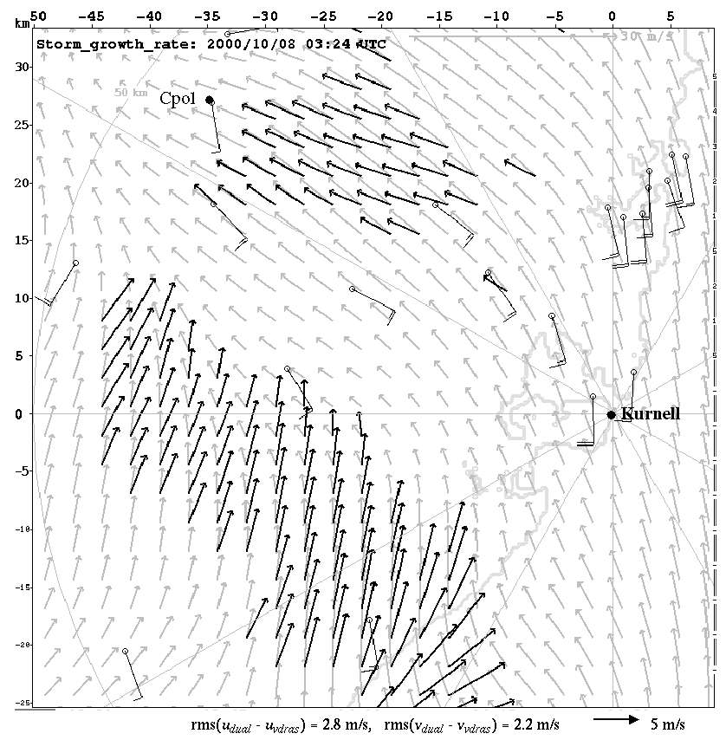
October 8th, VDRAS-Dual Doppler comparison
Cpol
rms(u_{dual} – u_{vdras}) = 2.8 m/s
rms(v_{dual} – v_{vdras}) = 2.2 m/s

Slide 34
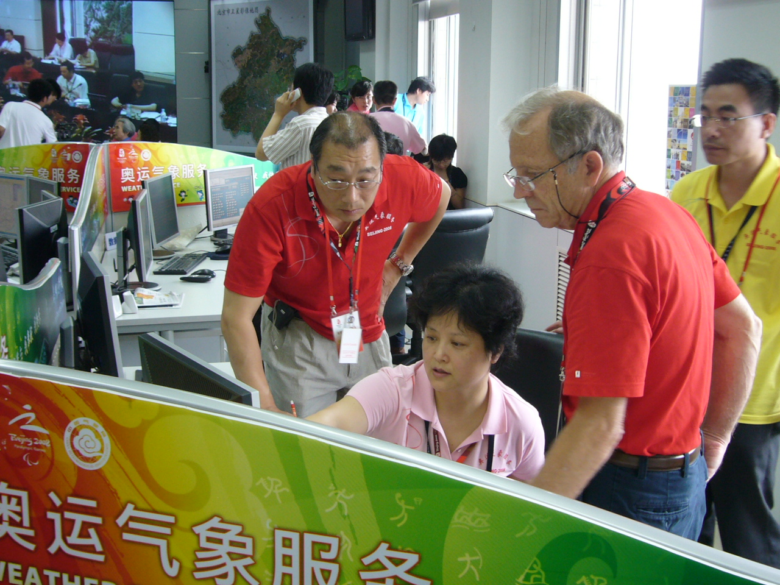
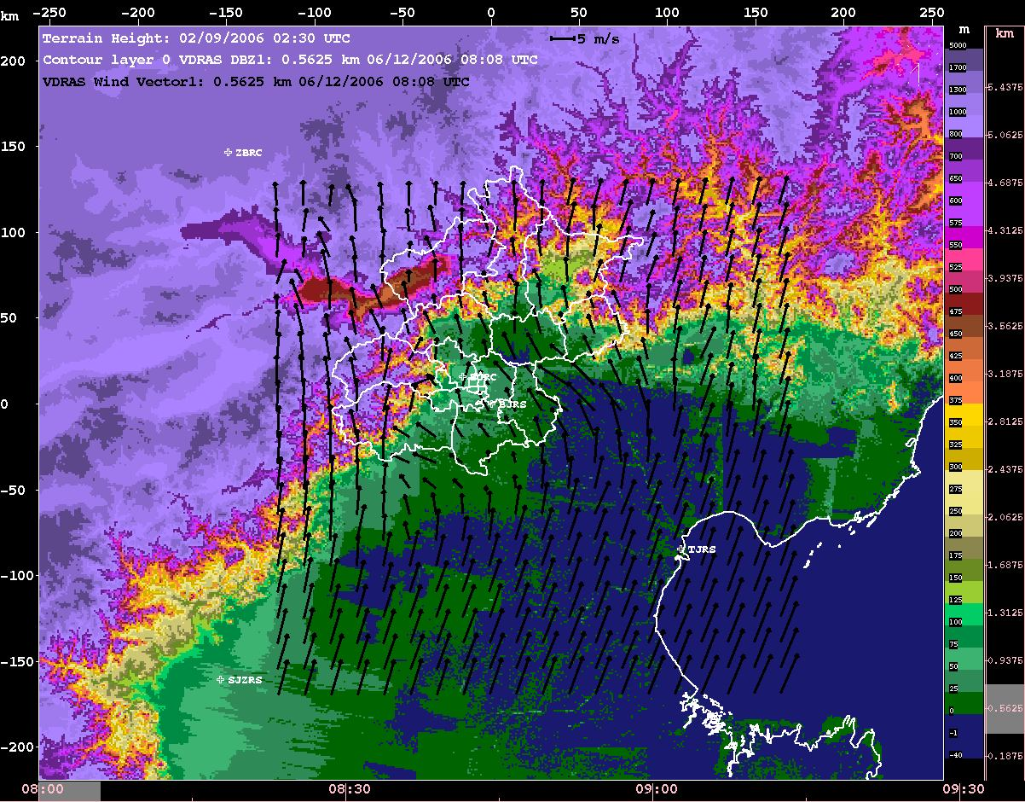

Real-time demonstration: WMO/WWRP B08FDP
Beijing 2008 Olympics Forecasting Demonstration Project

Slide 35
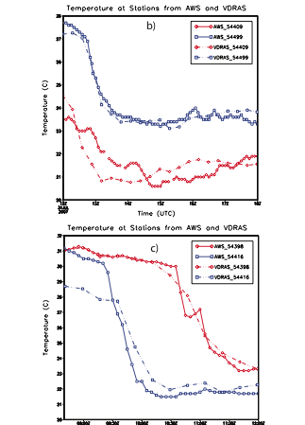
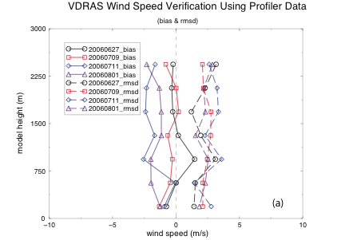
VDRAS verification for Olympics 2008 FDP
VDRAS cold pool compared
with AWS

Slide 36
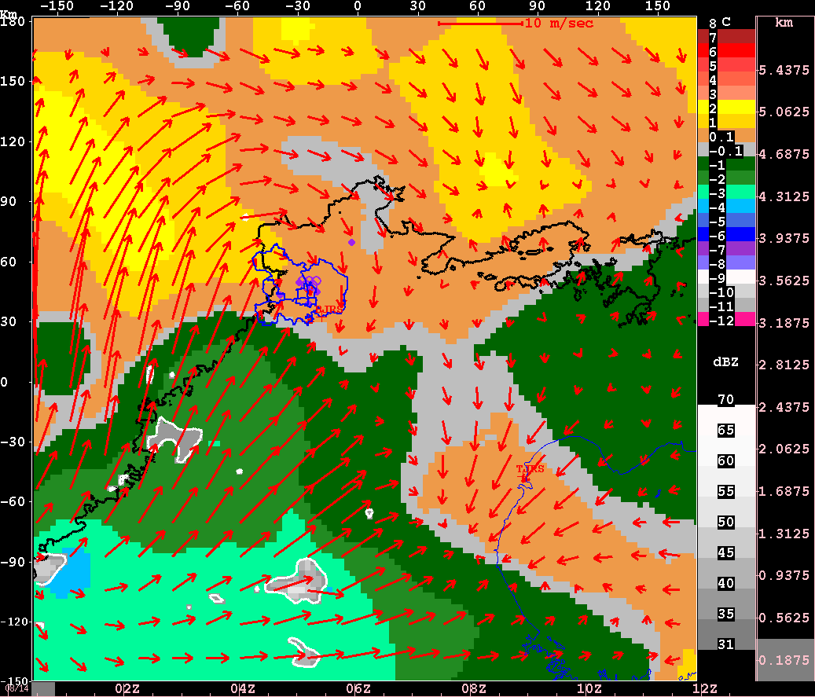
Aug. 14 2008 Storm during Olympics
VDRAS continuous analyses of wind and temperature perturbation
Frame interval: 24 min

Slide 37
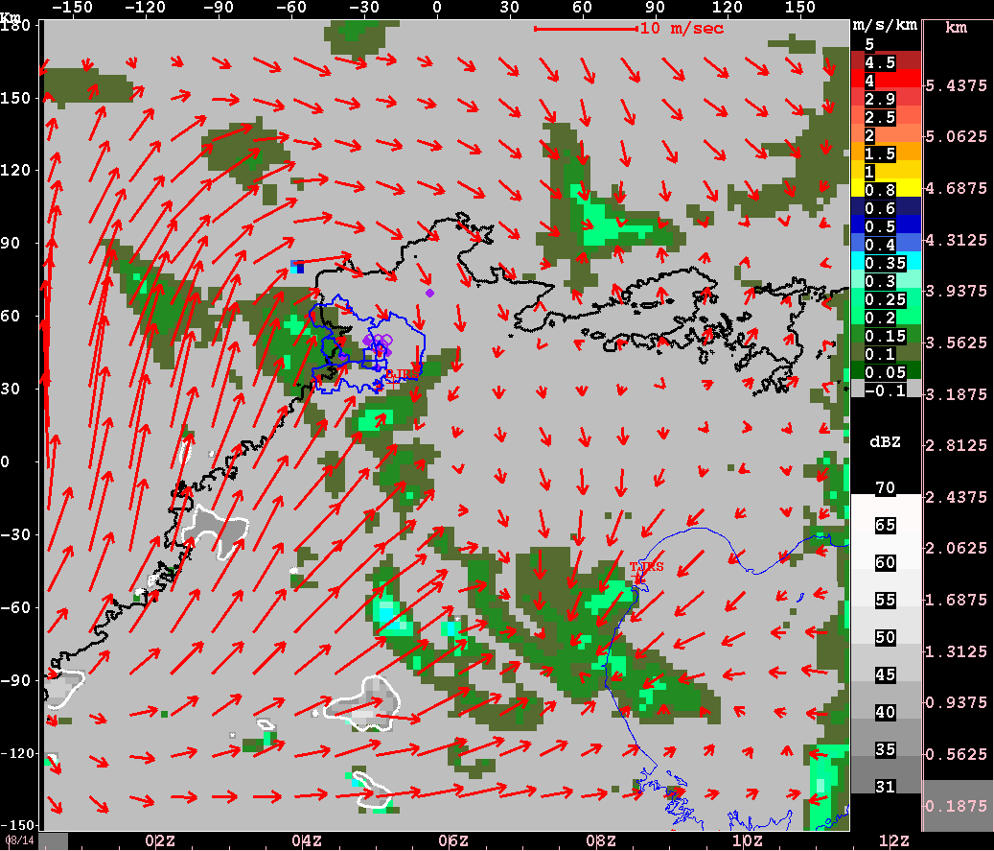
Aug. 14 2008 Storm during Olympics
VDRAS continuous analyses of wind and convergence
Frame interval: 24 min

Slide 38
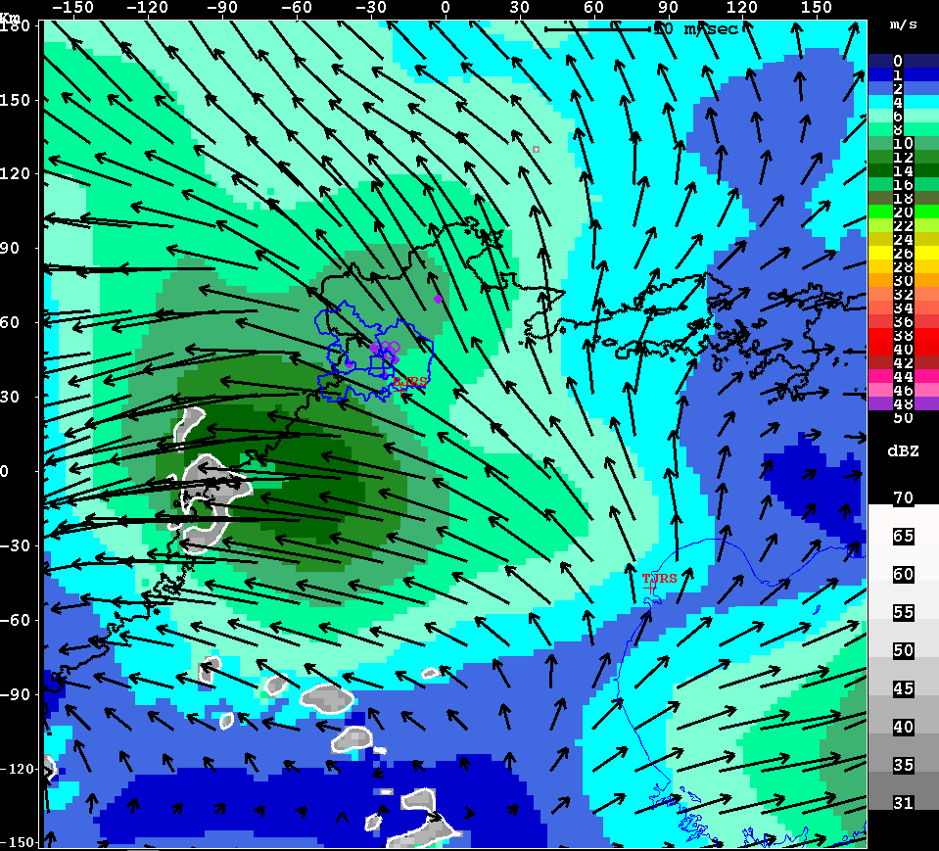
Aug. 14 2008 Storm during Olympics
VDRAS continuous analysis of wind shear (3.5km-0.187km)
Frame interval: 24 min

Slide 39
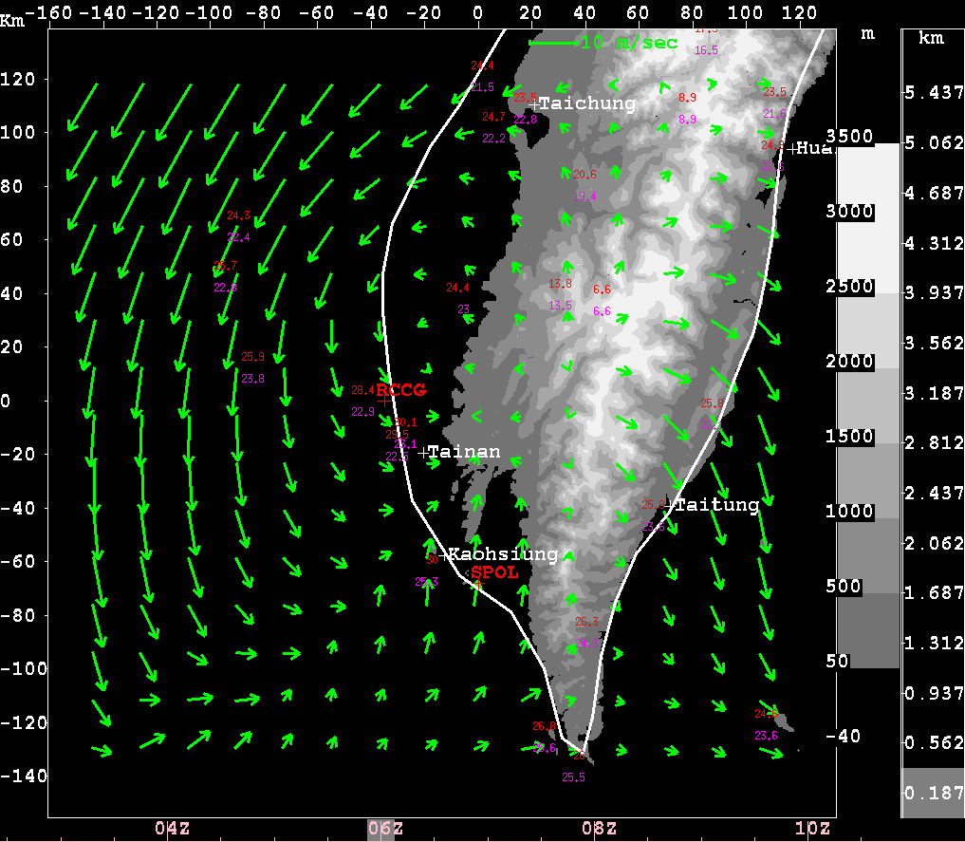
VDRAS experiements
with TiMREX data from Taiwan
VDRAS Domain
270km² x 5.625km
with a resolution of
3km x 0.375km
WRF 3km hourly
forecasts as background
42 AWS stations
Assimilation window is
10 min

Slide 40
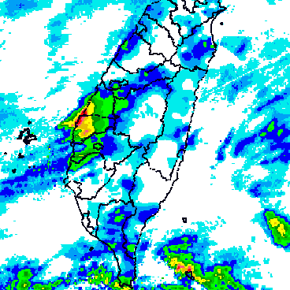
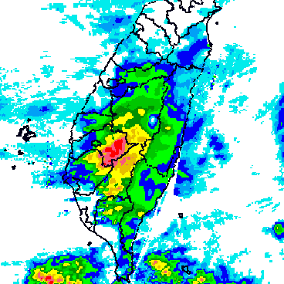
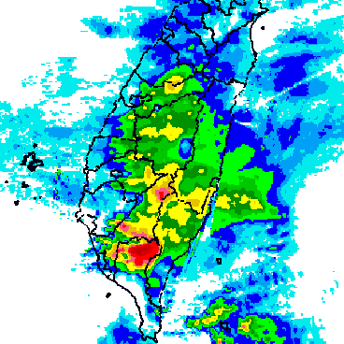
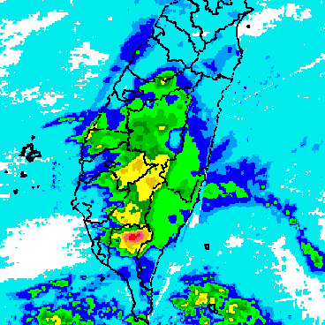
SoWMEX/TiMREX case of 31 May 2008
QPESUMS accumulated precipitation
00-03 UTC
03-06 UTC
06-09 UTC
09-12 UTC

Slide 41
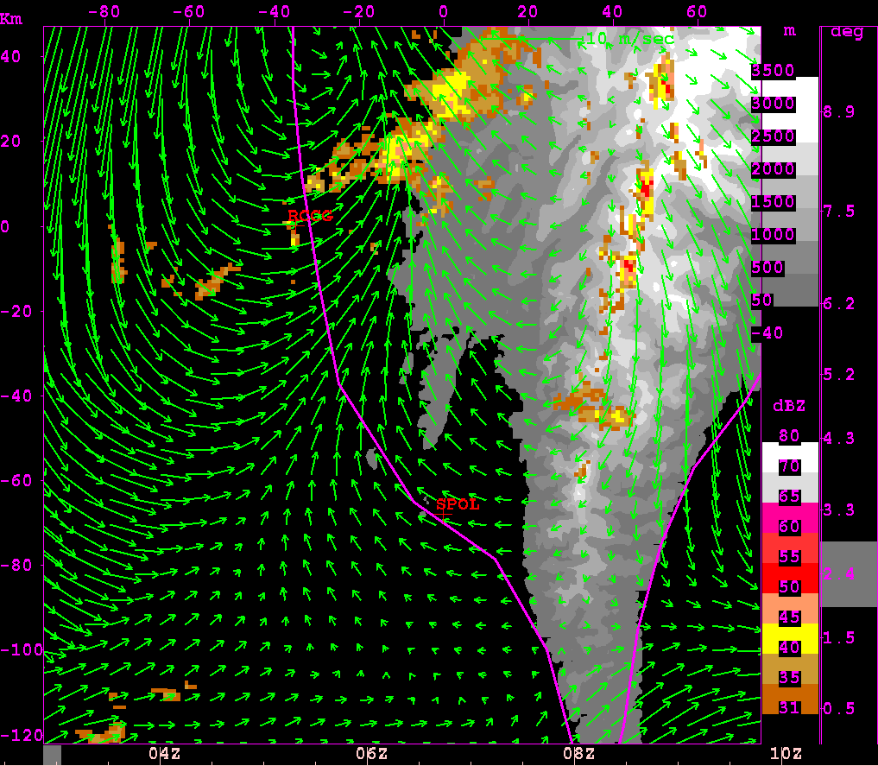
VDRAS wind analysis from CTRL experiment
03 UTC - 10 UTC

Slide 42
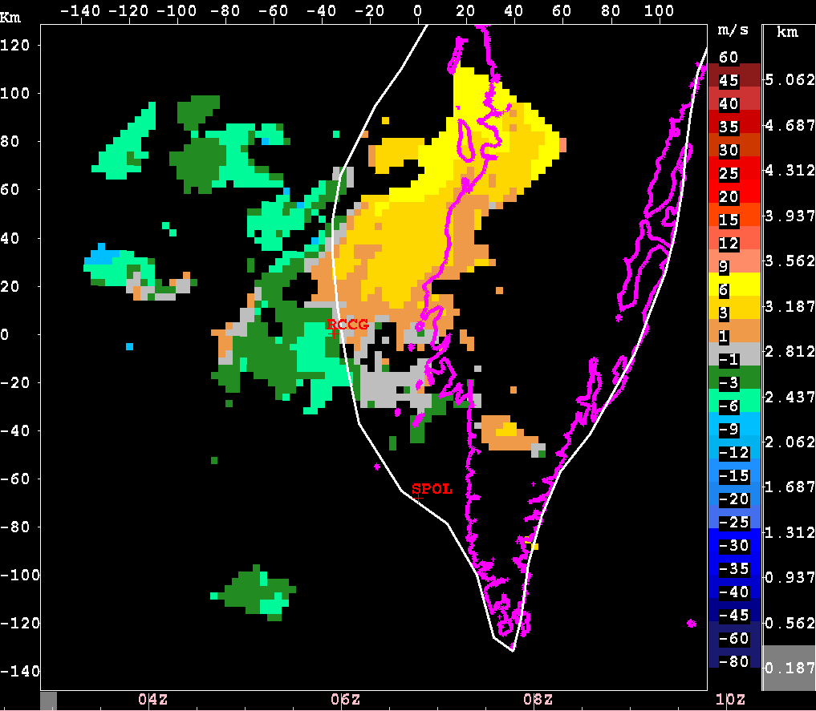
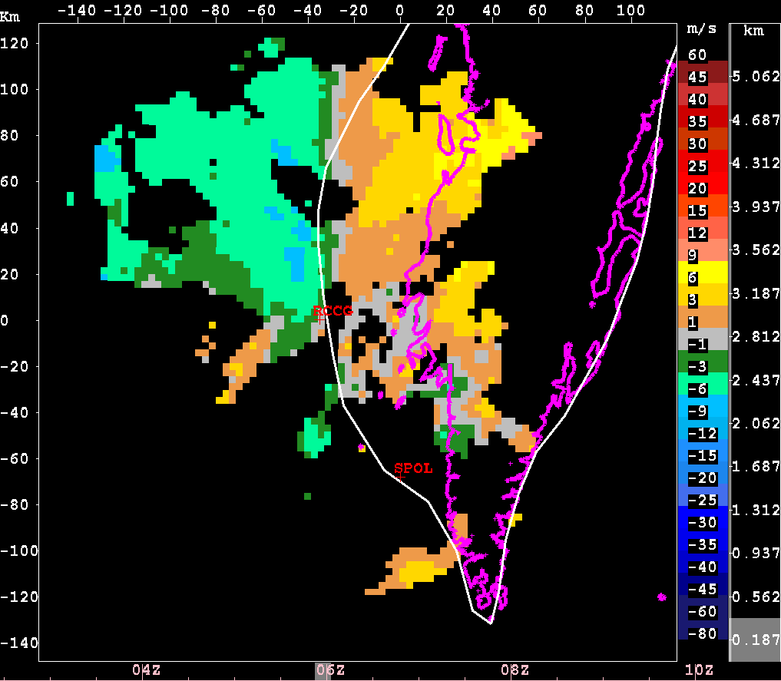
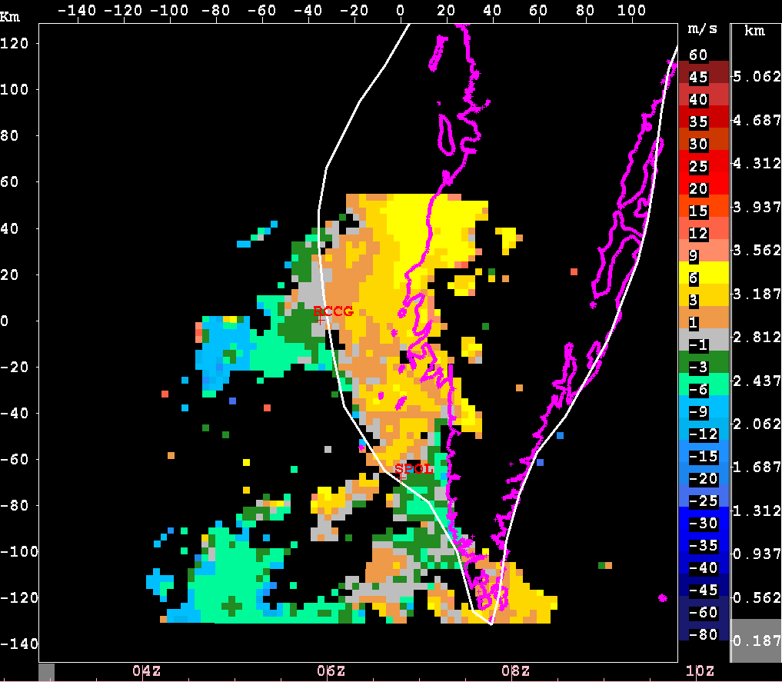
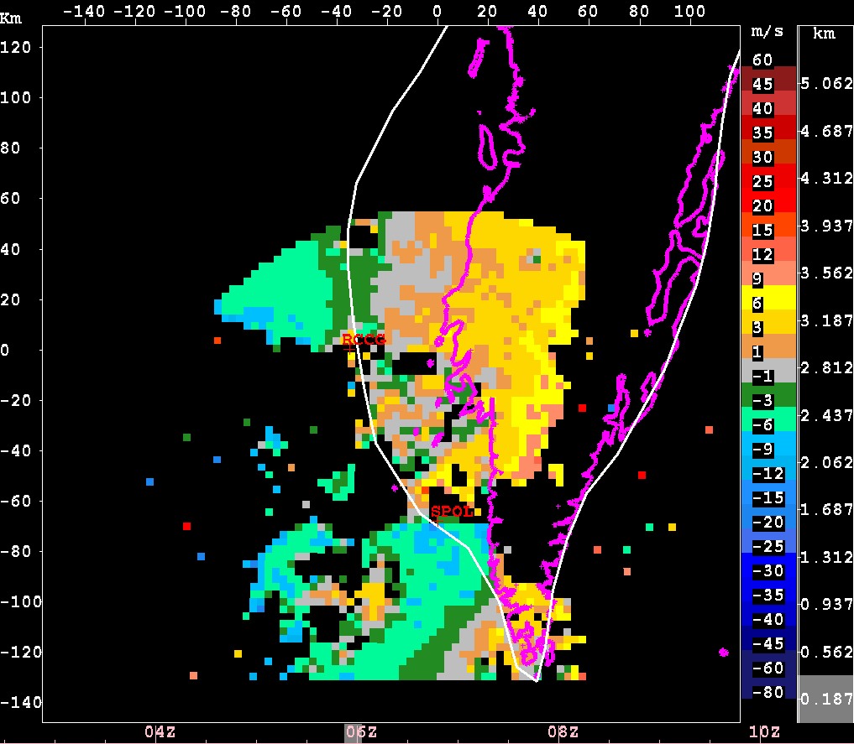
Comparing radial velocities from RCCG and S-Pol
Sensitivity
experiments
to radar quantity
RCCG 03 UTC
RCCG 06 UTC
CTRL: analysis with both S-Pol & RCCG
RCCG: analysis with RCCG only
SPOL: analysis with S-Pol only
SPOL 03 UTC
SPOL 06 UTC

Slide 43
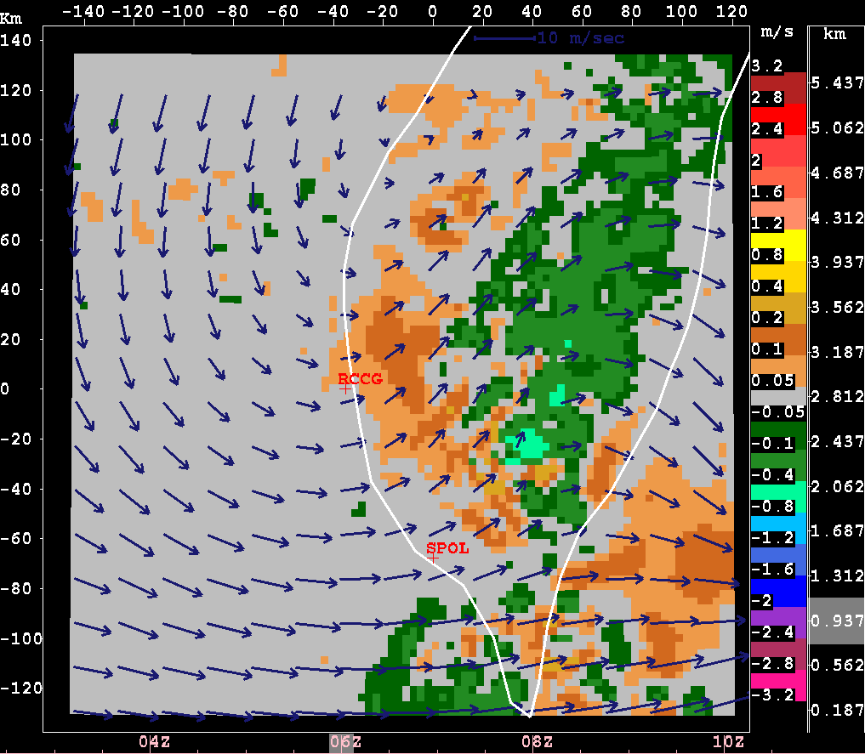
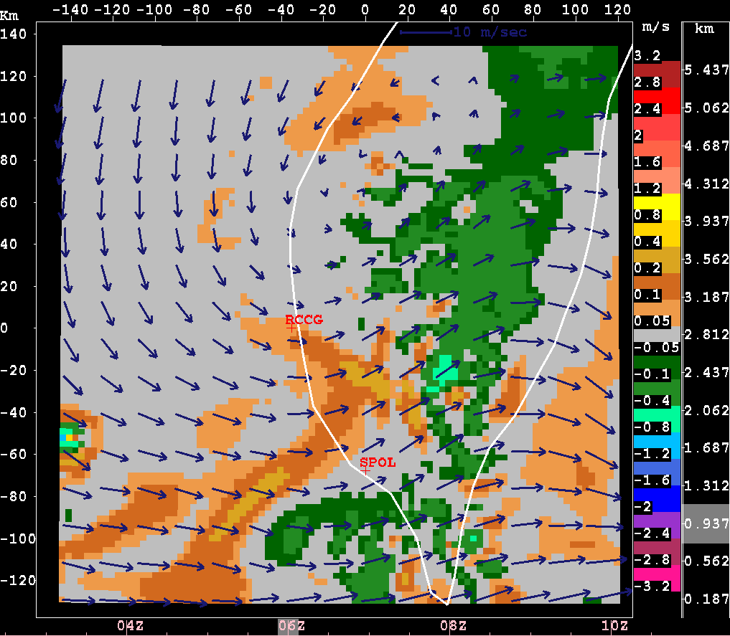
Vertical velocity at 06 UTC
RCCG
Z = 0.937 km
SPOL

Slide 44
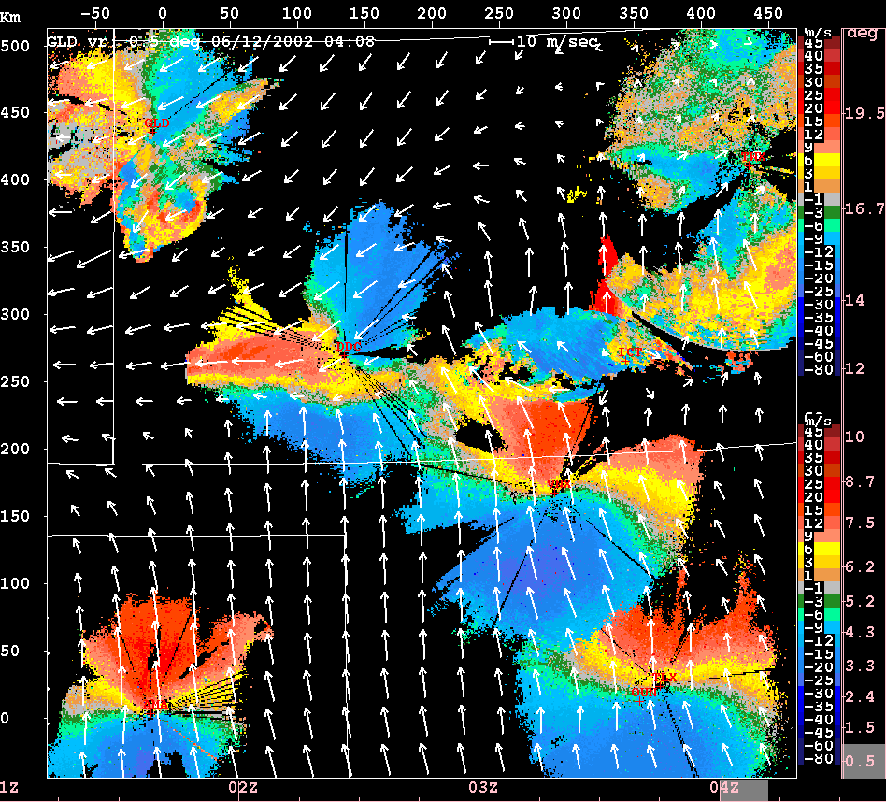
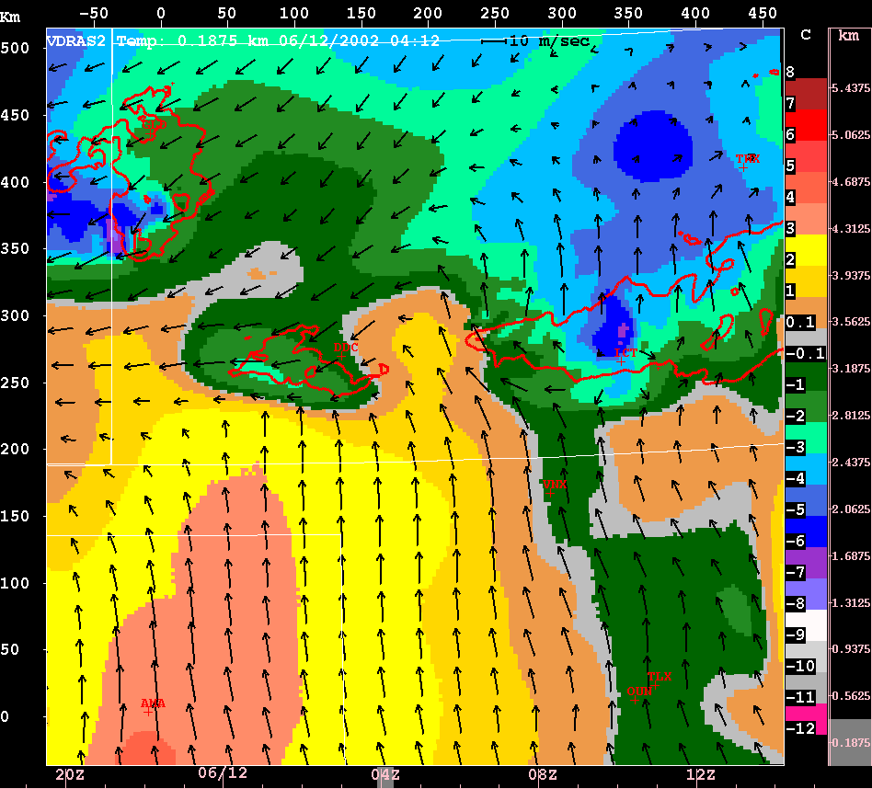
VDRAS analysis by assimilating 8 NEXRADs over IHOP domain
Analyzed temperature
Red contour: 25 dBZ ref.
Radar radial velocities

Slide 45
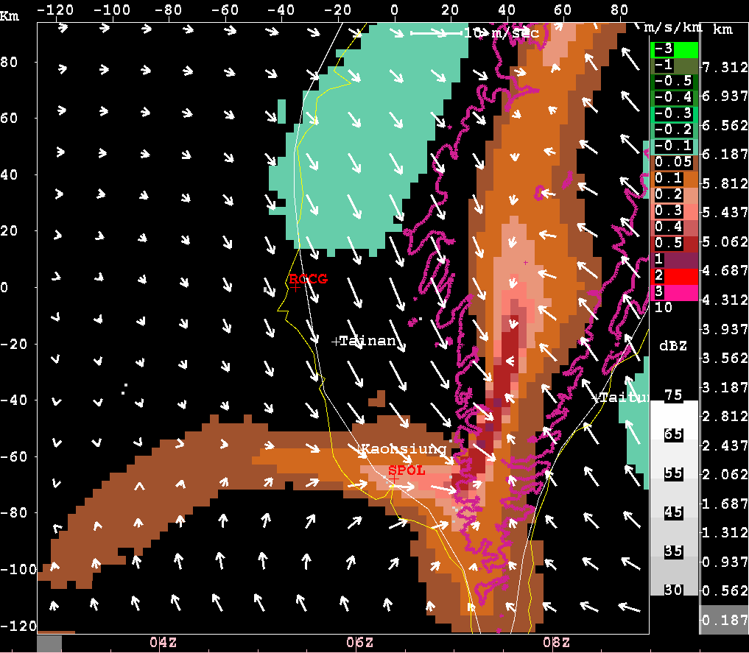
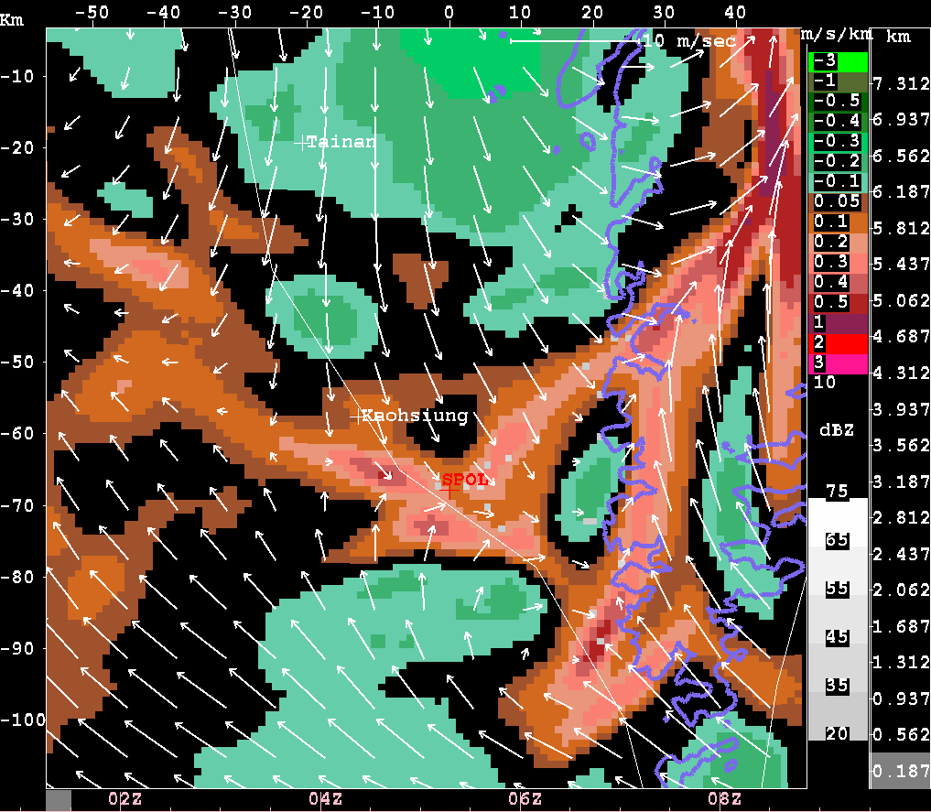
VDRAS sensitivity to horizontal resolution
VDRAS continuous analyses of divergence and wind
Frame interval: 15 min
3KM
1KM

Slide 46
Applications of VDRAS
Predictors for thunderstorm nowcasting
- Checklist
- Thunderstorm forecast rules
Develop thunderstorm conceptual models
High-resolution urban analysis
Initialization of NWP models
Wind energy prediction

Slide 47
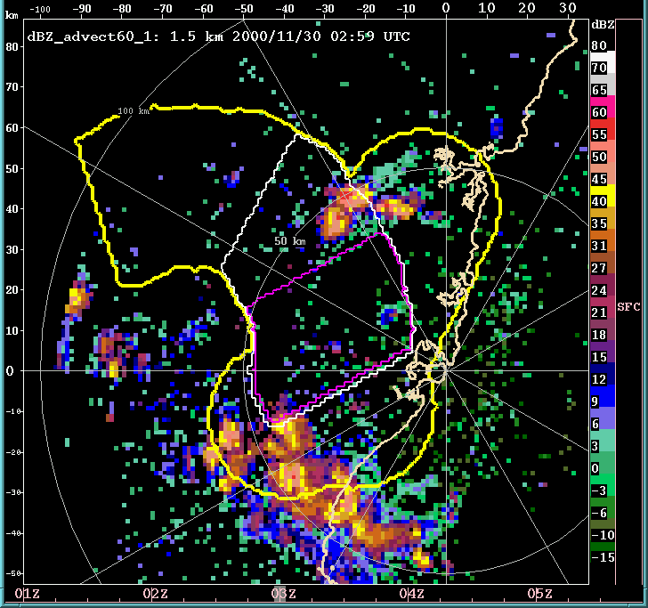
Use of VDRAS Vertical Velocities in Thunderstorm Nowcasting
60 min
extrapolation
0.1
0.3
Contours of
Vertical velocity
0.5
0.1 m/s
0.3 m/s
0.5 m/s

Slide 48
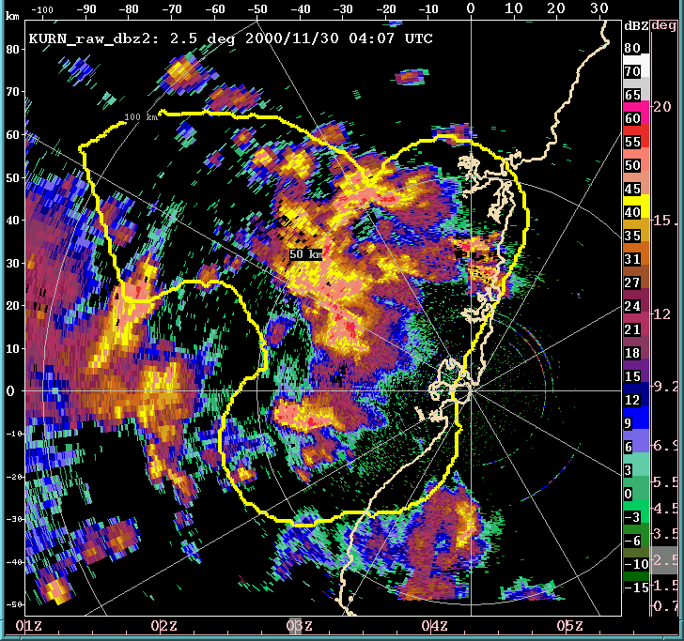
Use of VDRAS Vertical Velocities in Thunderstorm Nowcasting
Verification
0.1
0.3
0.5

Slide 49
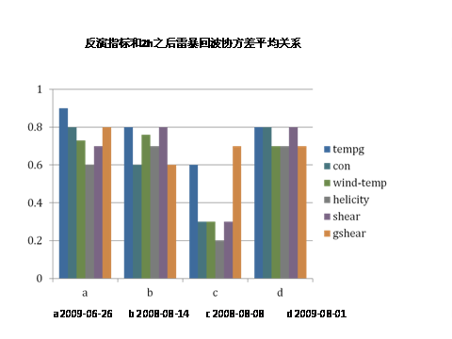
VDRAS diagnosed quantities as storm predictors
Courtesy of Xian Xiao (IUM)

Slide 50
Outline
Background
- Motivation
- Radar observations and preprocessing
Basic concept of variational data assimilation
Variational Doppler Radar Analysis System (VDRAS)
- 4D-Var Framework
- Results from some applications
WRF variational radar data assimilation
- 3D-Var
- 4D-Var

Slide 51
Current WRF-VAR radar data assimilation capability
Include both 3DVAR and 4DVAR components
Incremental formulation for both
Assimilate radial velocity and reflectivity
Microphysics used in Tangent linear and adjoint model is
is the Kessler warm rain scheme
Continuous cycles – tested for 3DVAR but not yet for 4DVAR
Multiple outer updates for the nonlinear basic state

Slide 52
WRF-VAR Radar DA
Cost function
For radar DA
Reflectivity data assimilation
- Assimilate rainwater
- Cloud analysis (optional)
- Assimilate water vapor within cloud (optional)
Control variables
  - stream function
  - unbalanced velocity potential
  - unbalanced temperature
  - unbalanced surface pressure
  - pseudo relative humidity

Slide 53
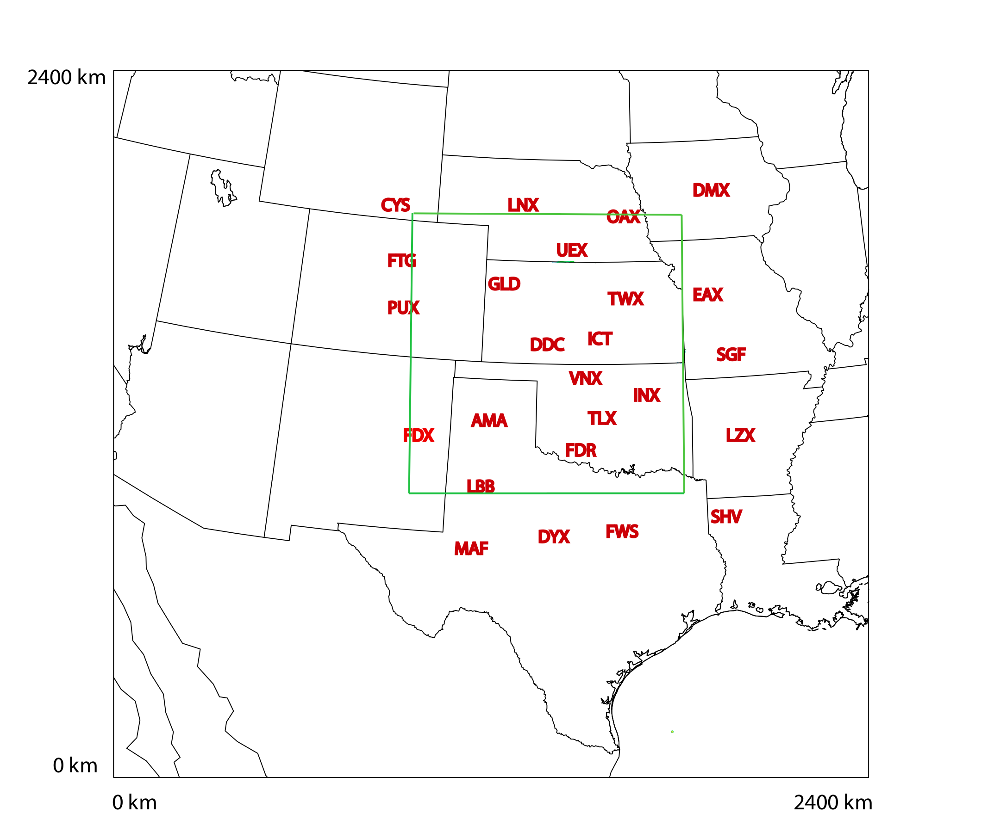
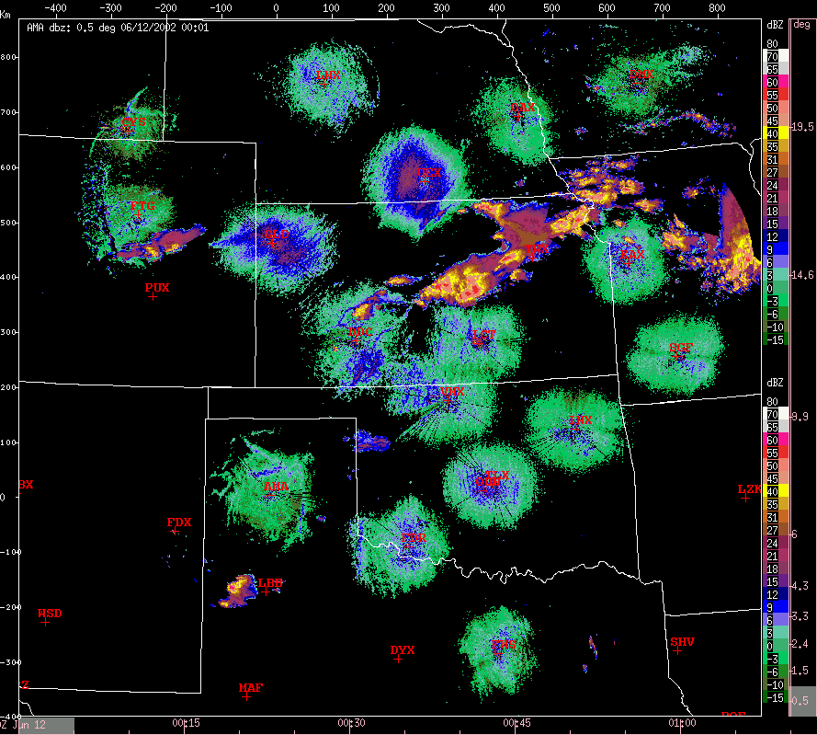
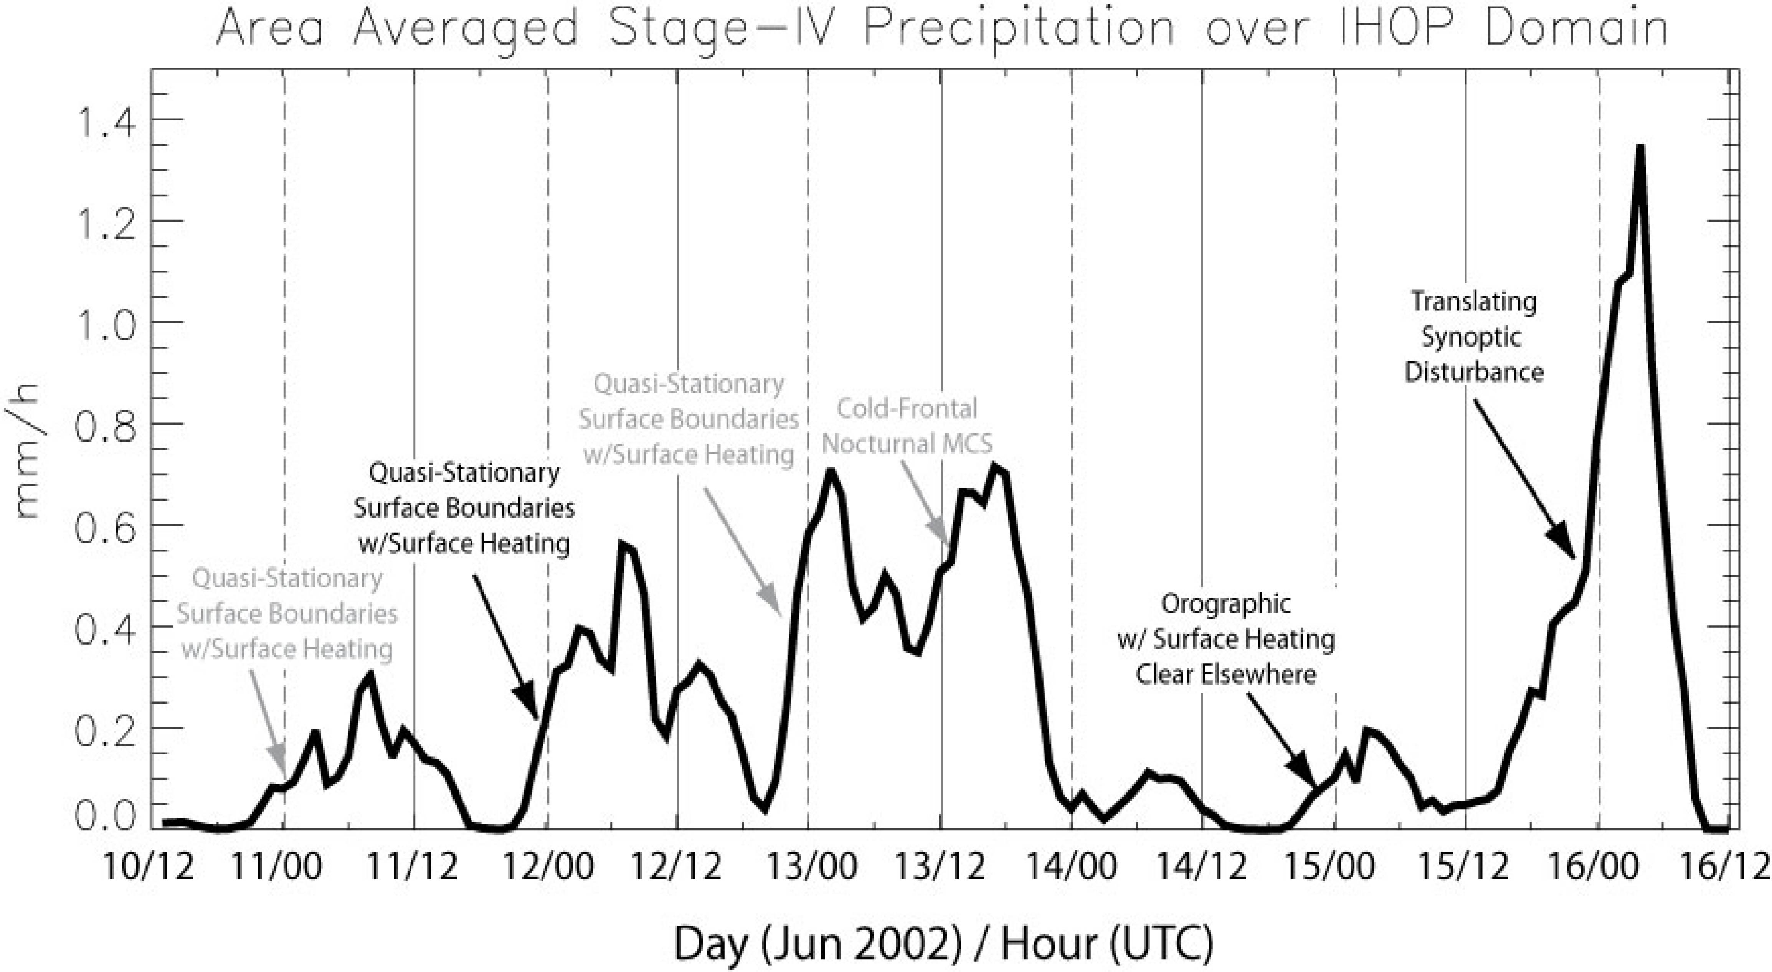
IHOP one-week retrospective study with WRF
3 hourly cycled 3DVAR
25 NEXRADS
WRF DA and forecast domain
Averaged precipitation over the week

Slide 54
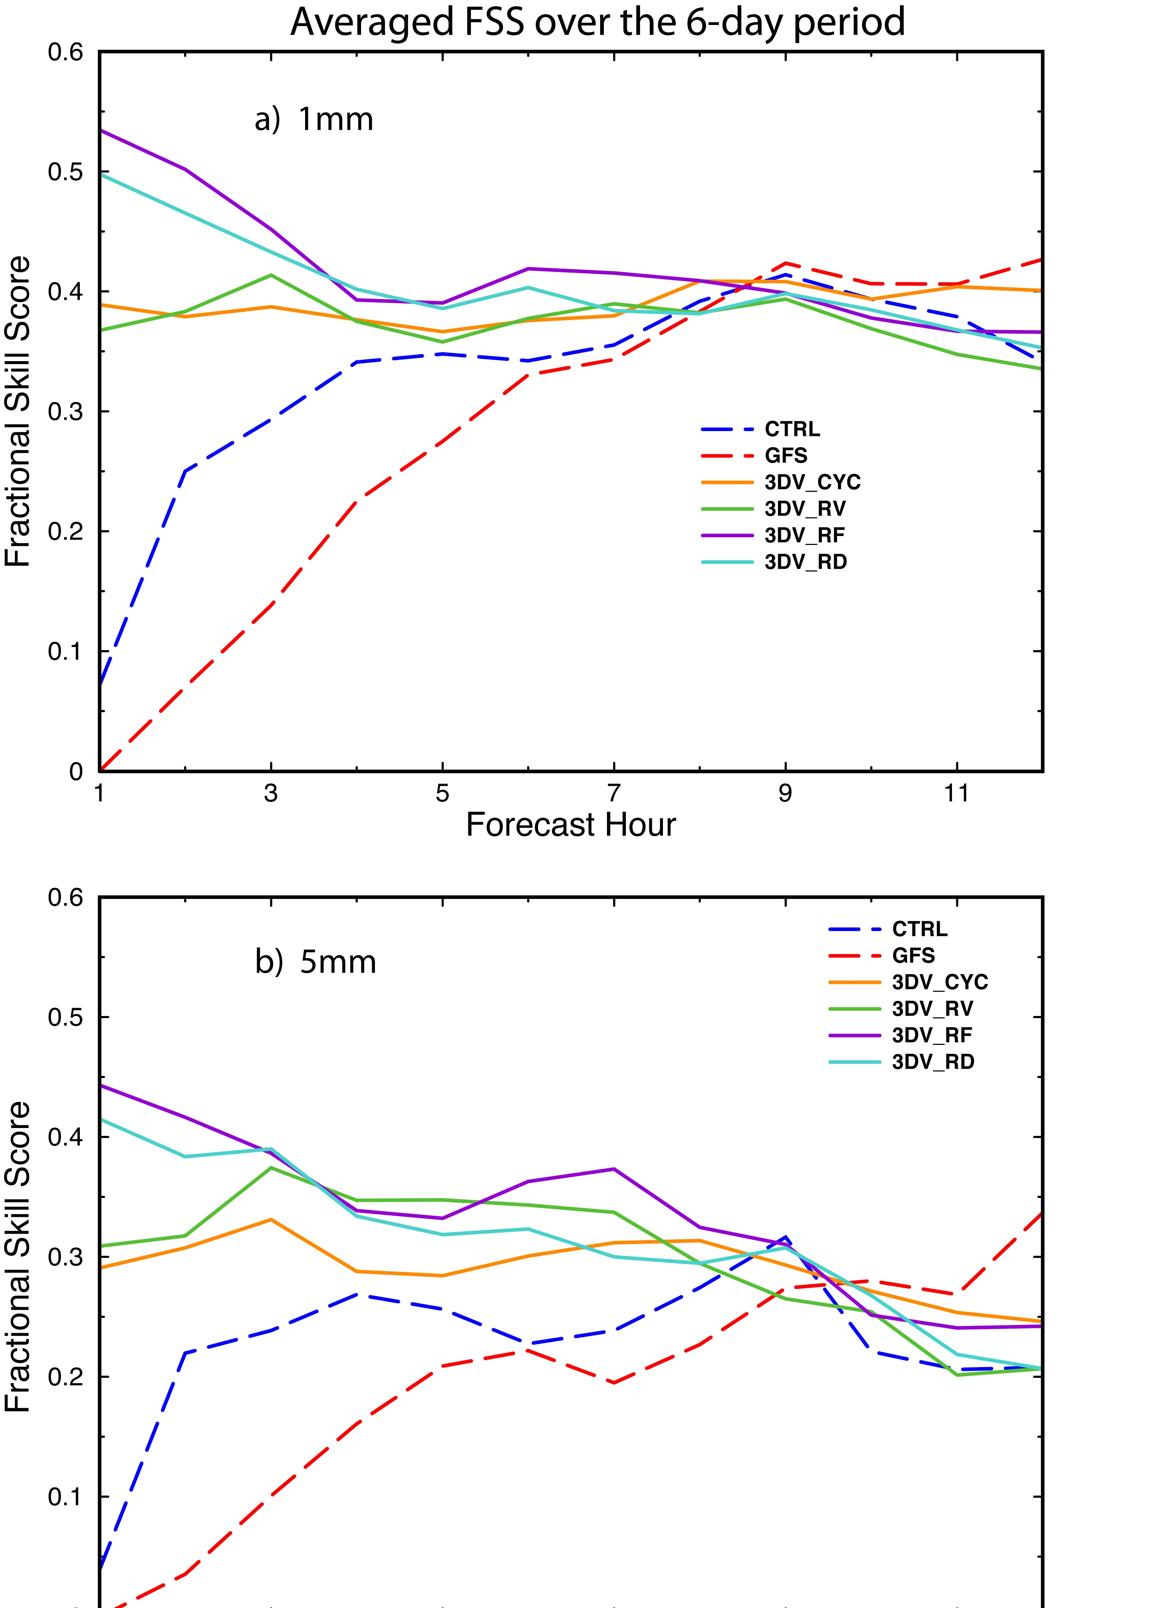
DA and forecast experiments
CTRL: Control with no radar DA
initialized by NAM
GFS: Same as CTRL but
initialized by GFS
3DV_CYC 3DVAR 3h cycle no radar
3DV_RV: Radial velocity data added
3DV_RF: Reflectivity data added
3DV_RD: Both radar data
Dashed lines:
Cold start
Solid lines:
Warm start

Slide 55
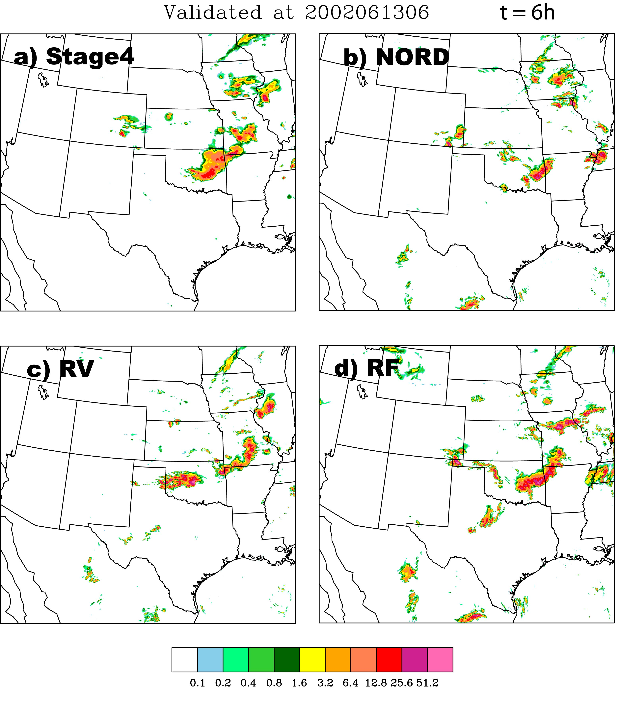

6-h Forecasts after four 3DVAR cycles
Dashed lines:
Cold start
Solid lines:
Warm start

Slide 56

4 convective cases during summer 2009 in Beijing
5 mm hourly precipitation

Slide 57


23 July 2009 case
Assimilation starts at
00 UTC; forecasts start
at 06 UTC.

Slide 58
WRF 4DVAR Radar DA development
1. Radar reflectivity assimilation
- Assimilating retrieved rainwater from RF;
- The error of retrieved rainwater is specified
by error of RF.
2. New control variables and background error covariance
- Cloud water (qc), rain water (qr);
- Recursive filter is used to model horizontal
correlation ;
- Vertical correlation is considered by EOFs;
3. Microphysics scheme
- Linear/adjoint of a Kessler warm-rain scheme;
- Incorporated into WRF tangent/adjoint model;
- Apply Sun and Crook (1997) to treat high nonlinearity

Slide 59


Mid-west squall line (IHOP) experiments
Compare 3 experiments:
3DV
Assimilate RV and RF from
6 radars at 0000 UTC with
WRF 3DVAR
3DV_Qv
Same as 3DVAR, but also
Assimilate derived in-cloud
humidity
4DV
Assimilate RV and RF between
0000 UTC and 0030 UTC with WRF
4DVAR
0000 UTC
0600 UTC

Slide 60

Single observation test with rainwater obs

Slide 61
Hourly Precipitation forecasts
Obs
3DV
3DV_QV
4DV

Slide 62
Fractions Skill Score of hourly precipitation
3DV
4DVAR
3DV_QV
FSS
4DV
3DVAR_Qv
3DVAR
Forecast hour

Slide 63

4DVAR better analyzes the cold pool (z=200m)

Slide 64
Comparing y-component of wind (z=200m)

Slide 65
Summary
The variational technique has been used for radar data
assimilation since early 1990’s
Radar data preprocessing and quality control is an important
step for success
Most of the real data studies used warm-rain scheme and
simplified operation operators
Radar observations improve 0-12h QPF when assimilated with
3D-Var or 4D-Var technique. The time range of the positive
impact are case dependent
Real data case study using WRF 4D-Var showed improvement
over 3D-Var
The radar DA systems VDRAS, WRF 3D-Var, and 4D-Var are
good tools for studying convective weather and improving
its prediction

Slide 66
Future work
Polarimetric radar data assimilation with ice physics
Improve radar observation operator
VDRAS analysis with sub-1km resolutions for studies
of tornados, urban heat island effect, etc.
Assimilation of higher-resolution data from phased array radar,
X-band radar, and lidar.
Frequent updating for WRF 3D-Var and 4D-Var
Diurnal variation of radar data impact
Improve QPF of weakly forced convective systems
Sensitivity to choice of control variables in WRF-VAR
Use more sophisticated microphysical schemes in WRF 4D-Var
…….

Slide 67
References
Sun, J., D. W. Flicker, and D. K. Lilly, 1991: Recovery of three-dimensional wind and temperature fields from single-Doppler radar data. J. Atmos. Sci., 48, 876-890.
Sun J., and N. A. Crook, 1997: Dynamical and microphysical retrieval from Doppler radar observations using a cloud model and its adjoint: Part I. model development and simulated data experiments. J. Atmos. Sci., 54, 1642-1661.
Sun J., and N.A. Crook, 1998: Dynamical and microphysical retrieval from Doppler radar observations using a cloud model and its adjoint: Part II. Retrieval experiments of an observed Florida convective storm, J. Atmos. Sci., 55, 835-852.
Sun, J., and N. A. Crook, 2001: Real-time low-level wind and temperature analysis using single WSR-88D data, Wea. Forecasting, 16, 117-132.
Crook, N. A., and J. Sun, 2004: Analysis and forecasting of the low-level wind during the Sydney 2000 forecast demonstration project. Wea. Forecasting., 19, 151-167.
Sun, J., M. Chen, and Y. Wang, 2009: A frequent-updating analysis system based on radar, surface, and mesoscale model data for the Beijing 2008 forecast demonstration project. Submitted to Wea. Forecasting.

Slide 68
References
Wilson, J., N. A. Crook, C. K. Mueller, J. Sun, and M. Dixon, 1998: Nowcasting thunderstorms: A status report. Bull. Amer. Meteor. Soc., 79, 2079-2099.
Sun, J., 2005: Convective-scale assimilation of radar data: progress and challenges. Q. J. R. Meteorol. Soc., 131, 3439-3463.
Sun, J., and Y. Zhang, 2008: Assimilation of multipule WSR_88D Radar observations and prediction of a squall line observed during IHOP. Mon. Wea. Rev., 136, 2364-2388.
Xiao, Q., Y.-H. Kuo, J. Sun, W.-C. Lee, E. Lim, Y. Guo, D. M. Barker, 2005: Assimilation of Doppler radar observations with a regional 3D-Var system: impact of Doppler velocities on forecasts of a heavy rainfall case. J. Appl. Meteor. 44, 768-788.
Xiao, Q., Y.-H. Kuo, J. Sun, W.-C. Lee, and D. Barker, 2007: An Approach of Doppler Reflectivity Data Assimilation and its Assessment with the Inland QPF of Typhoon Rusa (2002) at Landfall, J. Appl. Meteor., 46, 14-22.
Sun, J., S. Trier, Q. Xiao, M. Weisman, H. Wang, Z. Ying, Y. Zhang, and Mei Xu, 2012: 0-12 hour warm-season precipitation forecast over the central United States: sensitivity to model initialization. Wea. Forecasting, In press.

Slide 69
References
Wang H., J. Sun, Fan, S., and X. Huang, 2012: Indirect assimilation of radar reflectivity with WRF 3D-Var and its impact on prediction of four summertime convective events. Submitted to J. Appl. Meteor. Climatol..
Wang H., J. Sun, Xin Zhang, X. Huang, and T. Auligne, 2012: Radar data assimilation with WRF 4D-Var: Part I. system development and preliminary testing. Submitted to Mon. Wea. Rev.
Sun, J., and H. Wang, 2012: Radar data assimilation with WRF 4D-Var: Part II. Comparison with 3D-Var for a squall line case. Submitted to Mon. Wea. Rev.

