Slide 1






Improvements in simulating tropical-extratropical cloud bands over
South America by using convective-permitting models.
Authors:
Marcia Zilli, Neil Hart
School of Geography and the Environment, University of Oxford, UK
Kate Halladay, Ron Kahana
Met Office, UK
Kyoko Ikeda and SAAG
National Center for Atmpspheric Research, USA
VI CPCM Workshop, Buenos Aires, 7-9 September 2022
Marcia Zilli

Slide 2
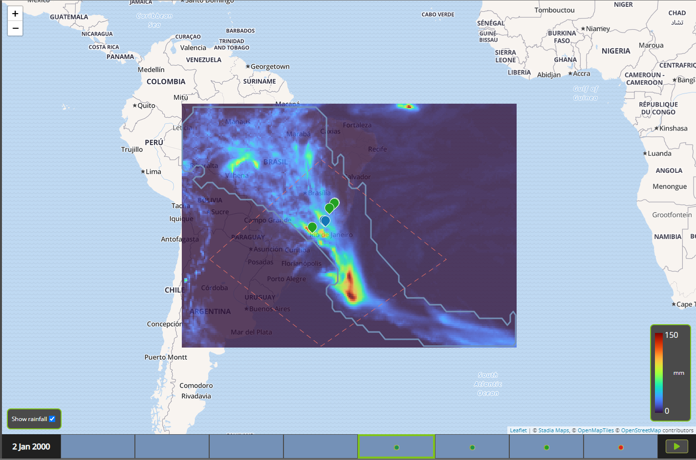


What are Cloud Bands?
SCAN ME
Continuous areas of low OLR connecting convective areas from the tropics to the extratropics.
Responsible for large fractions of the rainy season precipitation ​
Intense events: floods and landslides
Absence/late onset: dry spells and drought ​
Example of a cloud band in 02 Jan 2000.
Image from the VIEWpoint cloud band Explorer
<https://the-iea.github.io/vp-cloud-band-explorer/>

Slide 3
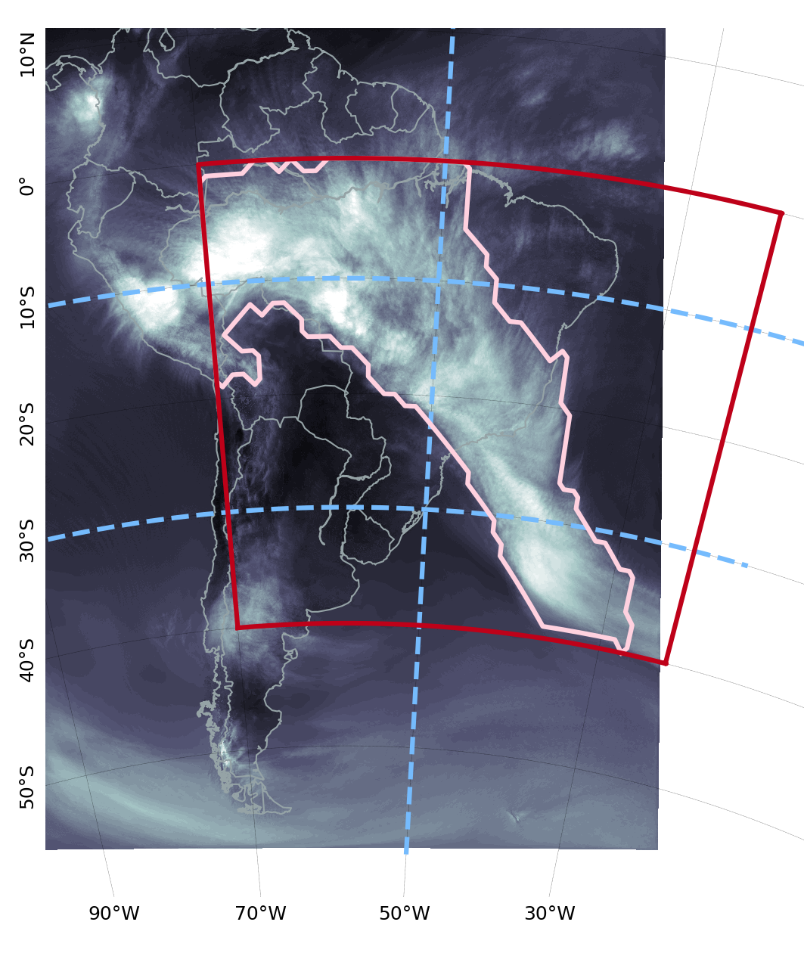


Identifying the Cloud Bands
Cloud band detection algorithm developed by Hart et al. (2012, 2013) and adapted to South America [Zilli and Hart 2021].
Obs data:​ OLR (NOAA CDR V1.2​) and Precipitation (ERA5)
CPM
Forcing
GCM AMIP
SAAG-WRF @ 4km
[2000-2021]
ERA5
UKMO control @ 4.5km
[1998-2007]
UKMO UM-N512
HadGEM3-N96
HadGEM3-N216
UKMO hindcast @ 4.5km
[1998-2007]
ERA-I @ 25km (downscaled by RCM)
CPMs and forcings are regridded to NOAA/ERA5 grid (conservative area-weighted interpolation)
SAAG-WRF OLR for 02 Jan 2000.
Threshold at 250 W/m² ​
Minimum OLR threshold defined per dataset
Notes:
MetBot amounts to an automation of Neil Streten's 1973 manual analysis and others later such as Mike Harrison '84 over southern African and Ivan Kuhnel 1990 over Australia.

Slide 4
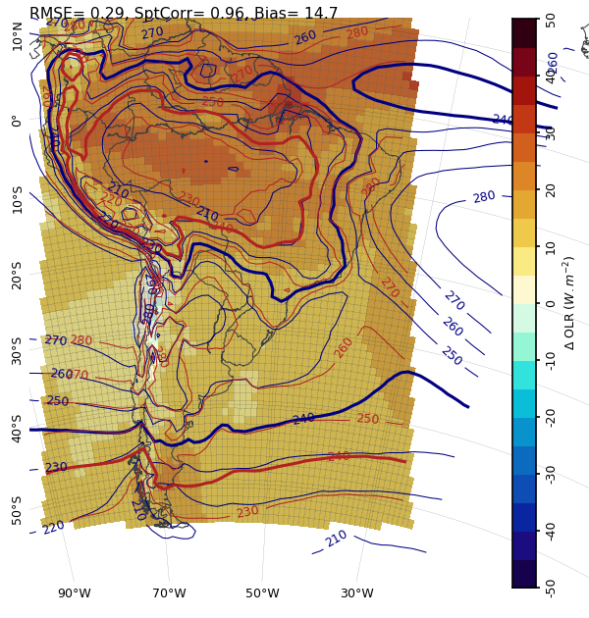
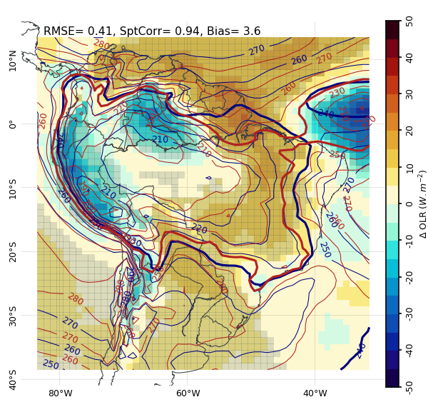
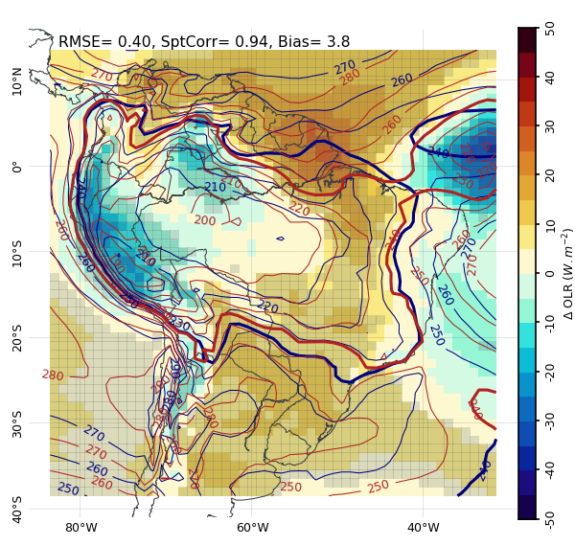
CPM First Results – OLR Climatology
Comparison to NOAA OLR (blue contour; bold contour = 240W/m²)
SAAG-WRF
NDJFM
UKMO – control
UKMO – hindcast
NDJFM
NDJFM
Mean bias: 3.6 W/m²
Mean bias: 3.8 W/m²
Mean bias: 14.7 W/m²

Slide 5
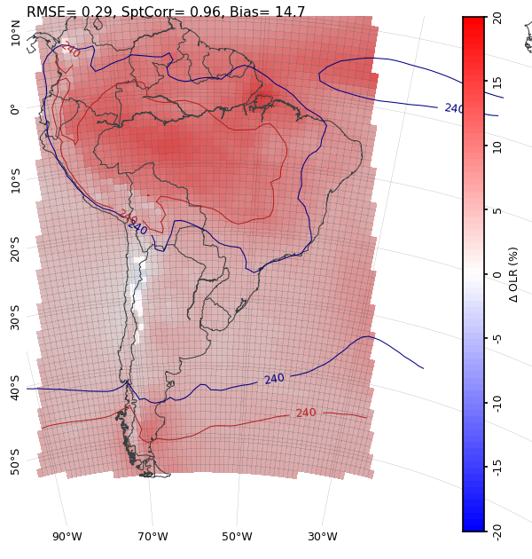
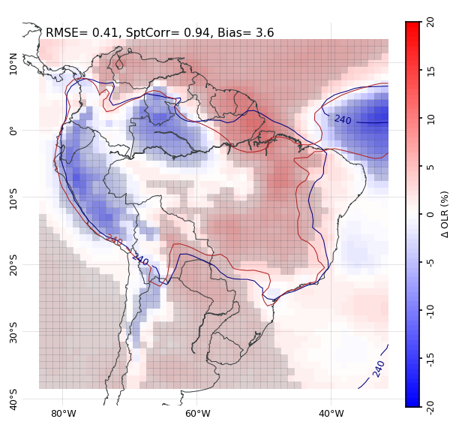
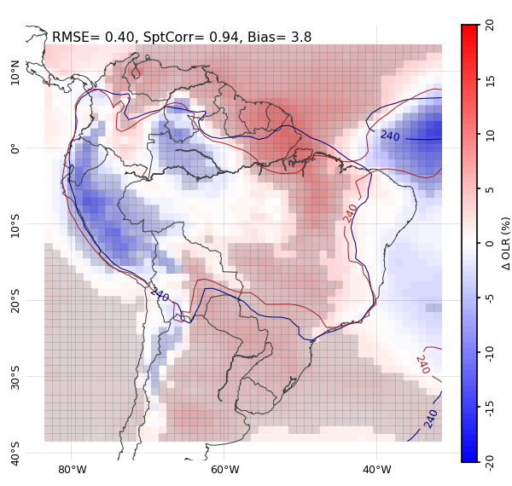
CPM First Results – OLR Climatology
Comparison to NOAA OLR (blue contour; bold contour = 240W/m²)
SAAG-WRF
NDJFM
UKMO – control
UKMO – hindcast
NDJFM
NDJFM
Mean bias: 3.6 W/m²
OLR threshold: 235 W/m²
Mean bias: 3.8 W/m²
OLR threshold: 240 W/m²
Mean bias: 14.7 W/m²
OLR threshold: 250 W/m²

Slide 6
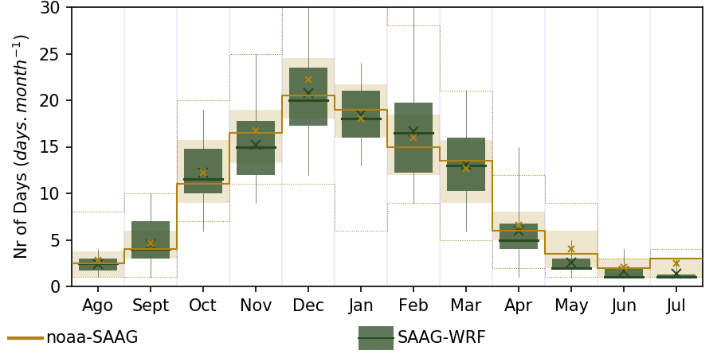
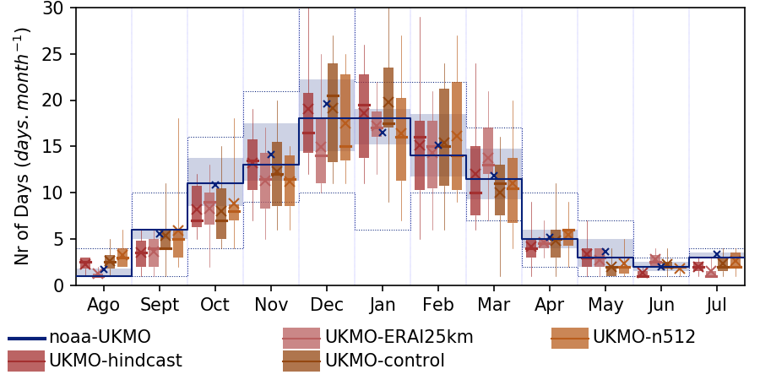

CPM First Results – Number of Events
Comparison to the number of days with events considering NOAA OLR
SAAG-WRF
UKMO CPM and their forcings
  Seasonal cycle very well simulated, with UKMO CPM improving upon their forcings
  Small delay on the onset of the cloud band season and longer events in February

Slide 7
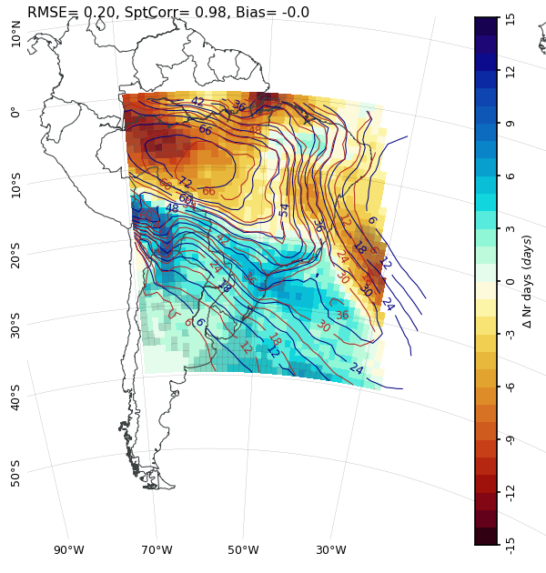
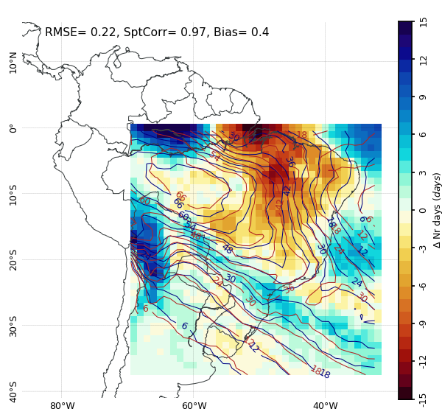
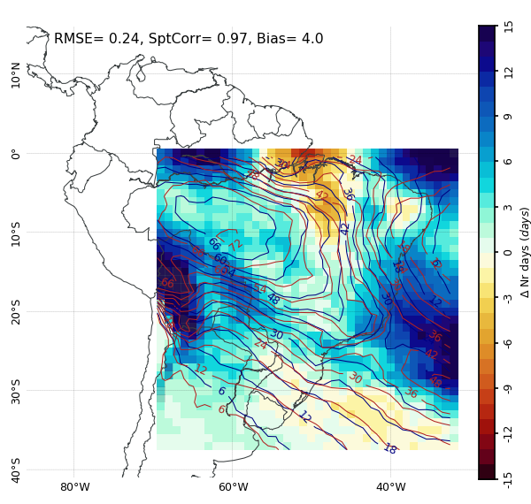
CPM First Results – Cloud Band Events
Comparison to the number of days with events considering NOAA OLR (blue contour)
SAAG-WRF
NDJFM
UKMO – control
UKMO – hindcast
NDJFM
NDJFM
OLR threshold: 235 W/m²
OLR threshold: 240 W/m²
OLR threshold: 250 W/m²

Slide 8
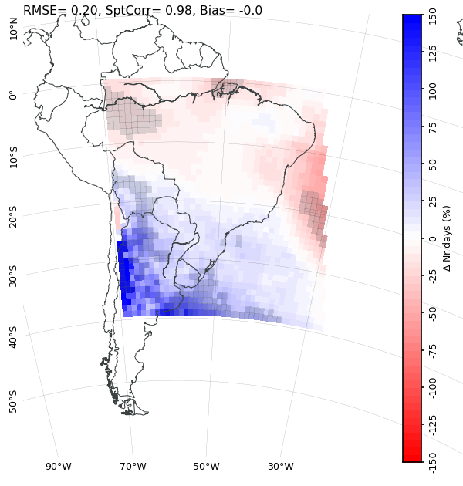
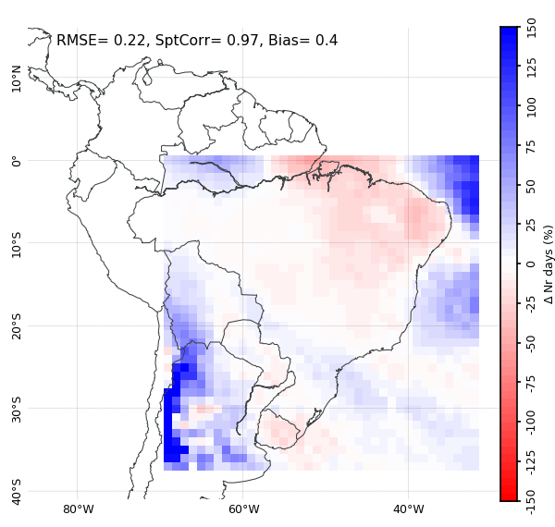
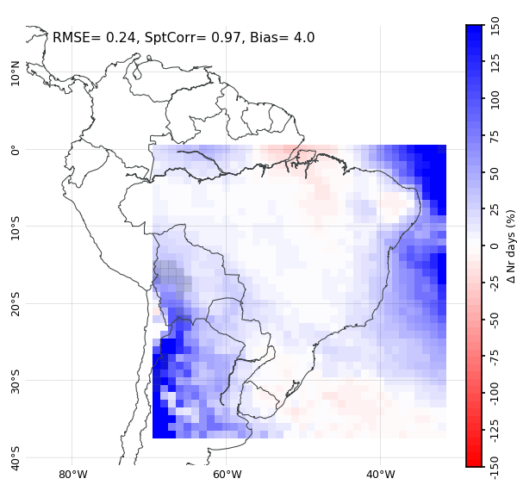
CPM First Results – Cloud Band Events
Comparison to the number of days with events considering NOAA OLR (blue contour)
SAAG-WRF
NDJFM
UKMO – control
UKMO – hindcast
NDJFM
NDJFM
OLR threshold: 235 W/m²
OLR threshold: 240 W/m²
OLR threshold: 250 W/m²
Cloud bands located to the south of the observed position

Slide 9
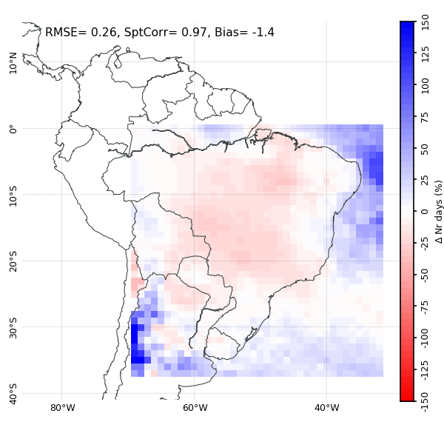
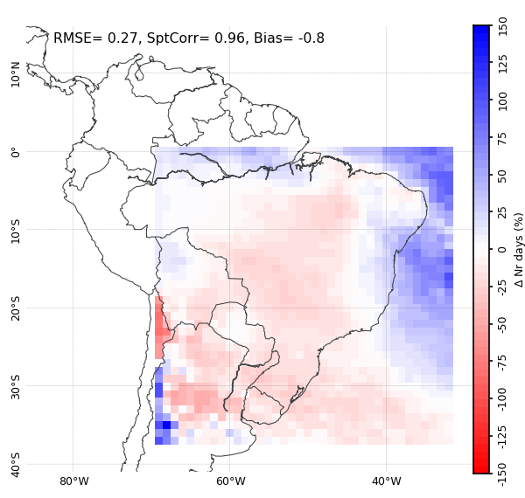
CPM First Results – Cloud Band Events
Comparison to the number of days with events considering NOAA OLR (blue contour)
UKMO – UM n512
UKMO – ERAI@25km (RCM)
NDJFM
NDJFM
OLR threshold: 240 W/m²
OLR threshold: 240 W/m²
Improvement upon the forcings simulations

Slide 10
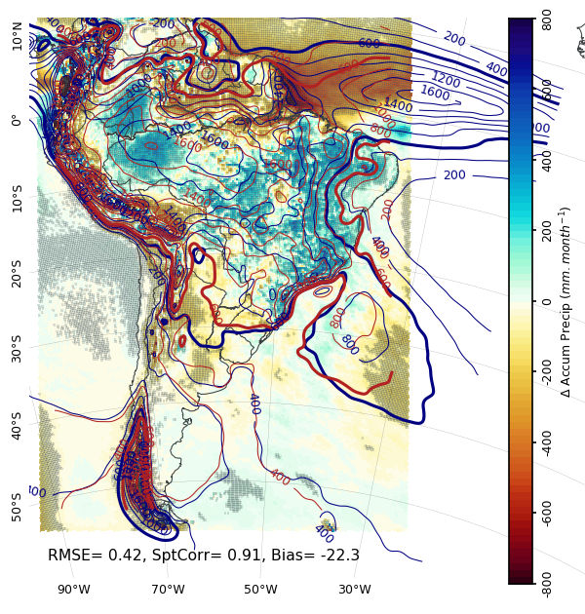
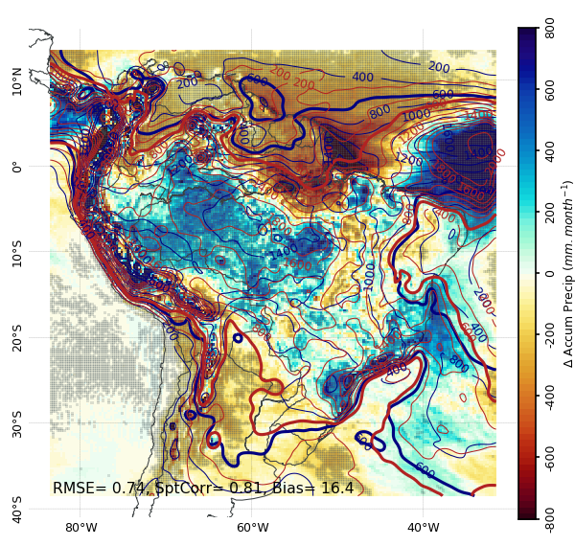
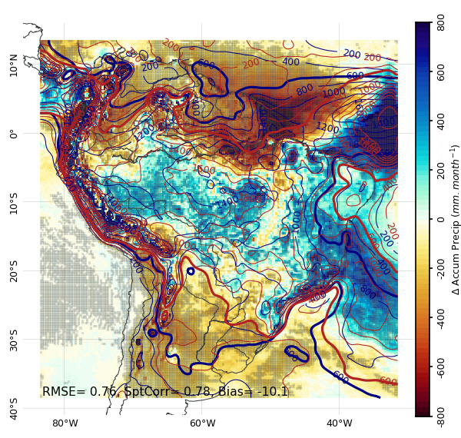
CPM First Results – Precipitation Climatology
Comparison to ERA5 Precipitation (blue contour; bolder contour = 600 mm/season)
SAAG-WRF
NDJFM
UKMO – control
UKMO – hindcast
NDJFM
NDJFM
Mean bias: 16.4 mm/season
OLR threshold: 235 W/m²
Mean bias: -10.1 mm/season
OLR threshold: 240 W/m²
Mean bias: -22.3 mm/season
OLR threshold: 250 W/m²

Slide 11
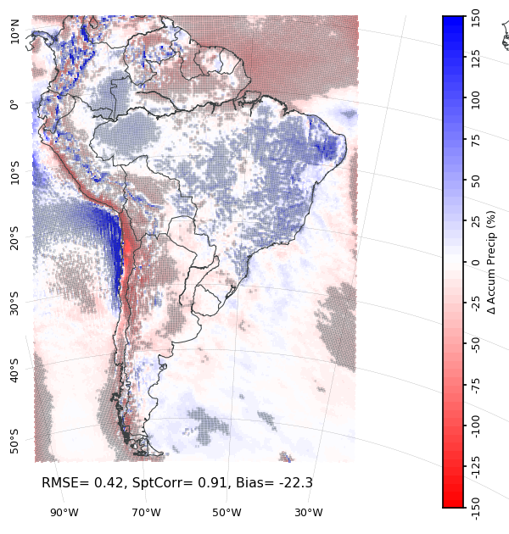
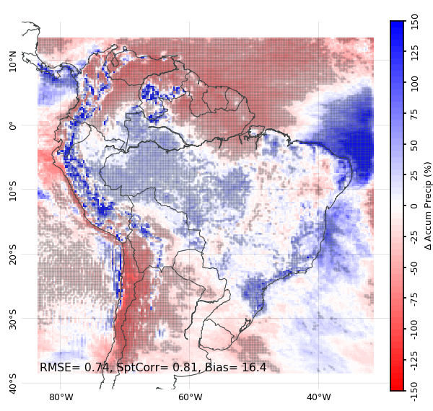
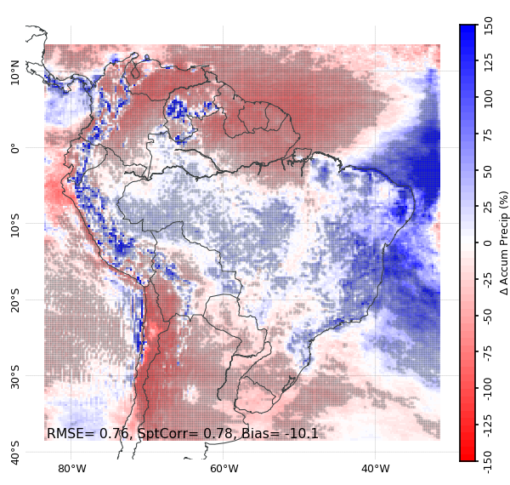
CPM First Results – Precipitation Climatology
Comparison to ERA5 Precipitation (blue contour; bolder contour = 600 mm/season)
SAAG-WRF
NDJFM
UKMO – control
UKMO – hindcast
NDJFM
NDJFM
Mean bias: 16.4 mm/season
OLR threshold: 235 W/m²
Mean bias: -10.1 mm/season
OLR threshold: 240 W/m²
Mean bias: -22.3 mm/season
OLR threshold: 250 W/m²

Slide 12
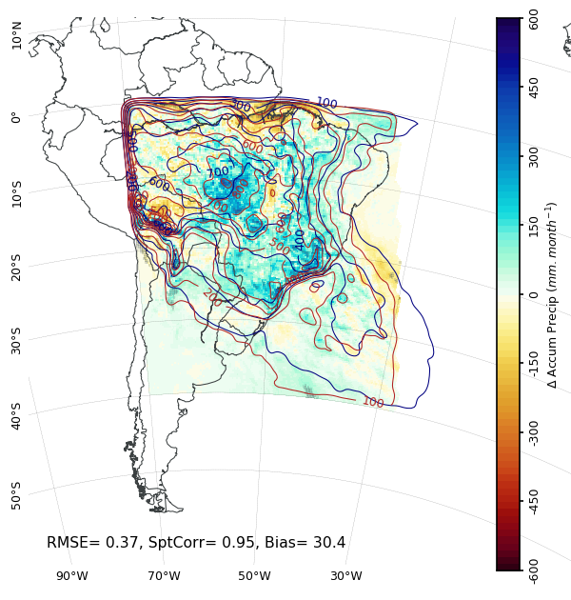
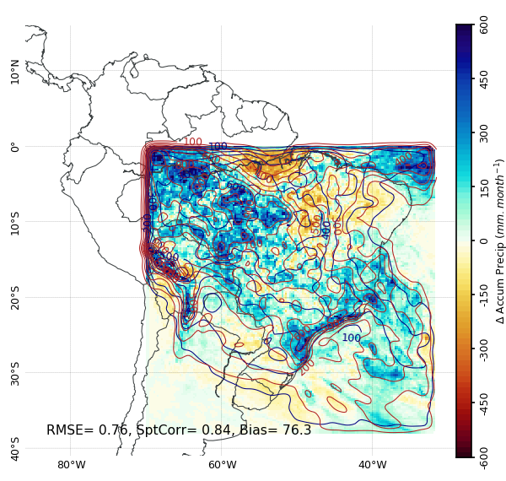
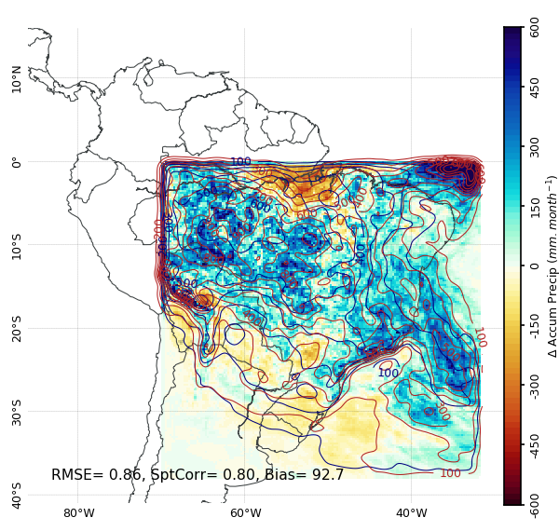
CPM First Results – Precipitation during Events
Comparison to the total precipitation considering ERA5 Precipitation (blue contour)
SAAG-WRF
NDJFM
UKMO – control
UKMO – hindcast
NDJFM
NDJFM
OLR threshold: 235 W/m²
OLR threshold: 240 W/m²
OLR threshold: 250 W/m²

Slide 13
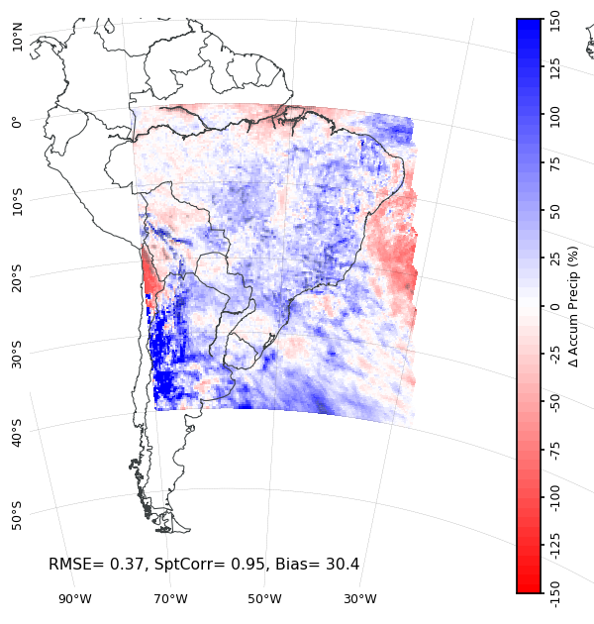
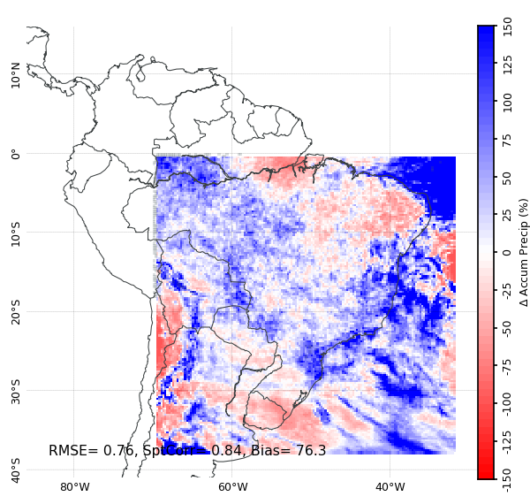
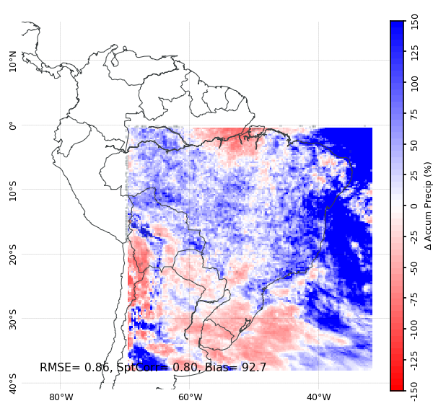
CPM First Results – Precipitation during Events
Comparison to the total precipitation considering ERA5 Precipitation (blue contour)
SAAG-WRF
NDJFM
UKMO – control
UKMO – hindcast
NDJFM
NDJFM
OLR threshold: 235 W/m²
OLR threshold: 240 W/m²
OLR threshold: 250 W/m²

Slide 14
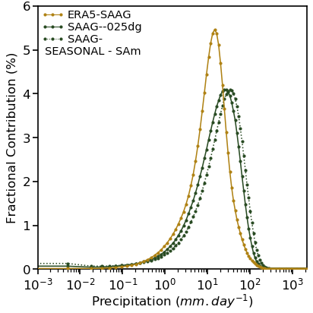
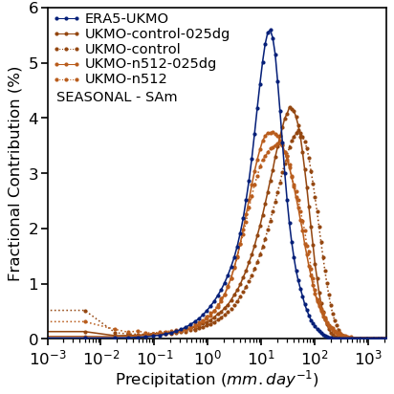
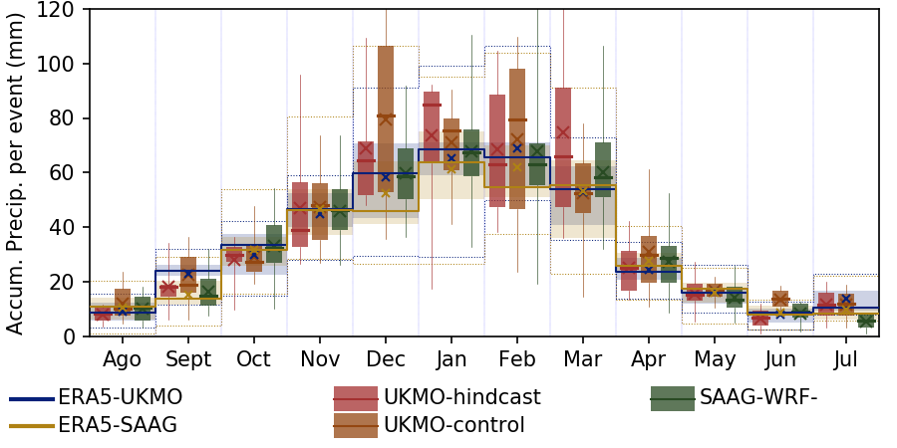
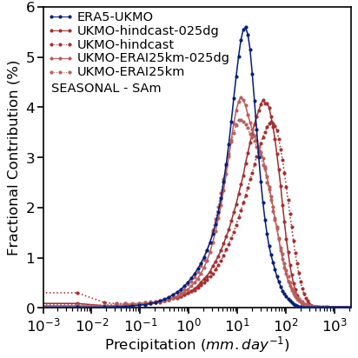
CPM First Results – Precipitation during Events
Comparison to the total precipitation considering ERA5 Precipitation
Total Precipitation during Events
SAAG-WRF
UKMO – control
  Wet bias during cloud band events, mainly related to more intense precipitation rate
UKMO – hindcast

Slide 15
Final Remarks
CPMs correctly simulate the location and seasonality of cloud band events, and overestimate the associated precipitation
Compare CPM results to observed precipitation dataset CHIRPS, Brazilian Daily Weather Gridded Data (Br-DWGD)
[Xavier et al 2022]
Inform on the convective-permitting simulations added value
Extend results to include process-based analysis of circulation as well as future scenarios
Develop a framework to evaluate the influence of thermodynamic biases in the development of the events
Notes:
Regional meteorological services such as NIWA and BoM

Slide 16




Thank you!!
Contacts:
marcia.zilli@ouce.ox.ac.uk
neil.hart@ouce.ox.ac.uk
SCAN ME
VIEWpoint cloud band Explorer:
https://the-iea.github.io/vp-cloud-band-explorer/
References:
Hart N et al (2012) Mon Wea Rev 140, 4005-4016,
doi: 10.1175/MWR-D-12-00127.1.
Hart N et al (2018) J Climate 31, 2797-2817,
doi: 10.1175/JCLI-D-17-0221.1.
Xavier AC et al (2022) Int J Climatol, 1, doi: 10.1002/joc.7731
Zilli MT and Hart N (2021) J Climate 34, 8125-8144,
doi: 10.1175/JCLI-D-21-0020.1

