Slide 1
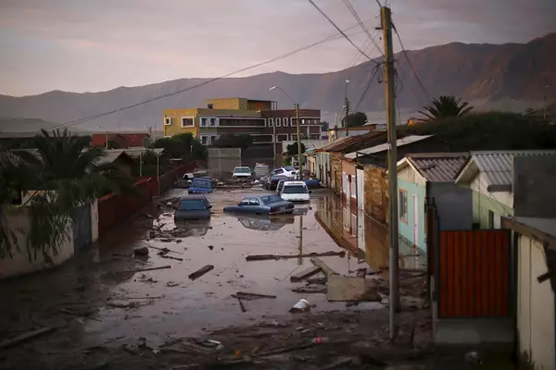


Evaluating Extreme Precipitation Forecasts using Convective-Permitting Modeling in THE Tarapacá Region, Chile
Lourdes Mendoza-Fierro, Christopher L. Castro, Hsin-I Chang, Rodrigo Valdés-Pineda, C. Bayu Risanto
University of Arizona, Department of Hydrology and Atmospheric Sciences
Tucson, Arizona USA
Corresponding author e-mail: lourdesfierro@arizona.edu
Sixth Convective-Permitting Workshop
7 – 9 September
University of Buenos Aires
Buenos Aires, Argentina
March 2015. A street is flooded at Chanaral town. Posted on March 26. 2015 by Ivan Alvarado. REUTERS.
Notes:
Photo: https://www.reuters.com/news/picture/flooding-in-chile-idUSRTR4V2HX

Slide 2
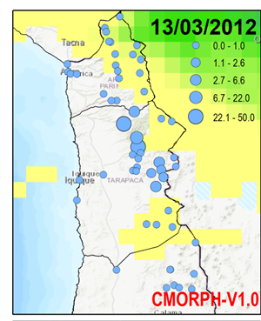
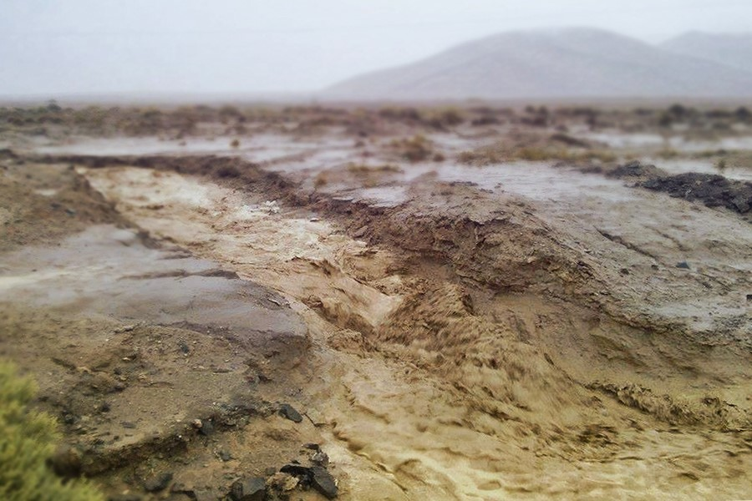
Northern CHILE: One of the DRIEST AREAS in south America, BUT subject to infrequent, high-impact flash flooding
Hazard risk of flash flooding in an arid to semi-arid region with complex terrain. Analogous to Arizona during our monsoon there.
Extreme streamflow events occur typically when precipitation is greater than 20 mm day⁻¹ as recorded by local rain gauge networks.

Slide 3
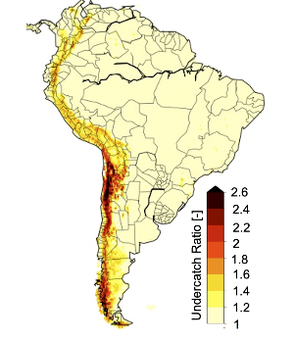
Research Motivation
Annual Average
undercatch estimates
Beck et. al (2020)
Apply CPM in Tarapacá for NWP: potentially improve short to medium range ensemble-based precipitation forecasts in northern South America.
Address precipitation undercatch problem: Satellite-based precipitation over the Andes is underestimated (Beck et al., 2020). So, can we alternatively evaluate CPM performance through a hydrologic response?
Develop prototype hydrometeorological prediction system: Use CPM simulated precipitation as an input to a hydrologic model to forecast streamflow
Forecast hydroclimate extremes: Demonstrate potential for real-time flash flood forecasting, in terms of time and magnitude of events.
Tarapacá Region
From South American Affinity Group
Notes:
Focus on results.
Include logo from Chile and reference to poster 4.10 (include the reference)
References in a separate slide, only 1 reference in SA.
Add a box in the map (study area)
Add caption to image, and mention the undercatch problem so there is an underestimation (but can be additional issues)

Slide 4
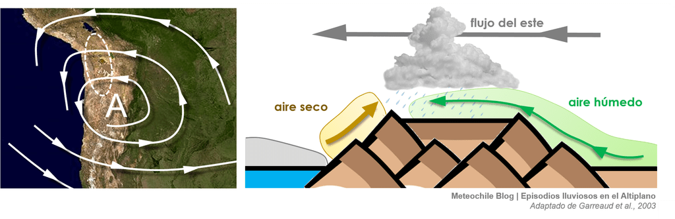
Bolivian WinteR (DECEMBER TO MARCH):
WHEN Most EXTREME CONVECTIVE PRECIPITATION EVENTS OCCUR in NORTHERN CHILE
https://blog.meteochile.gob.cl/2018/03/08/tormentas-en-el-altiplano-un-verano-fuera-de-lo-comun/
Notes:
No text on this
Only description about Bolivian winter and extreme (meteorology)
https://blog.meteochile.gob.cl/2018/03/08/tormentas-en-el-altiplano-un-verano-fuera-de-lo-comun/

Slide 5

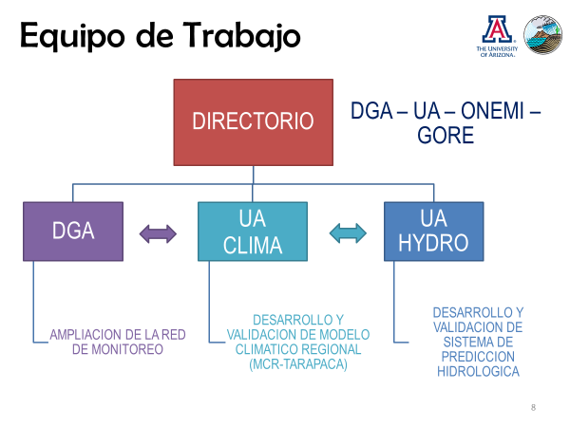

Long-term Goal: Develop A Real-time, ENSEMBLE-BASED Hydroclimate prediction system for the TARAPACá Region
For more, please see our accompanying poster 4.10
Session 4, South American High Resolution Modeling Research Activities

Slide 6
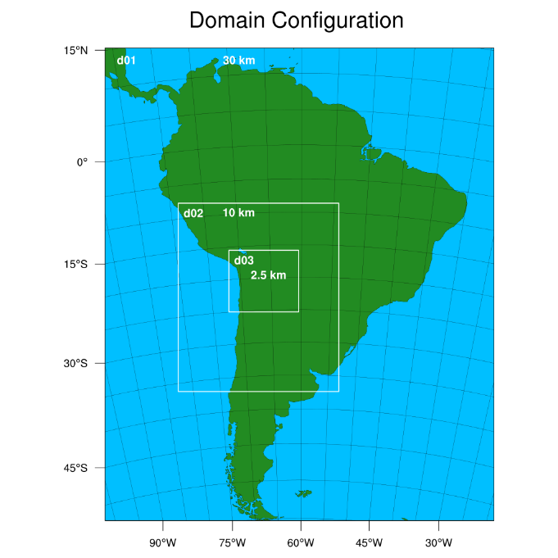
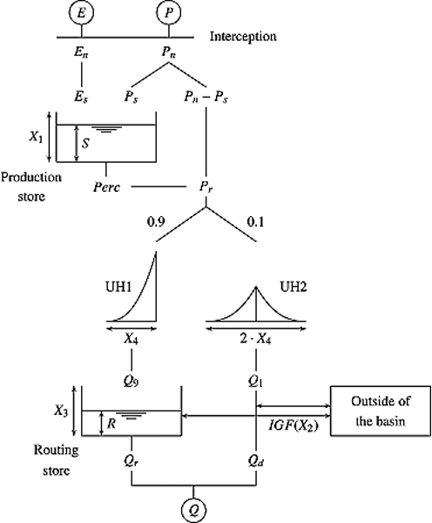
Hydroclimate modeling system:
USED TO retrospectively forecast
FIVE BOLIVIAN WINTER EXTREME EVENTS
WRF-ARW
Used for precipitation forecasts
Physics configuration of South American affinity group (SAAG)
120-hour forecast, 21 ensemble members using GEFS boundary conditions
Events simulations start 48 hrs. before streamflow peak
GR4J Hydrologic Model
Empirical parsimonious lumped model
Model calibration:
  Rainfall Accumulation
  Average Temperature
  Potential Evapotranspiration
Le Moine et al., 2007
Notes:
This one no needed, first bulled and domain figure in this slide (5 day forecast and be specific on how the start time is done), few days out instead of short and justify why this way. Societal impact related
Add figure about how the model works (Rodrigo). LUMP MODEL!! And mention the one value averaged over the basin
Mention that we are testing cases (Bolivian winter). Mention the case they need to know

Slide 7
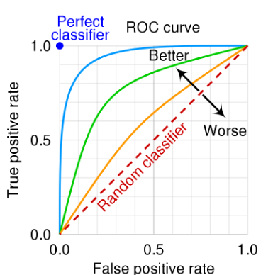
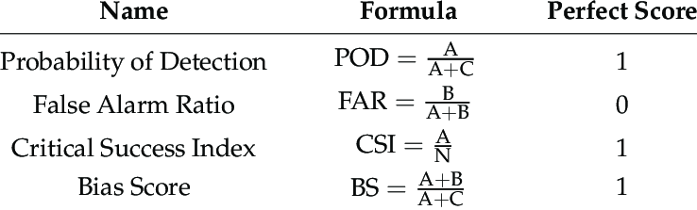
Forecast EVALUATION Methodology
 | Observation
 | True Positive | False Positive
Forecast | False Negative | True Negative
 | True Positive Rate (Observation Yes) | False Positive Rate (Observation No)
Receiver Operating Characteristic
(ROC) Curve
Threshold | NSE
20 mm | 0.7429 / GR4J Model
‘No skill’ = Area under ROC curve < 0.5
NSE: Nash-Sutcliffe efficiency
Observations defined as:
Precipitation: NASA GPM Final product
Streamflow: Basin outlet measurement by DGA of Chile.
Notes:
Threshold and criteria used (atmo and hydro)
Include the calibration values from the streamflow model

Slide 8
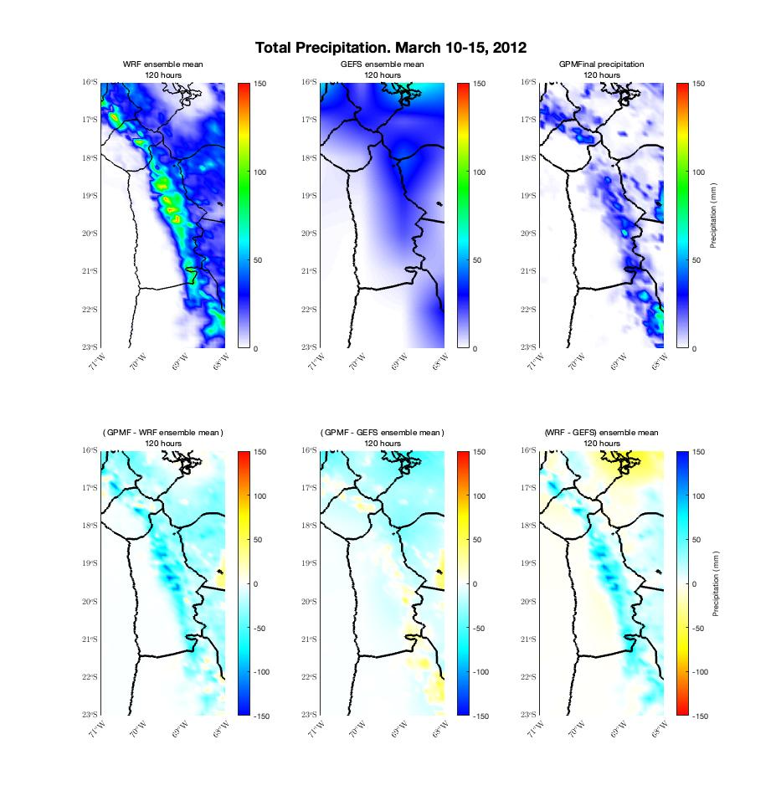
WRF vs. GEFS PRECIPITION: SAMPLE EXTREME EVENT
Notes:
Key message for the plots
Look at the camera (top of monitor)
Have cards to reduce words

Slide 9
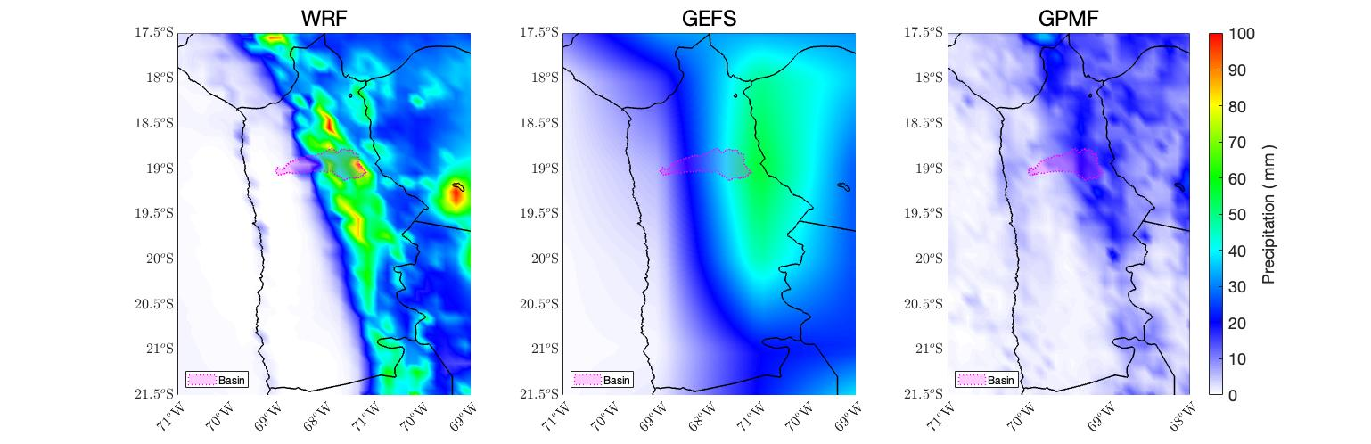
ensemble mean oF THE FIVE
BOLIVIAN WINTER EXTREME EVENTS
Notes:
General behavior across cases
Only the Bolivian cases

Slide 10
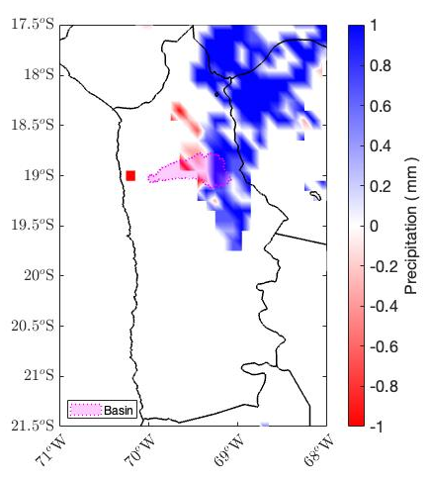
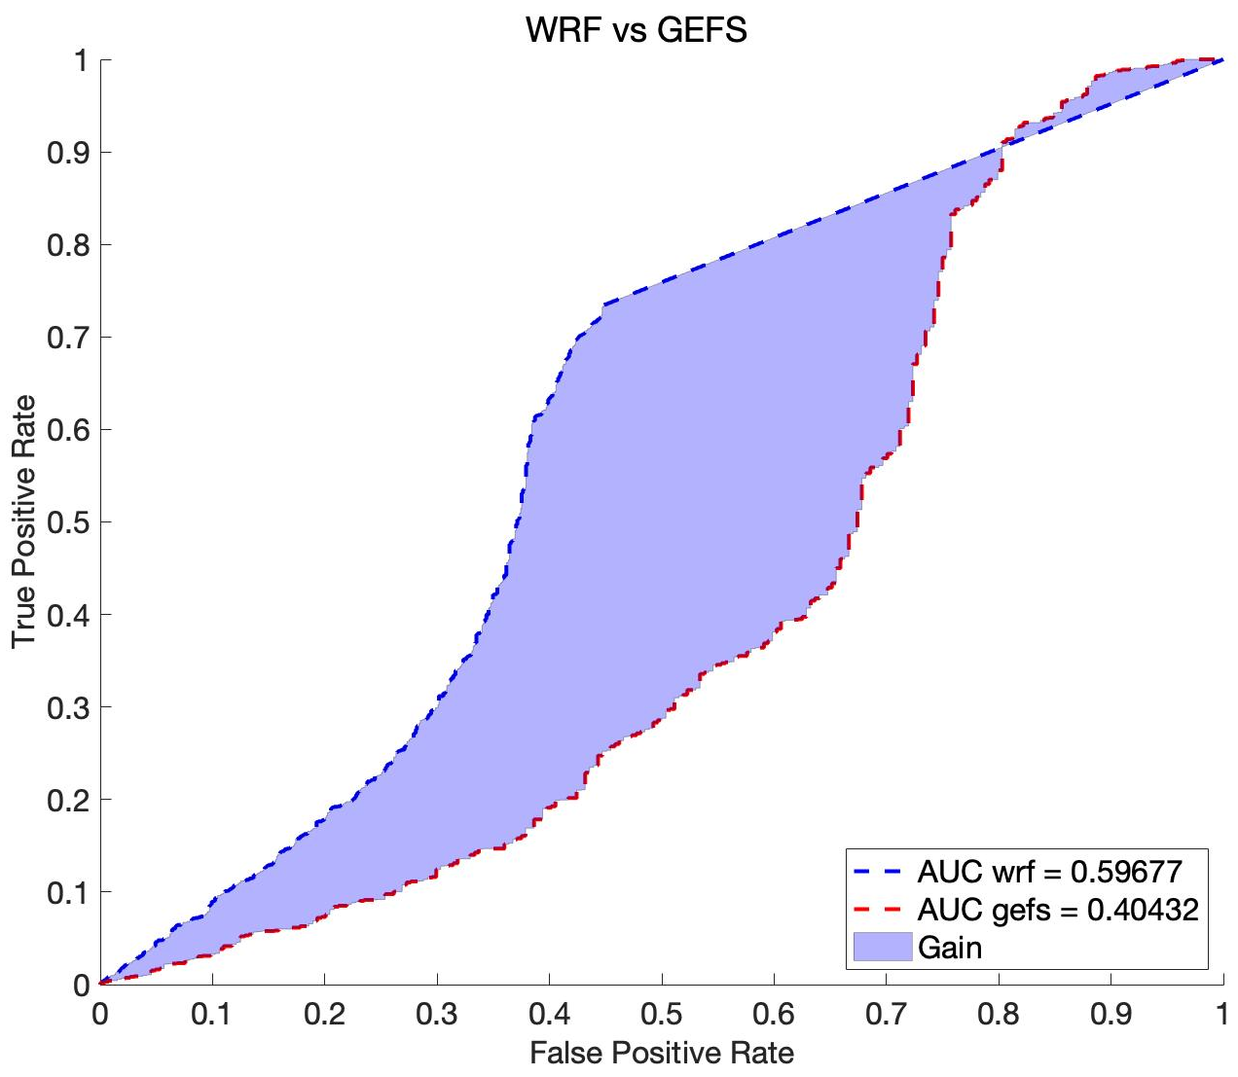
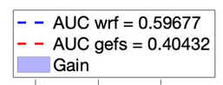
Forecast Verification:
Probability of DETECTION (POD) AND
Receiver Operating characteristic (ROC) CURVE
WRF – GEFS POD Difference
WRF vs. GEFS ROC curves
WRF
higher POD
AUC > 0.5
USEFUL SKILL
Area under
ROC curve
(AUC)
GEFS
higher POD
AUC < 0.5
NO SKILL
Notes:
Average across cases
Change color for FAR (1-FAR). Blue is WRF doing better*
Maybe only CSI with ROC, and provide differences and purpose on what they do (detection and usefulness) overall all cases.
No color fill, or fill the gain, everything bigger
Increase font size for titles

Slide 11
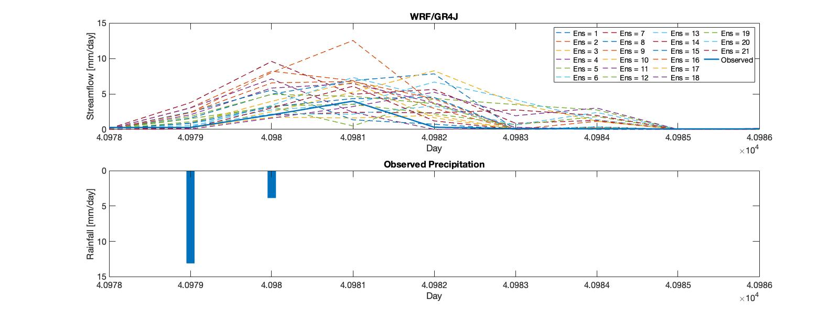
Streamflow simulation
Notes:
Only case 1 as proof of concept?
Evaluate modeled streamflow rsponse using CPM output.
To drive a hydrologic model, as a possible new evaluative metric.

Slide 12
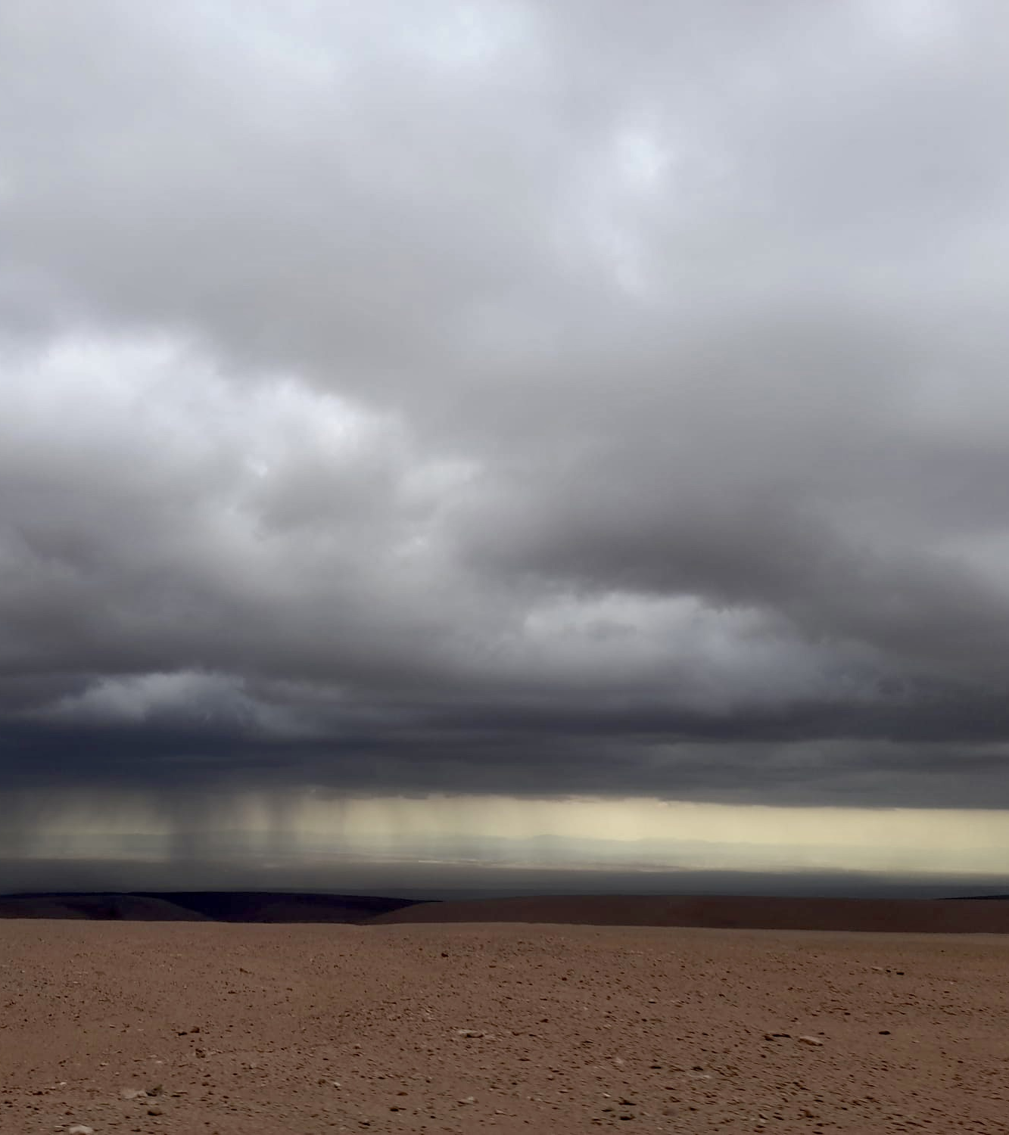
Conclusions and future work
CPM improves convective precipitation forecasts over the Andes above the ‘no skill’ raw GEFS.
Significant value-added from CPM to forecast extreme precipitation thresholds.
Preliminary setup of WRF and GRJ Model has shown satisfactory simulation results in the basin.
Possible to improve forecast capabilities for convective precipitation to drive operational hydrologic models in northern Chile.
Use of CPM can potentially address the undercatch issue in observed precipitation estimates in the Andes.
March 2022: A strange month in the Atacama Desert.
Posted on 25. March 2022 by José Vicencio.
Scientific News from AWARES.
Notes:
Solution to hyp.
Hydro as alternative for evaluation
Mention operational system goal as future work (bold)
Potential novel approach

Slide 13
Thank you
Questions?

Slide 14
References
Beck, H. E., Wood, E. F., McVicar, T. R., Zambrano-Bigiarini, M., Alvarez-Garreton, C., Baez-Villanueva, O. M., Sheffield, J., & Karger, D. N. (2020). Bias Correction of Global High-Resolution Precipitation Climatologies Using Streamflow Observations from 9372 Catchments, Journal of Climate, 33(4), 1299-1315. Moya-Álvarez et al. 2018, 2019,
Alvarado Ivan; A street is flooded at Chanaral town; March 26, 2015. REUTERS.
Le Moine, N., Andréassian, V., Perrin, C., and Michel, C. (2007), How can rainfall-runoff models handle intercatchment groundwater flows? Theoretical study based on 1040 French catchments, Water Resour. Res., 43, W06428, doi:10.1029/2006WR005608.
Schumacher, V, Justino, F, Fernández, A, et al. Comparison between observations and gridded data sets over complex terrain in the Chilean Andes: Precipitation and temperature. Int J Climatol. 2020; 40: 5266– 5288. https://doi.org/10.1002/joc.6518
Notes:
https://webgr.inrae.fr/en/people/legal-notice/

