Slide 1
Hydroclimate Research Program for the Andes
Mariano Masiokas, IANIGLA-CONICET, Argentina
Jhan Carlo Espinoza, IRD, France-Peru
VI CPCM Workshop, Buenos Aires, ARGENTINA
September 9, 2022

Slide 2
The general goal of ANDEX is to improve our understanding and prediction of relevant hydroclimatic processes and changes across the Andes, coordinating the efforts and activities of scientists working on Andean hydroclimatology (in-house and abroad)

Slide 3
An Initiating

Slide 6
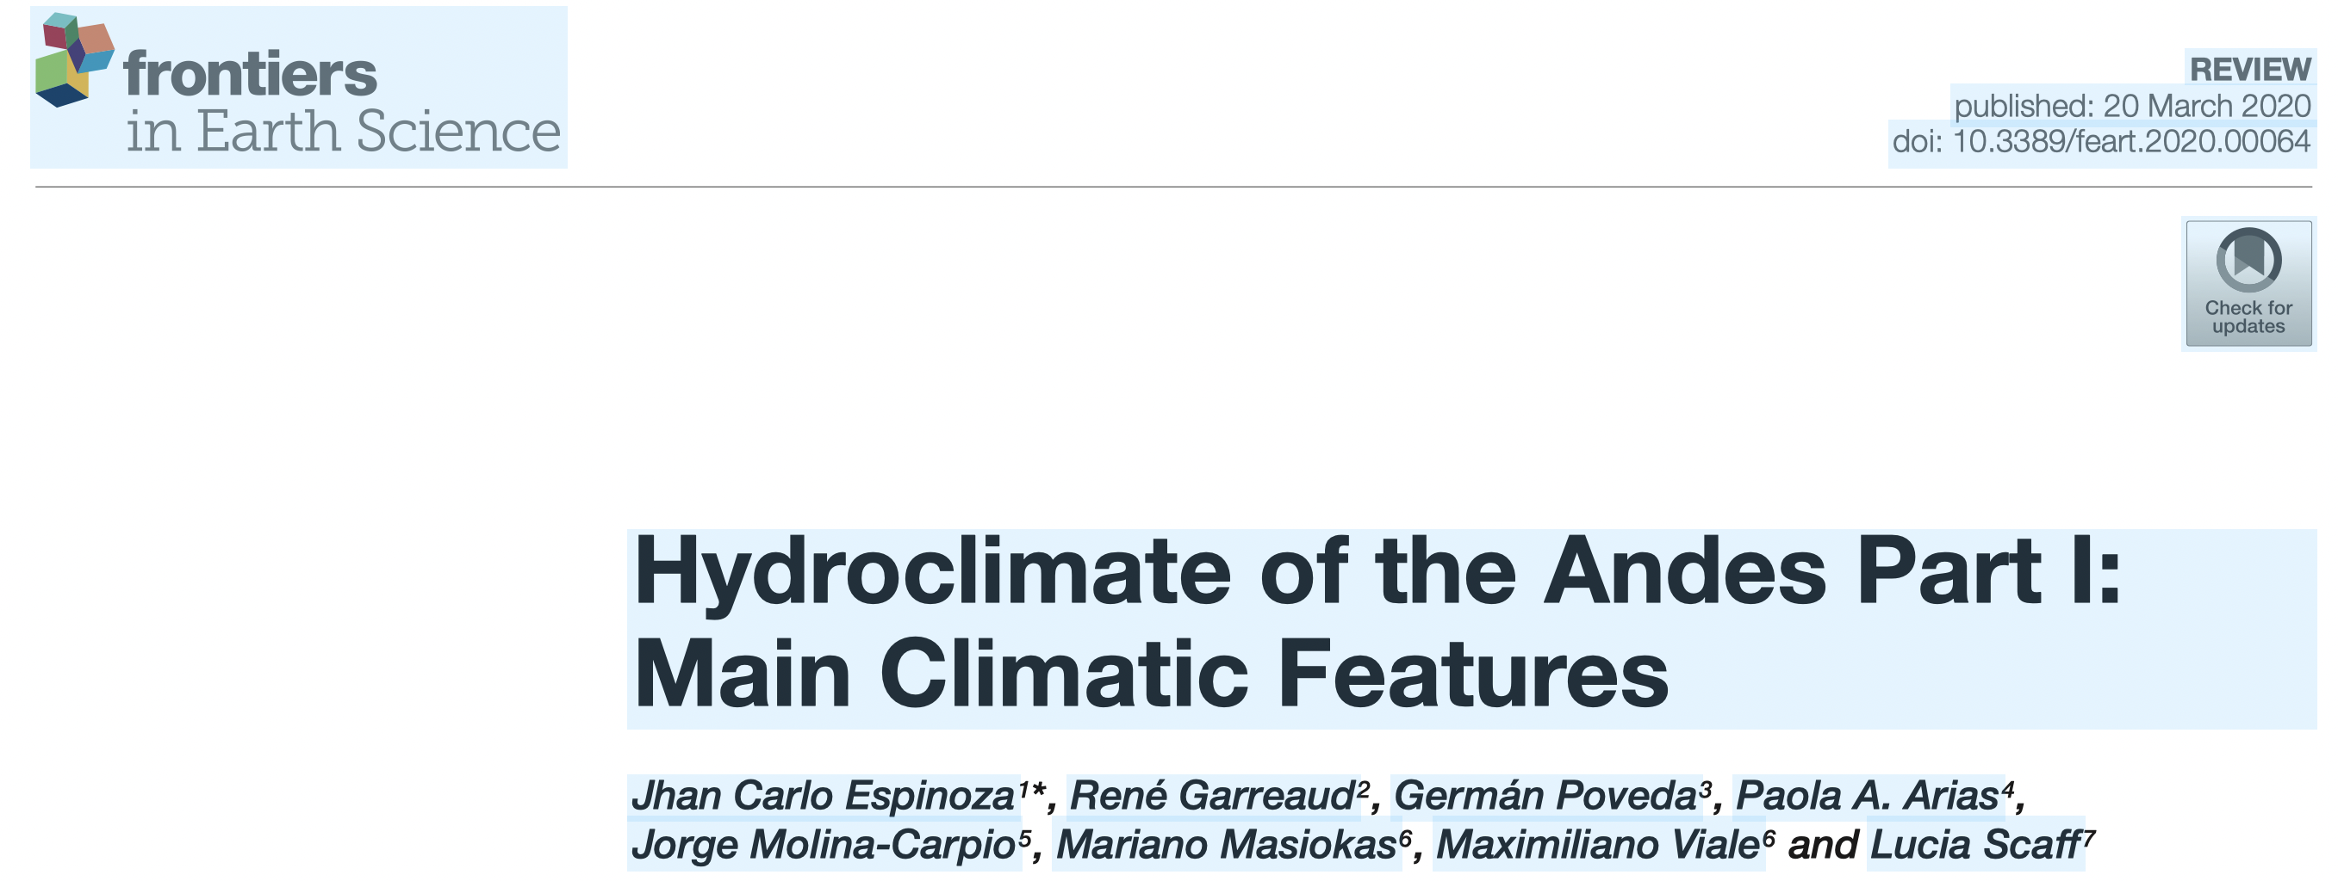
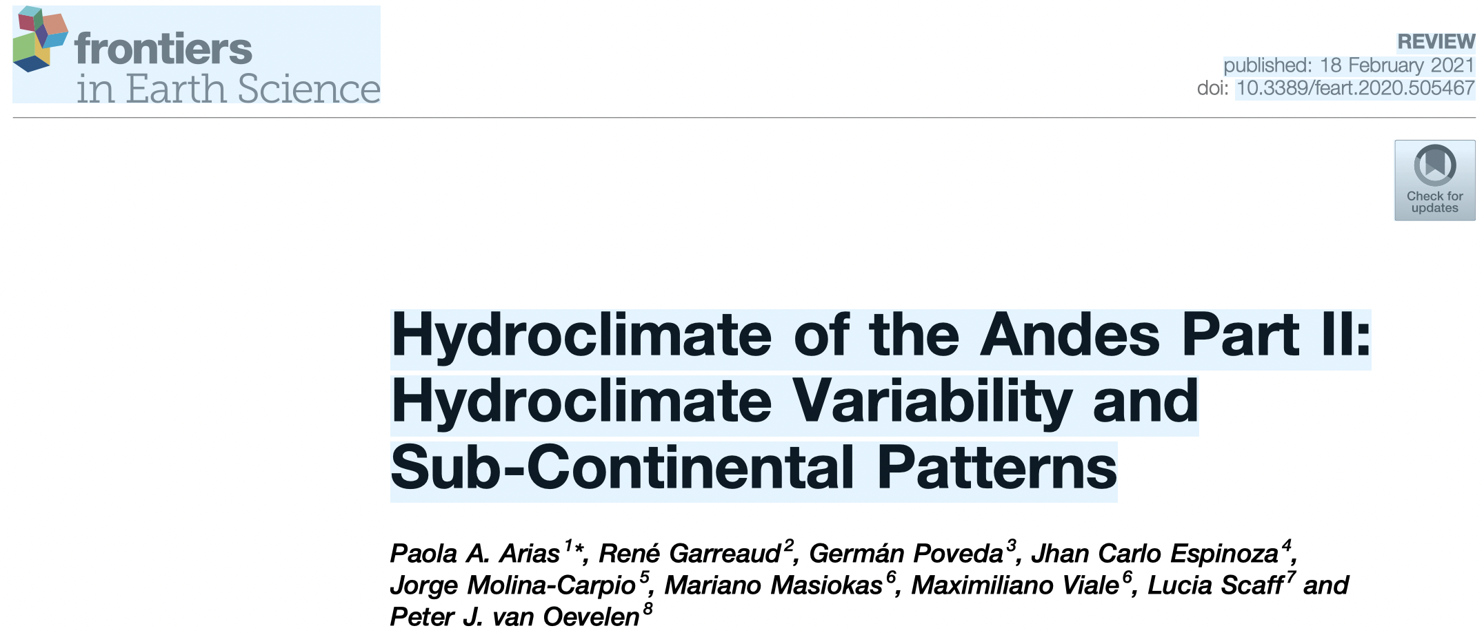
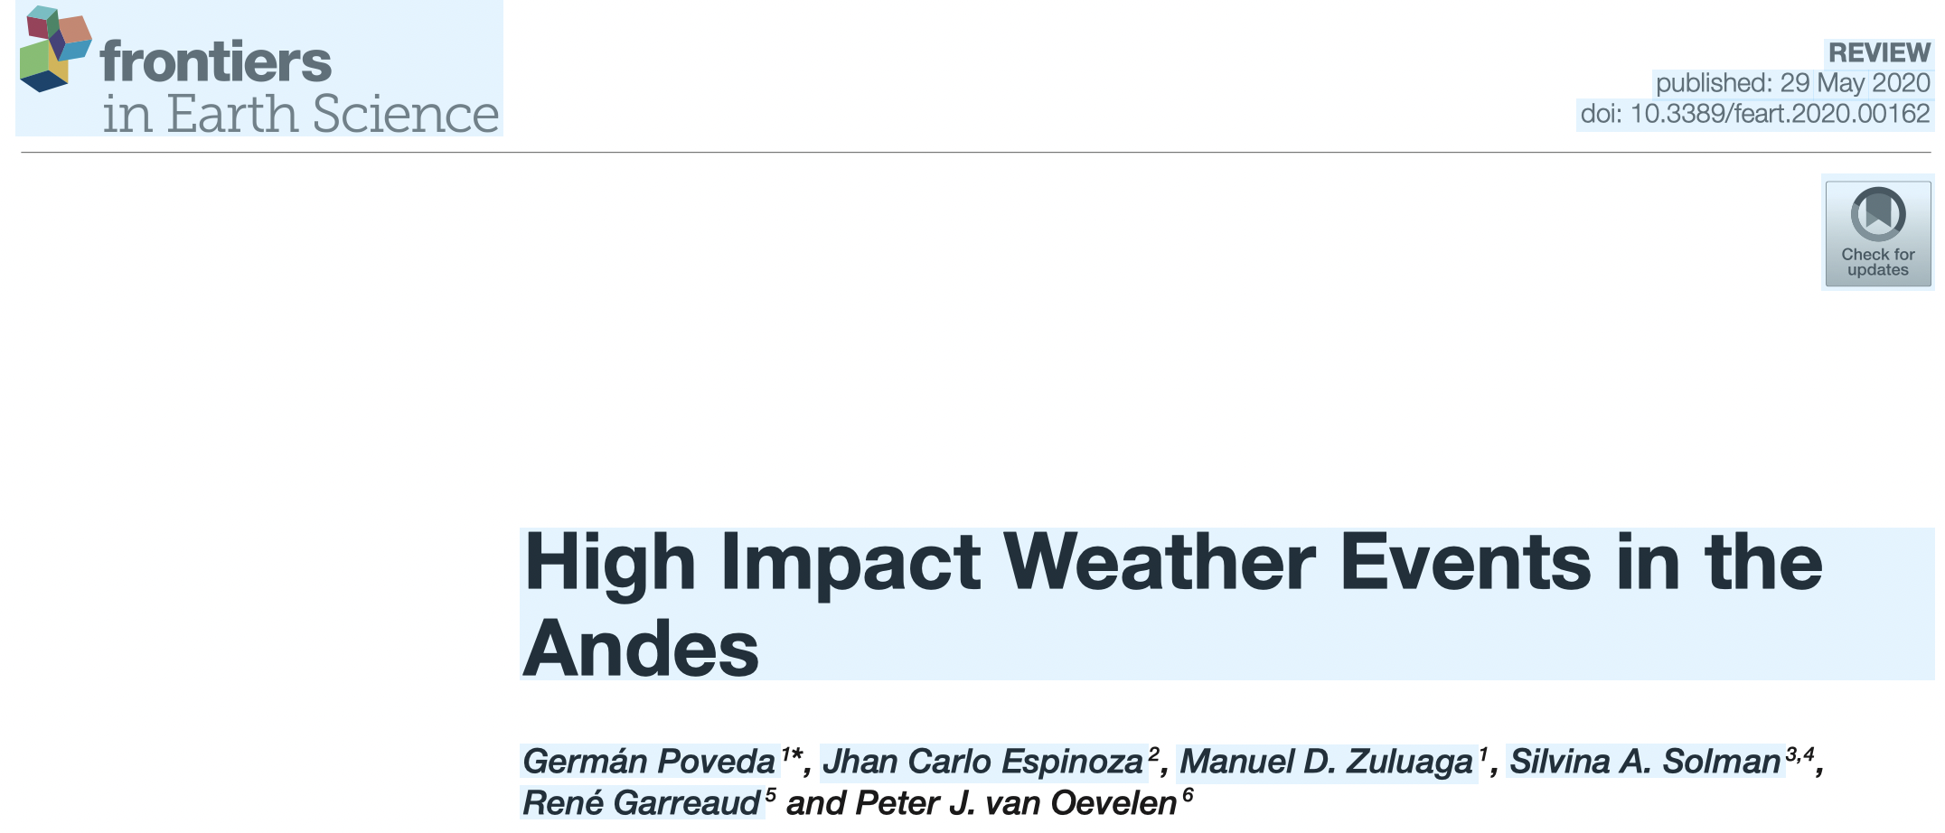
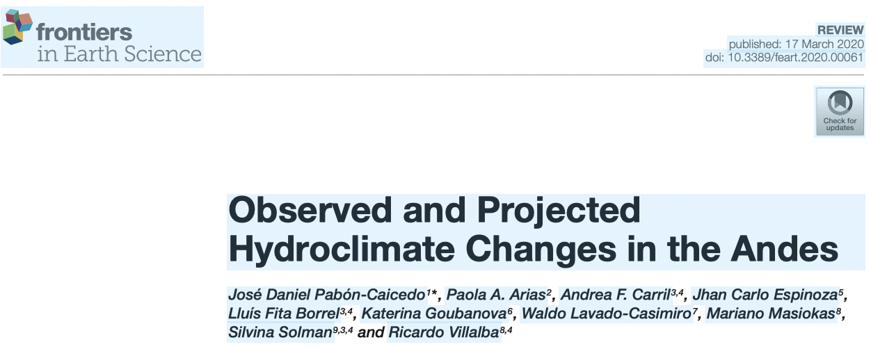
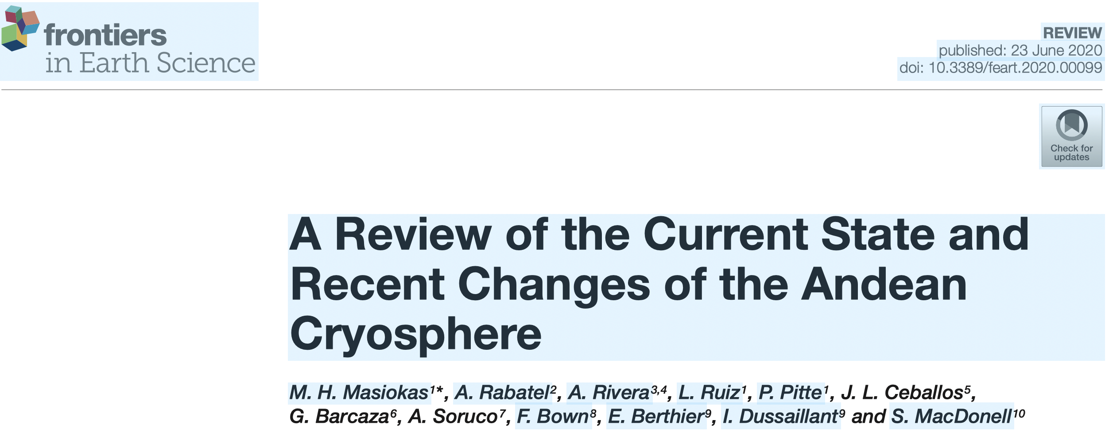
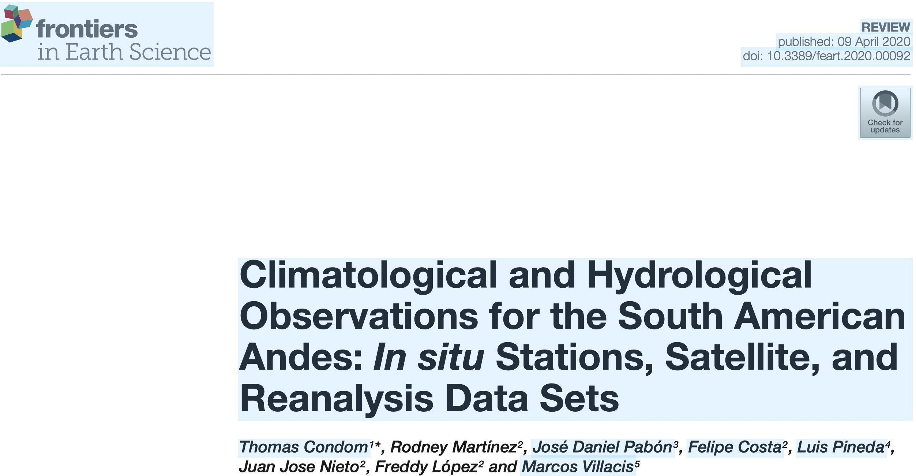
Review papers published in Frontiers (2020-21): Connecting Mountain Hydroclimate Through the American Cordilleras
Cited by 66
Cited by 23
Cited by 44
Cited by 49
Cited by 58
Cited by 26

Slide 7
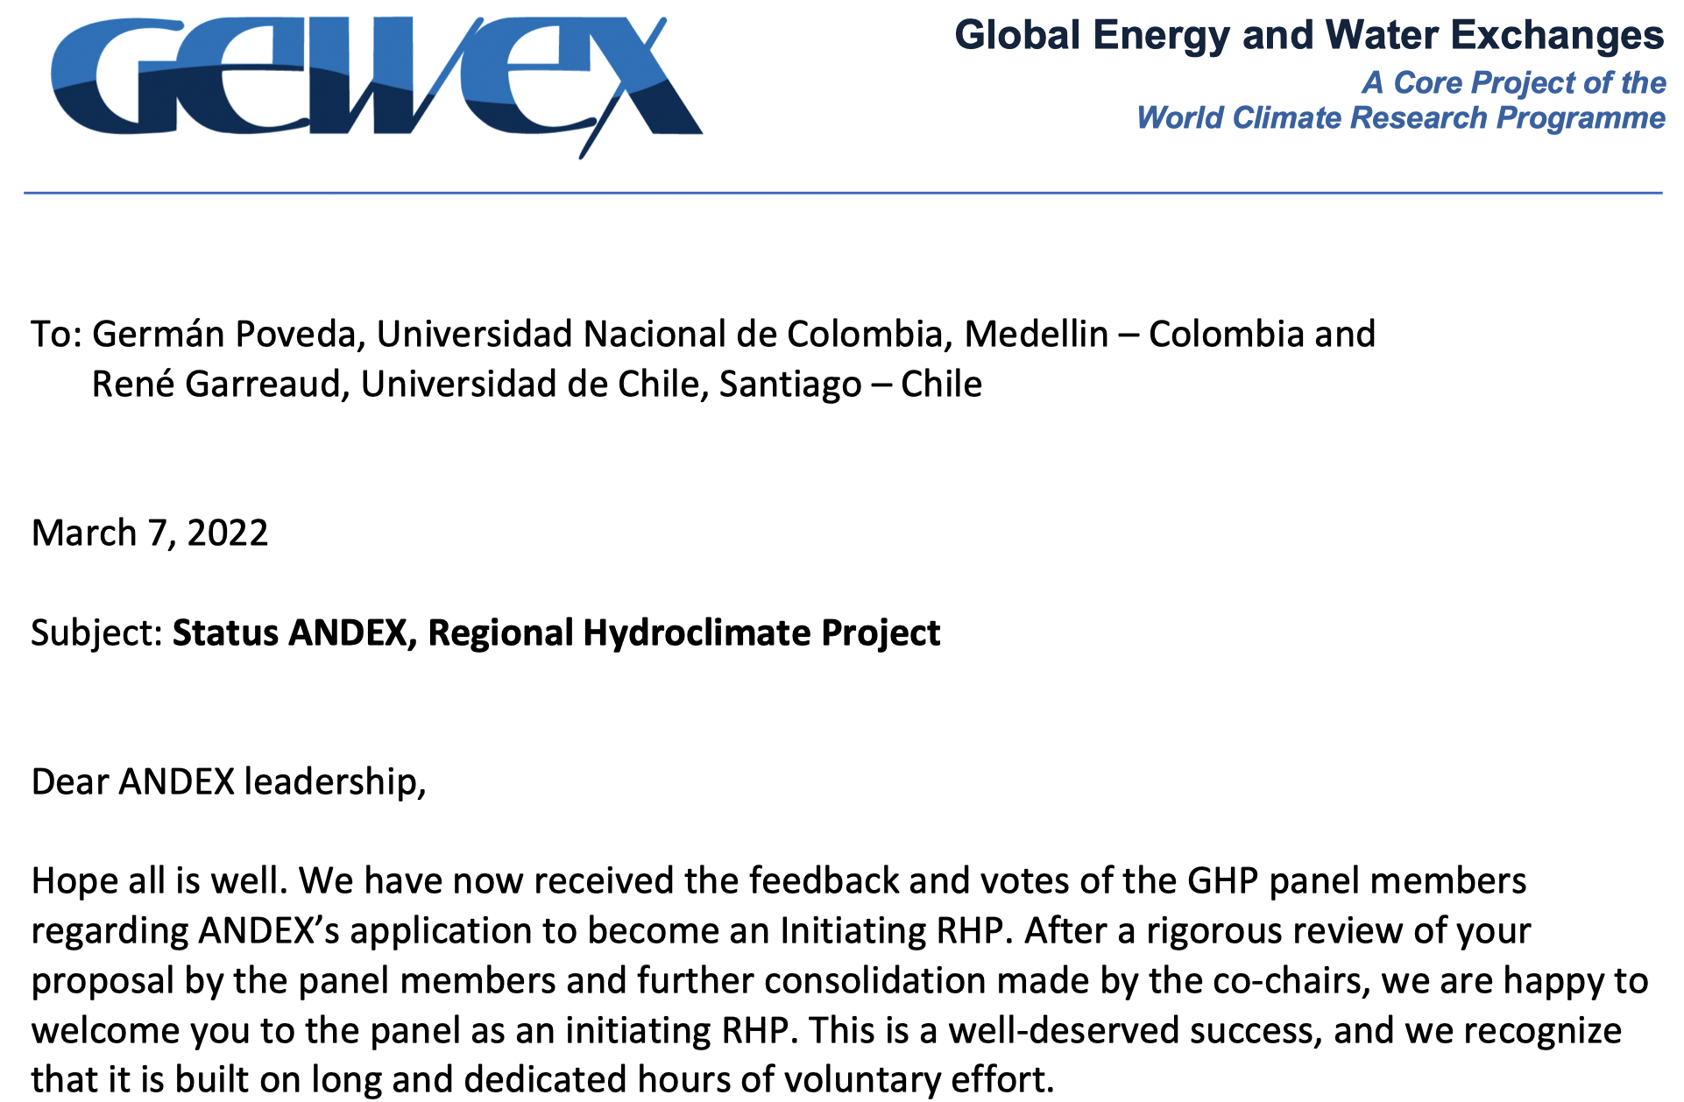
In March 2022 ANDEX becomes an Initiating RHP

Slide 8
In March 2022 ANDEX becomes an Initiating RHP
A number of recommendations were provided by the GEWEX panel to
better define timelines and milestones
enlarge the number of scientific disciplines in the group
open the program to the wider community working on hydro-climatic issues across the Andes
define mechanisms for collecting, managing, and providing access to hydro-climatological data

Slide 9
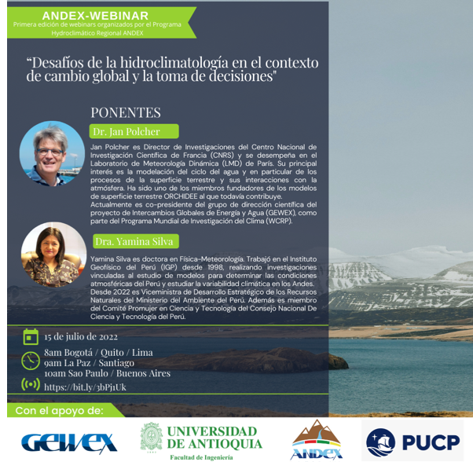
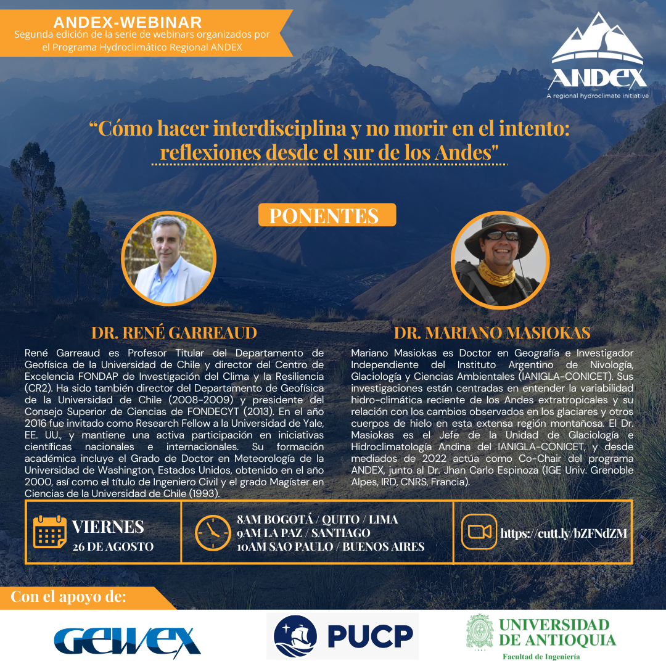
Webinars
Spanish-speaking webinars for the entire Andean hydroclimate community:
“Advances and challenges of the hydroclimate of the Andes: From science to policy”
Spanish-English simultaneus translation and zoom plateform for each webinar is financed by Pontificia Universidad Catolica del Peru (PUCP). Additional contributions from GEWEX and Univesidad de Antioquia (Colombia).
First session: July 15, 80 people attended.
Sessions are recorded and available in the ANDEX website.
Second session: August 26

Slide 10
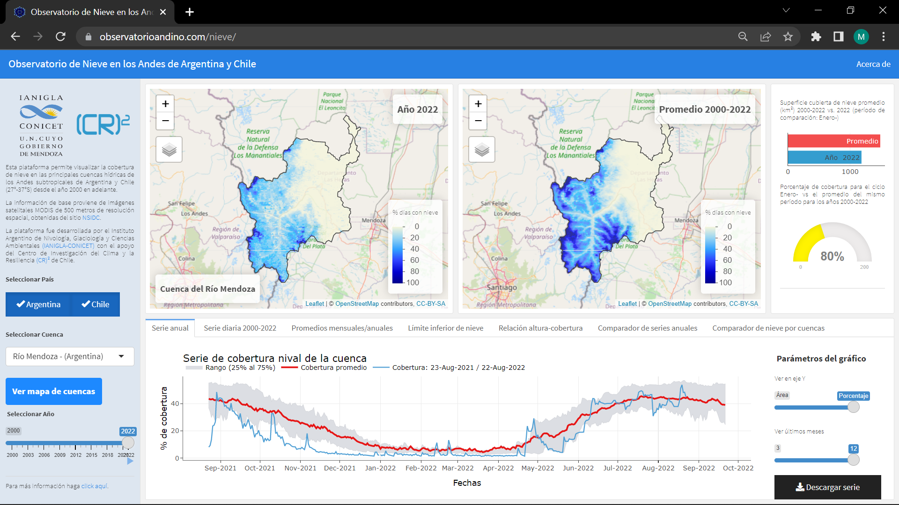
Observatorio de Nieve en los Andes de Argentina y Chile
https://observatorioandino.com/nieve/

Slide 12
Defining structure and general and specific outcomes

Slide 13
ANDEX Meeting in Buenos Aires, 3-5 Sept. 2022
Jhan Carlo Espinoza – Co-chair de ANDEX, IRD-Francia/Perú
Mariano Masiokas – Co-chair de ANDEX, IANIGLA, Argentina
Paola Arias – Universidad de Antioquia, Colombia
Jorge Molina – Universidad Mayor San Andrés, Bolivia
Daniel Pabón – CIIFEN, Guayaquil, Ecuador
René Garreaud – Universidad de Chile, Chile
Isabel Moreno – Universidad Mayor de San Andres, Bolivia
German Poveda – Universidad Nacional de Colombia, Colombia
Silvina Solman – Universidad de Buenos Aires, Argentina
Anna Stewart – Inter-American Institute for Global Change Research, Uruguay
Alejandro Martinez – Universidad de Antioquia, Colombia
Peter J. van Oevelen – International GEWEX Project Office, Fairfax (VA), USA
Jan Polcher – Co-chair GEWEX, IPSL-France.
Hugo Berbery – University of Maryland, USA/Argentina

Slide 14
Main Theme 1:
Water security for Andean populations
Main objective
Safeguarding the water supply for Andean populations by improved quantification of present and future changes in water availability
Specific Objectives
Characterize the water cycle across the Andes
Tailor seasonal forecasts for better water management
Assess existing water forecasts in the Andes
Estimate future projections of water supply and demand
Strengthen the water monitoring/observation network
Create a user-friendly interface/tool for monitoring data, forecasts & projections
Identify impacts of water cycle changes on human systems and ecosystems

Slide 15
Main Theme 2:
High impact events
Main Objective
Contribute in the reduction of water- and weather-related risks across the Andes
Specific Objectives
1 - Improve diagnosing, forecasting and predictive tools for water and weather-related hazards
2 - Assess the socio-environmental vulnerability to hydrometeorological hazard considering multi-dimensional elements and a common framework across the Andean countries.
3 - Gauge the magnitude, frequency and direction of future changes of weather and water-related hazard along the Andes for improved socio-environmental resilience for a changing climate.

Slide 16
Main Theme 1:
Water security for Andean populations
Main Theme 2:
High impact events
Shared Objectives
1 - Strengthen and interconnect a growing community of scientists, practitioners and planners dealing with hydroclimate and meteorological risk.
2 - Inform society at large…

Slide 17
Co-Chairs
Scientific Comitee
Main Theme 1:
Water security for Andean populations
Main Theme 2:
High impact events
Climate patterns and drivers
Environmental and ecological changes
Water resources / Cryosphere
Gobernance and Policy
Integrative theme 1:
Observations and data
Integrative theme 3:
Science underpinning sustainable development
Integrative theme 2:
Numerical modeling
Information and data sharing platform
Communication / Education
Capacity Building

Slide 18
Muchas gracias

