Slide 1
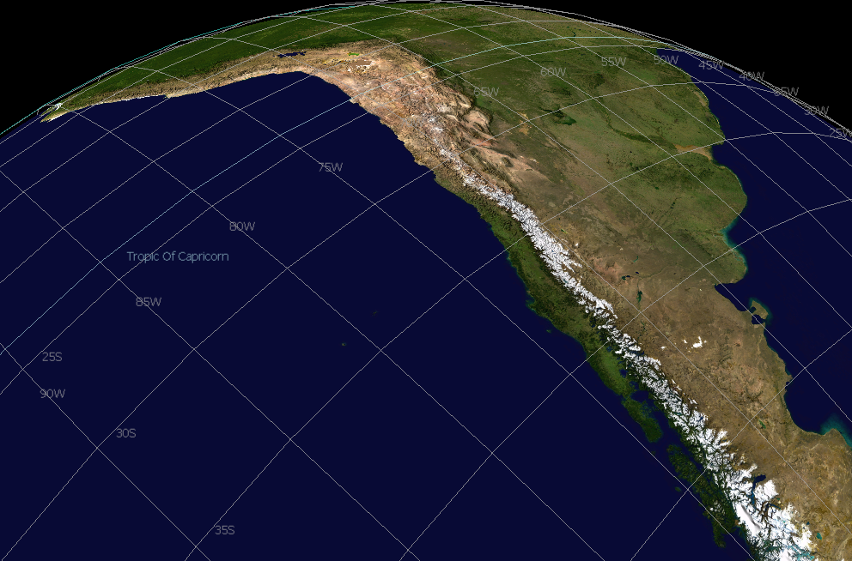
A brief overview of recent glacier changes and their main climatic forcings across the Andes
Mariano Masiokas
IANIGLA-CONICET
Mendoza, Argentina

Slide 2
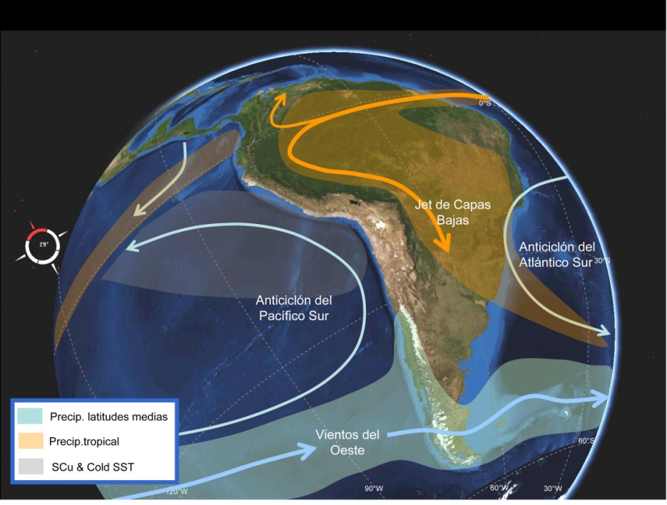
Garreaud 2009

Slide 3
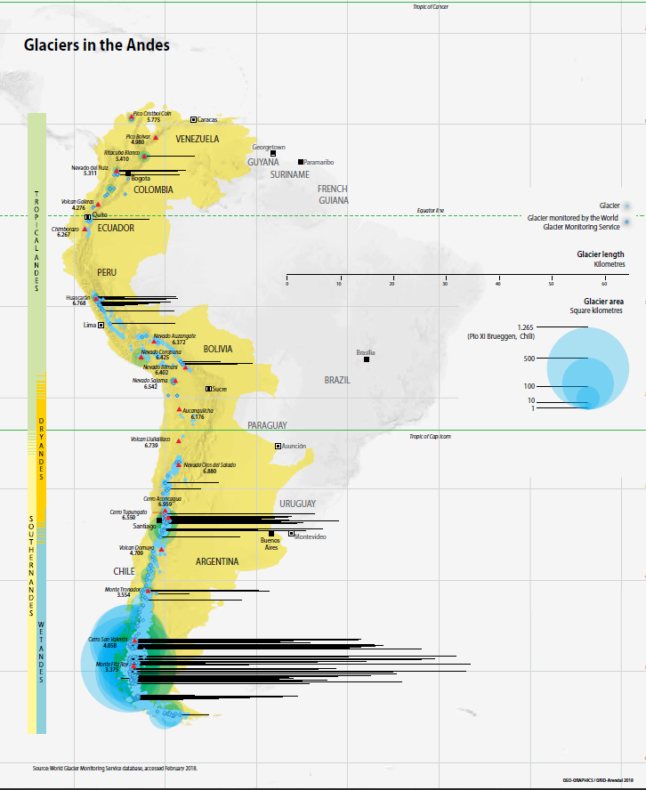
UNESCO 2018

Slide 4
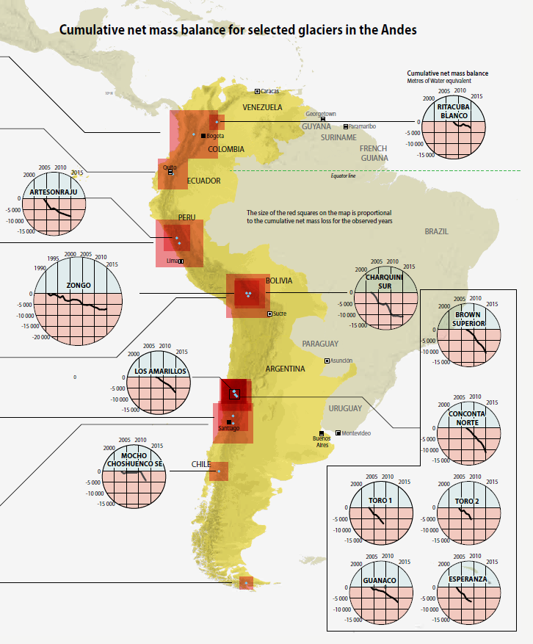
UNESCO 2018

Slide 5
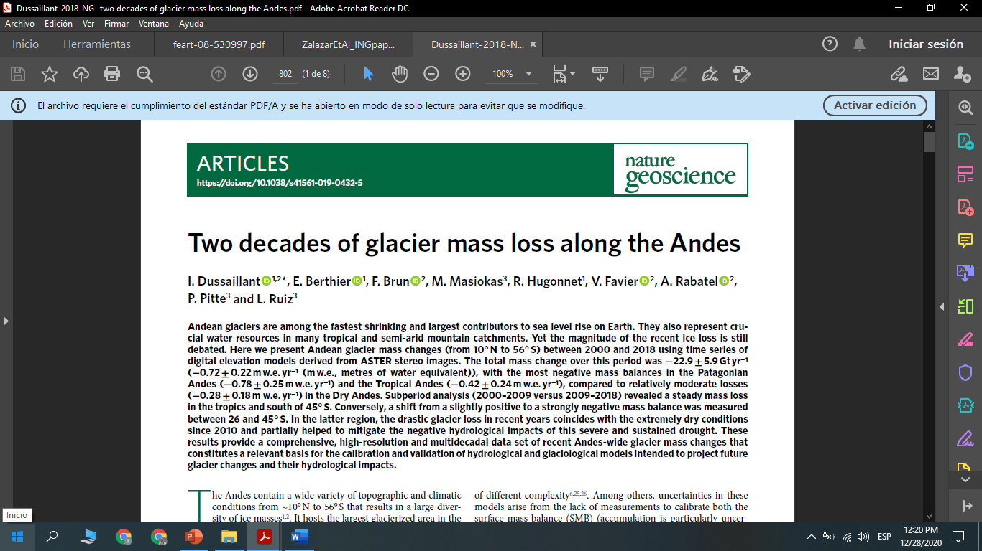
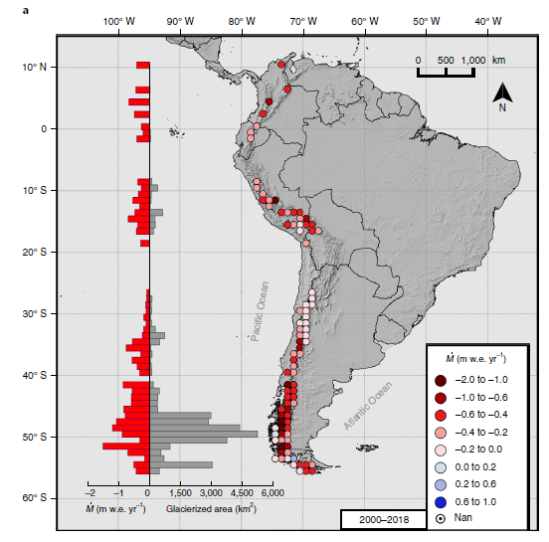

Slide 6
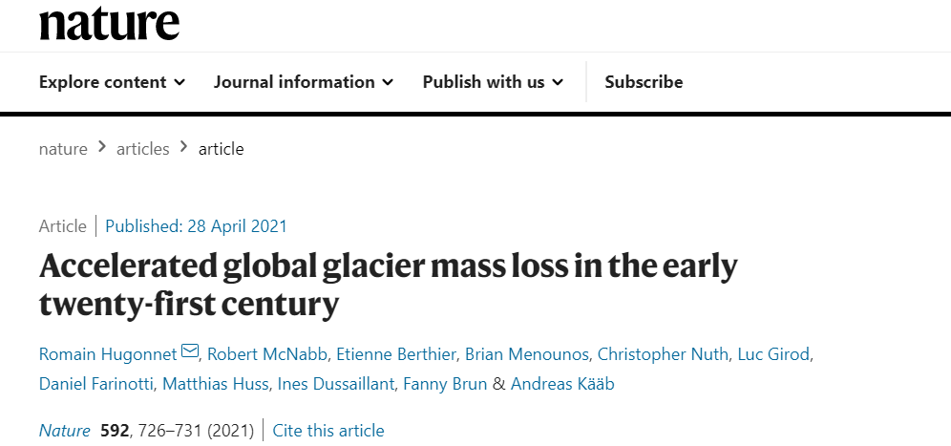

Slide 8
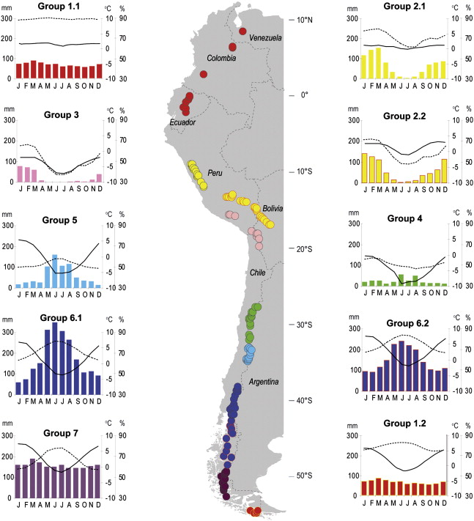
Climatic conditions at glacier sites across the Andes
RH
T
PP
Sagredo & Lowell, 2012. Climatology of Andean glaciers: A framework to understand glacier response to climate change. Global and Planetary Change 86-87, 101-109.

Slide 9
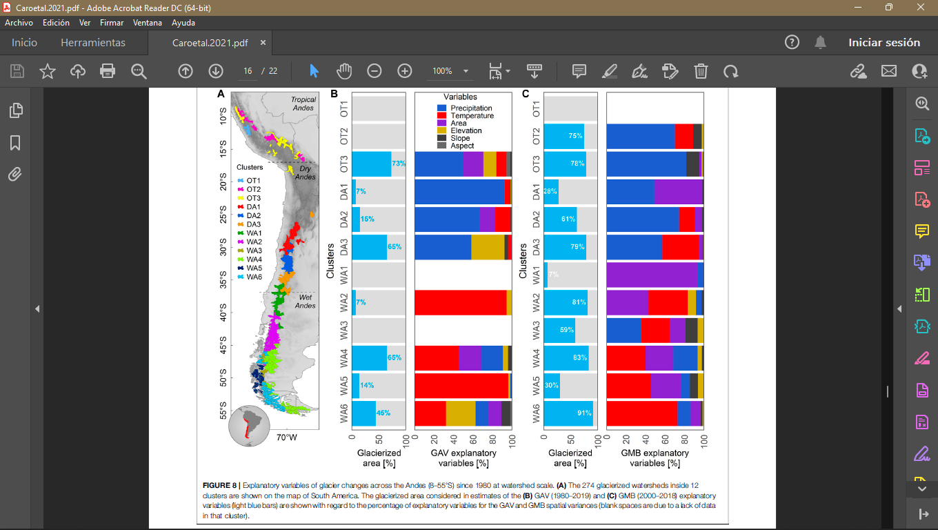
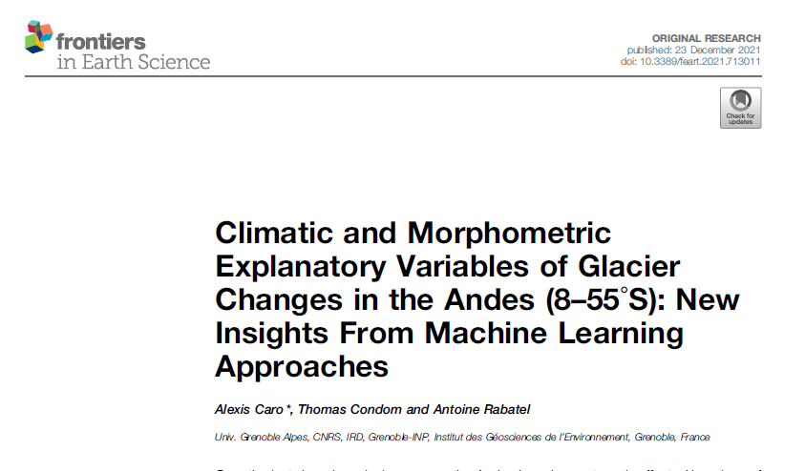
Caro et al. 2021
Caro et al. 2021

Slide 10
Some thoughts
The Andean glaciers are the most diverse on Earth and result from a wide variety of climatic and topographic conditions
The current status and recent variations of Andean glaciers are well documented
The glacier-climate relationships are complex and vary across the Andes
High-resolution climate modelling could help to better resolve the spatio-temporal variability of key variables affecting glaciers
This would also be useful and relevant for
Validation of climate model outputs in complex terrain
Improved understanding of glacier-climate relationships
Better glaciological and hydrological models
Improved estimations of future scenarios for Andean water resources
…

Slide 11
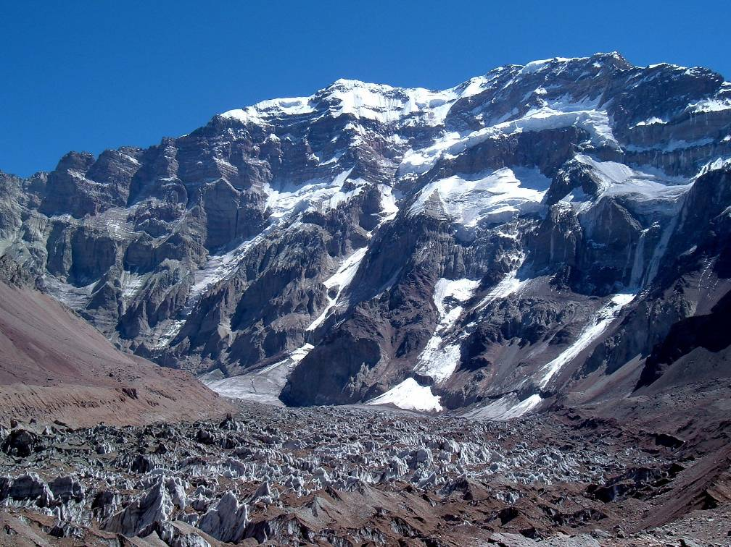
Thank you
Cerro Aconcagua,6962 m
Mendoza, Argentina

