Slide 1

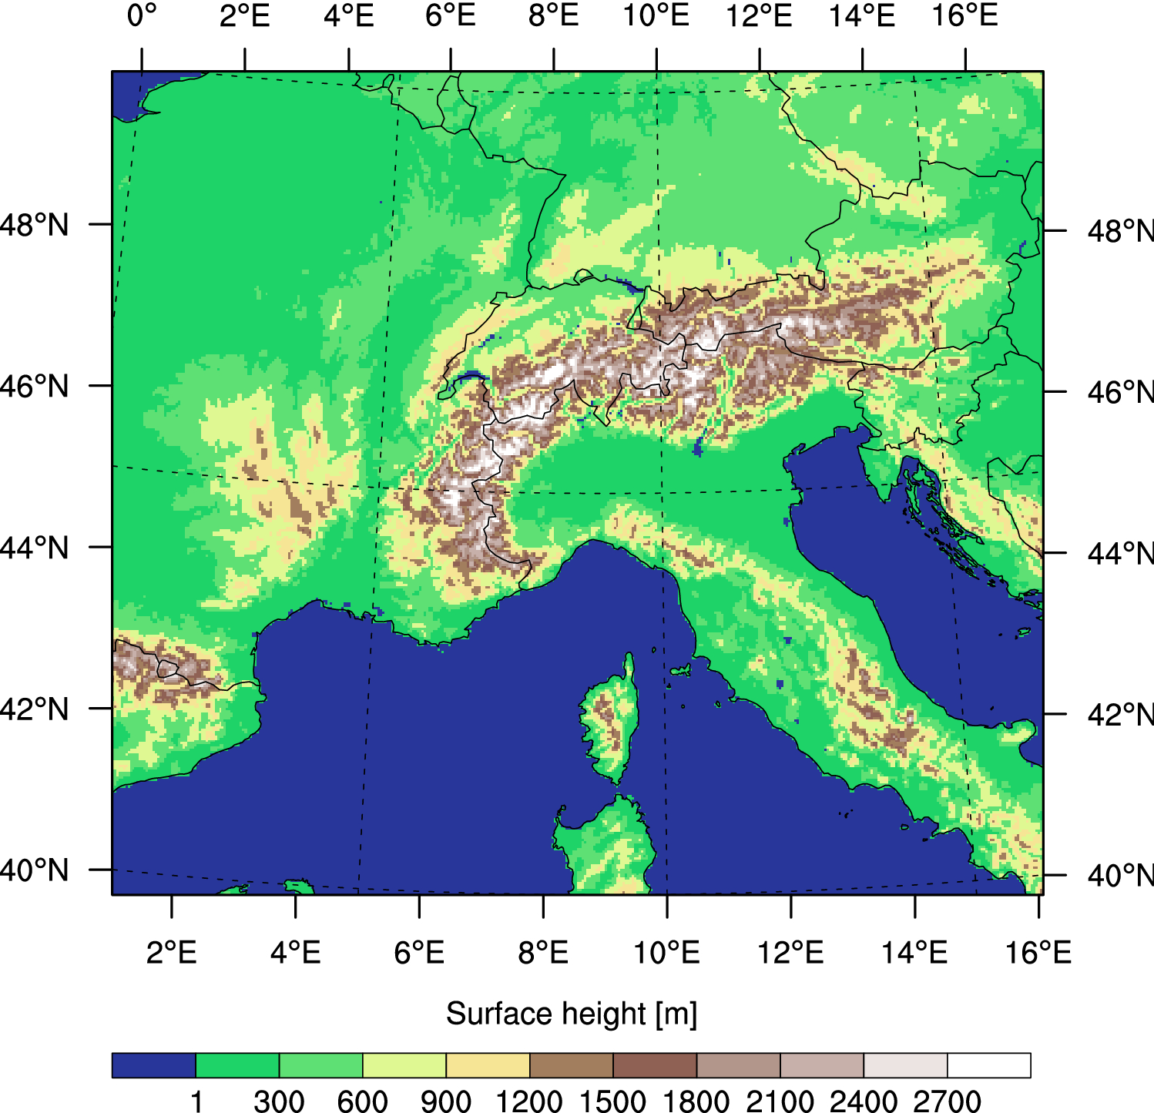


Highlight findings from the WCRP CORDEX Flagship Pilot Study on Convection over Europe and Mediterranean (FPSCONV)
Stefan Sobolowski, Erika Coppola & the entire FPSCONV Team
VI CPCM Workshop, 7-9 September 2023, Buenos Aries Argentina

Slide 2
FPS-Convection Europe: Objectives
Investigate convective-scale events, their processes and their changes in a few key regions of Europe and the Mediterranean using ensembles of convection-permitting RCMs, statistical models and available observations
Provide a collective assessment of our modeling capacity at convection-permitting scale
Shape a coherent and robust collective assessment of the consequences of climate change on convective event impacts at local to regional scales

Slide 3
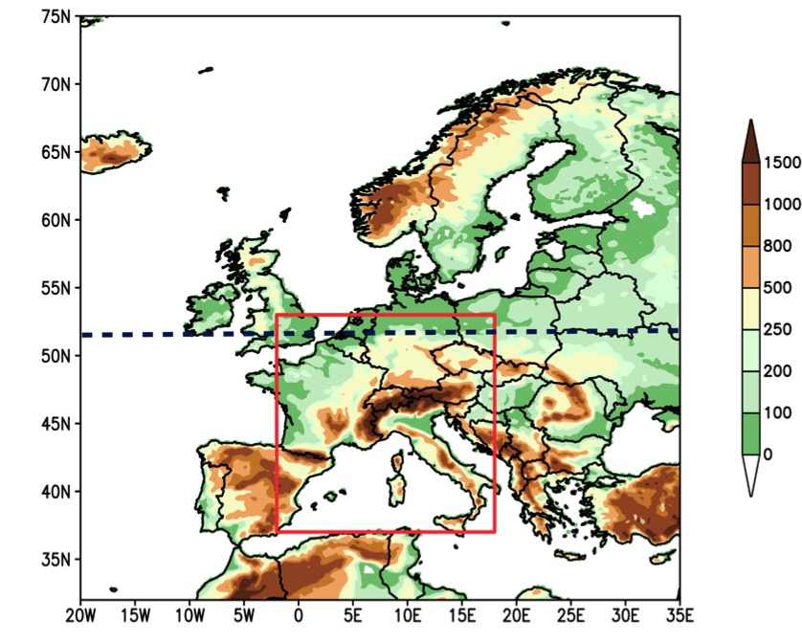
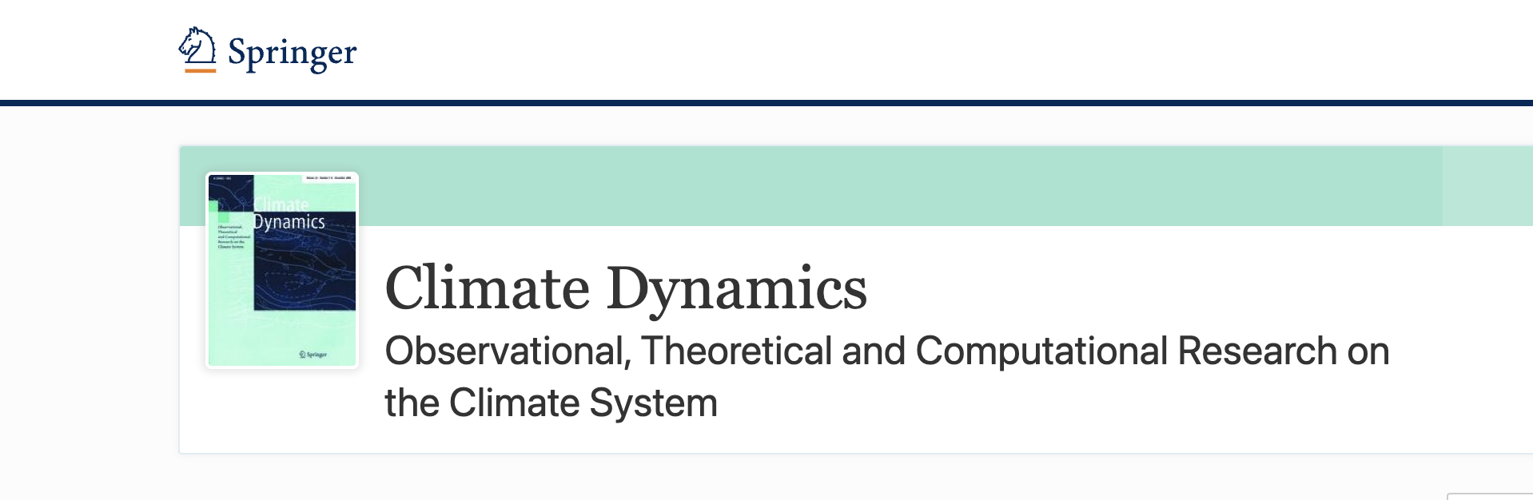

FPS contribution to the CP research
FPS contributed to confirm, reinforce and add robustness to the following topics:
•Better represent the spatial patterns and variability of precipitation at daily and hourly time scales
•Improve the representation of hourly frequency and intensity of precipitation events
•Improve representation of the summer diurnal cycle of precipitation both in terms of timing and intensity at the sub-daily scale
•Improve the representation of extreme events
•Refine and enhance the projected patterns of change of coarse resolution counterparts. Some climate change sign modifications are found locally (whose reliability is under investigation)
Special Issue
FPS new research topics and results
•Added-Value on Precipitation by CMP vs RCM and GCM
•Storm Tracking Algorithms in convection-permitting numerical models
•heatwaves in an ensemble of km-scale simulations
•Evaluation of uncertainties in CPMs and their parent RCM
•Convective and orographic rainfall over the Alps
•Added-Value on Temperature CPM vs RCM
•Climate Response of Heavy Precipitation Events over the Alps and in the Mediterranean

Slide 4
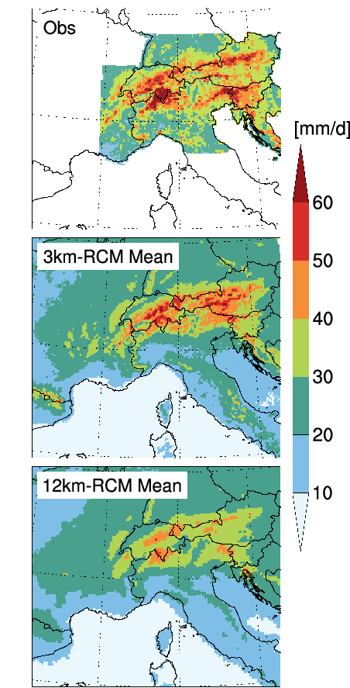
More realistic representation of precipitation with convection-permitting models compared to coarser counterparts
23-member ensemble:
  Reduces biases & uncertainty ranges;
  Improves diurnal cycles;
  Mitigates the “drizzle” problem;
  Captures heavy precipitation
Clear improvement in heavy precipitation (P99)
Ban et al. 2021 https://link.springer.com/article/10.1007%2Fs00382-021-05657-4

Slide 5
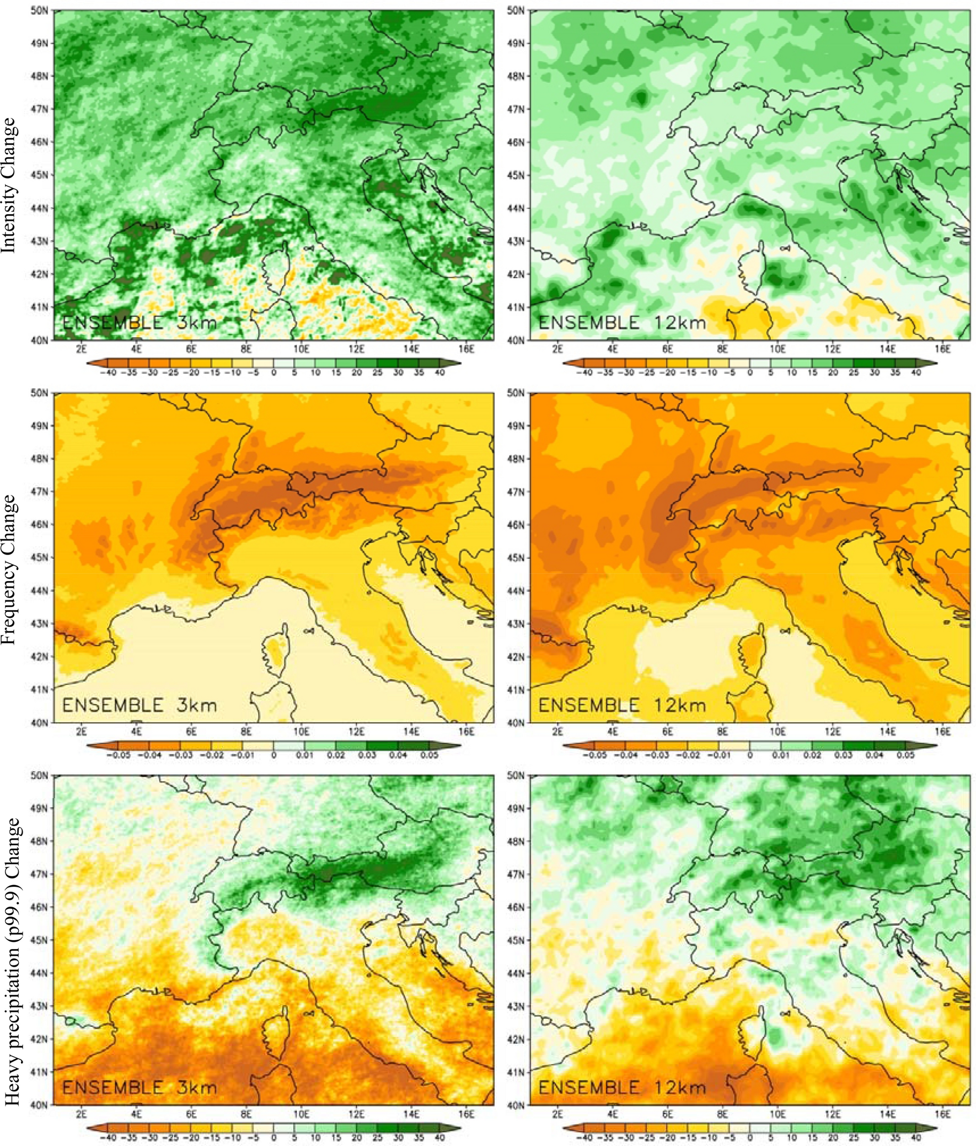
Future changes provide yet more evidence of shift to more enhanced convective activity despite overall (mean) drying in the region
3km JJA
12km JJA
12-member ensemble:
  Enhances & refines patterns of change;
  More intense less frequent events;
  Reduced uncertainty compared to coarse resolutions;
More intense
Frequency reductions more focused
More realistic heavy precipitation increases/ decreases over Alps/ Mediterranean
Pichelli et al. 2021 https://link.springer.com/article/10.1007%2Fs00382-021-05657-4

Slide 6
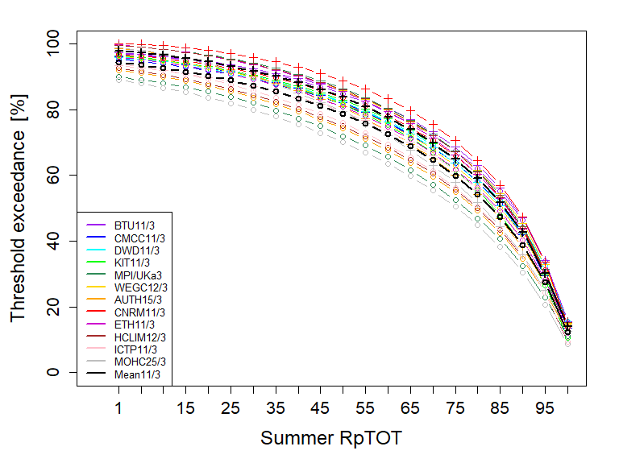
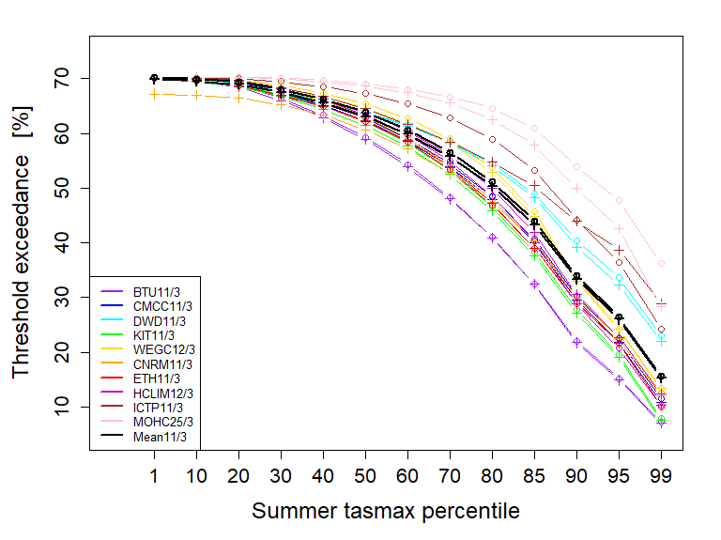

RxpTOT for the period 2090-2099
TXxp for the period 2090-2099 over land points only
+ CPM
o RCM
o RCM
+ CPM
Summer RxpTOT percentile
Heavier future precipitation with CPMs in all percentiles.
Slight reduced warm days with CPMs in all percentiles.
RxpTOT:
percentage of precipitation due to wet days with precipitation exceeding the xth percentile of wet days in the base period.
percentage of days with maximum temperature exceeding the xth percentile of daily maximum temperature in the base period.
TXxp:

Slide 7
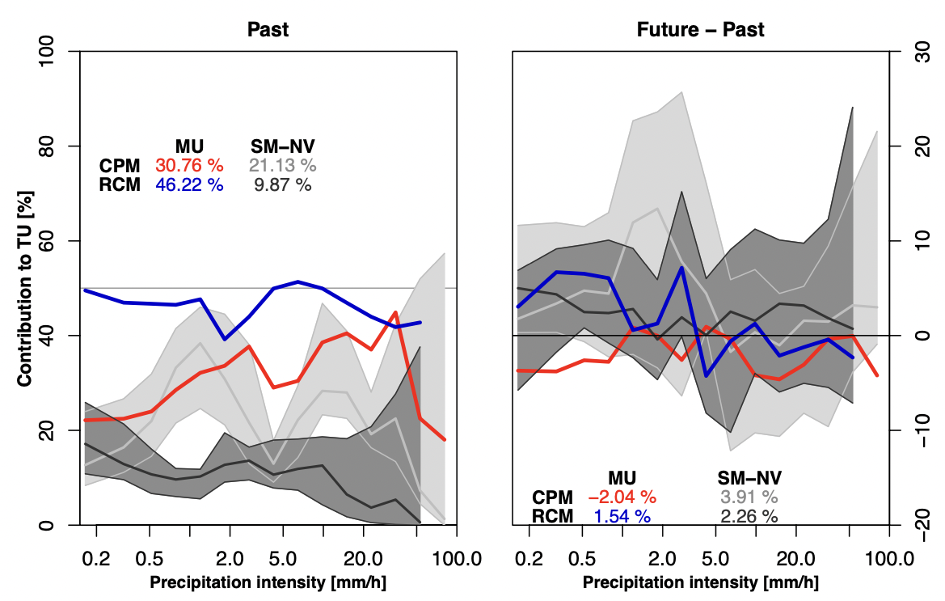
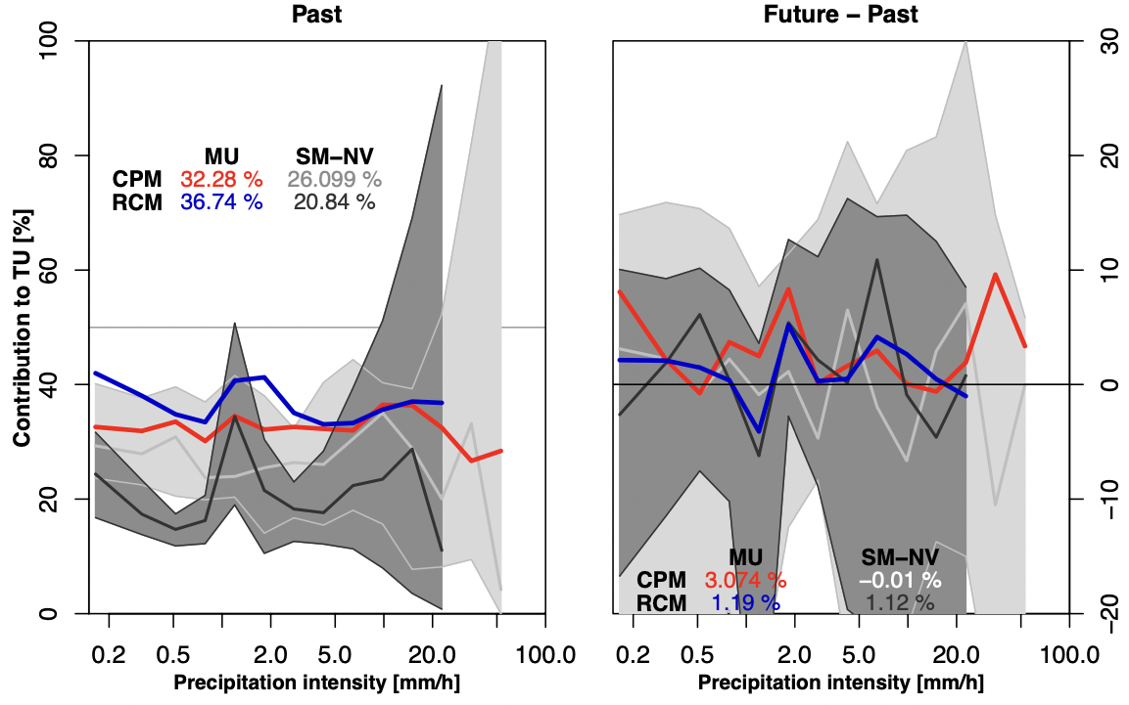
Fractional contribution of total precipitation to total uncertainty reduced in CPM
JJA
﻿Model uncertainties contribute to total uncertainties substantially more in RCMs than in CPMs especially for extremes
DJF
The convergence in CPMs is likely to be linked to the explicit representation of convection
courtesy of Giorgia Fosser
Notes:
Pdf of the fractional contribution to the total precipitation for JJA. The model uncertainty contribution to total uncertainty is indicated in blue for RCM and is in average around 46% while for CPM in red is of 30% and drops at ~20% for extremes while for the RCMs is stable at ~50%.
The convergence in CPMs is likely to be linked to the explicit representation of convection. In fact, in DJF the model uncertainty can explain only between 32% and 35% of the total uncertainty for both CPMs and RCMs in either time slices and all precipitation intensities.

Slide 8

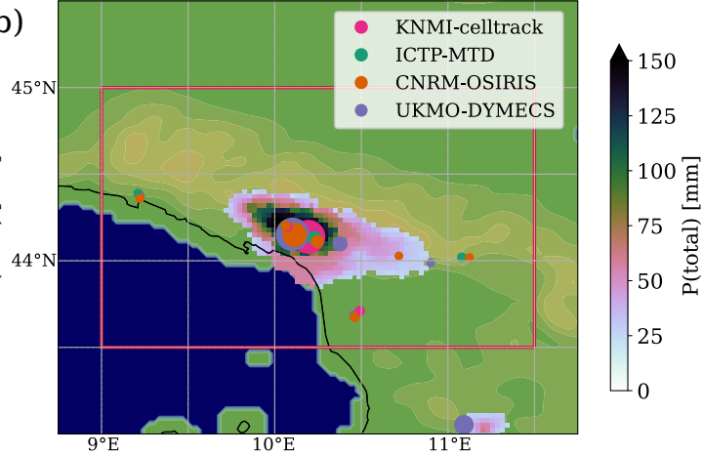
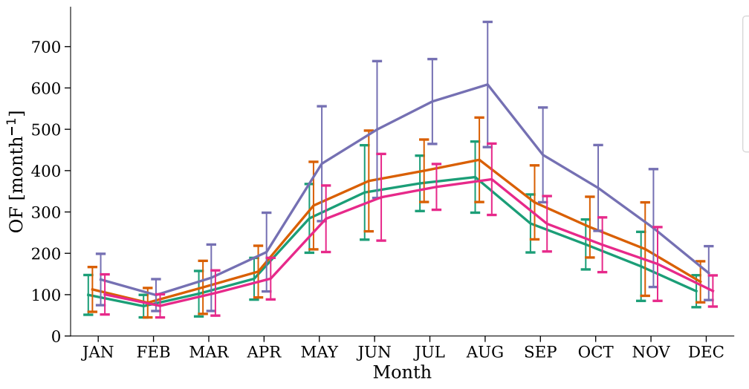
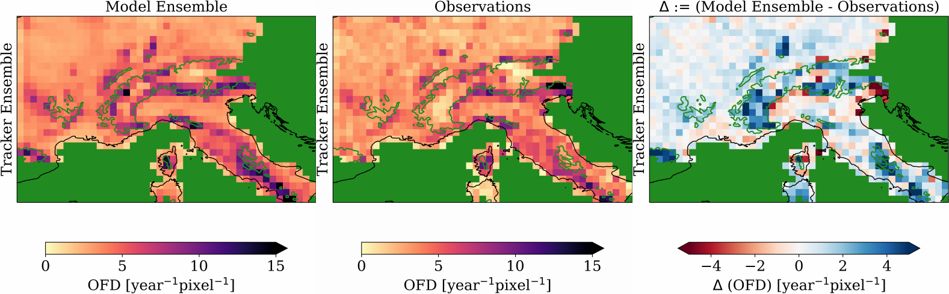

Evaluation of Alpine-Mediterranean Precipitation Events
in convection-permitting Regional Climate Models
using a Set of Tracking Algorithms
Sebastian K. Müller, et al., submitted
1a) historical case studies and 1b) climatologies
Two-fold scientific objective:
1) Tracker-Intercomparison using observations
→ trackers produce qualitatively similar results
and thus equivalent scientific conclusions.
2) Lagrangian evaluation of the cpRCM ensemble using the tracker ensemble mean:
→ hot-spots and dry-spots of HPE occurrence are well-represented in cpRCMs
→ biases of
HPE properties are
mostly positive
→ radar-based
observations improve
the spatio-temporal
representation of HPEs
Submitted version:

Slide 9
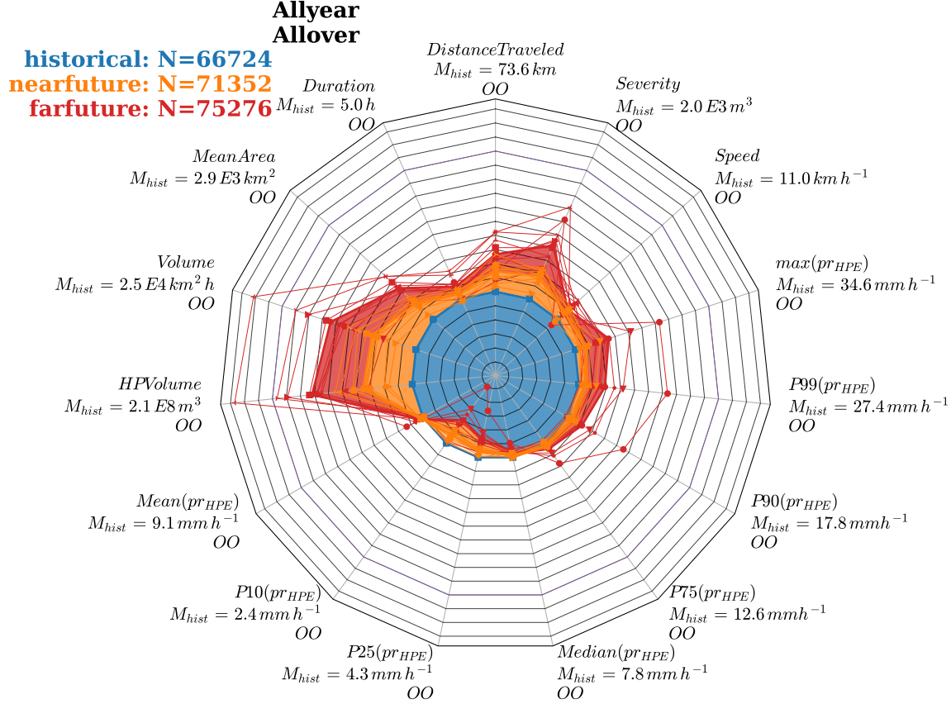

The Climate Change Response of Heavy Precipitation Events (HPEs)
over the Alps and in the Mediterranean
Sebastian K. Müller, et al.
Results:
→ HPEs are more frequent in a
warmer climate, but not in summer
→ HPEs propagate faster and farther,
are longer-lasting and greater in surface area
→ HPE precipitation volume, intensity
and Severity increase
_x0001_Response differentiated for
seasons, regions and categories:
→ Landfalling orographically forced HPEs in fall
are most severe, intense and heavy
+ they show the strongest climate change response
→ Southern Italy is the region most affected
→ in regions north of the Alps HPE occurrence
frequency doubles in wintertime
→ the stronger the climate warming, the stronger is the response of HPE properties
Changes of HPE-properties w.r.t. historical period [%]:

Slide 10
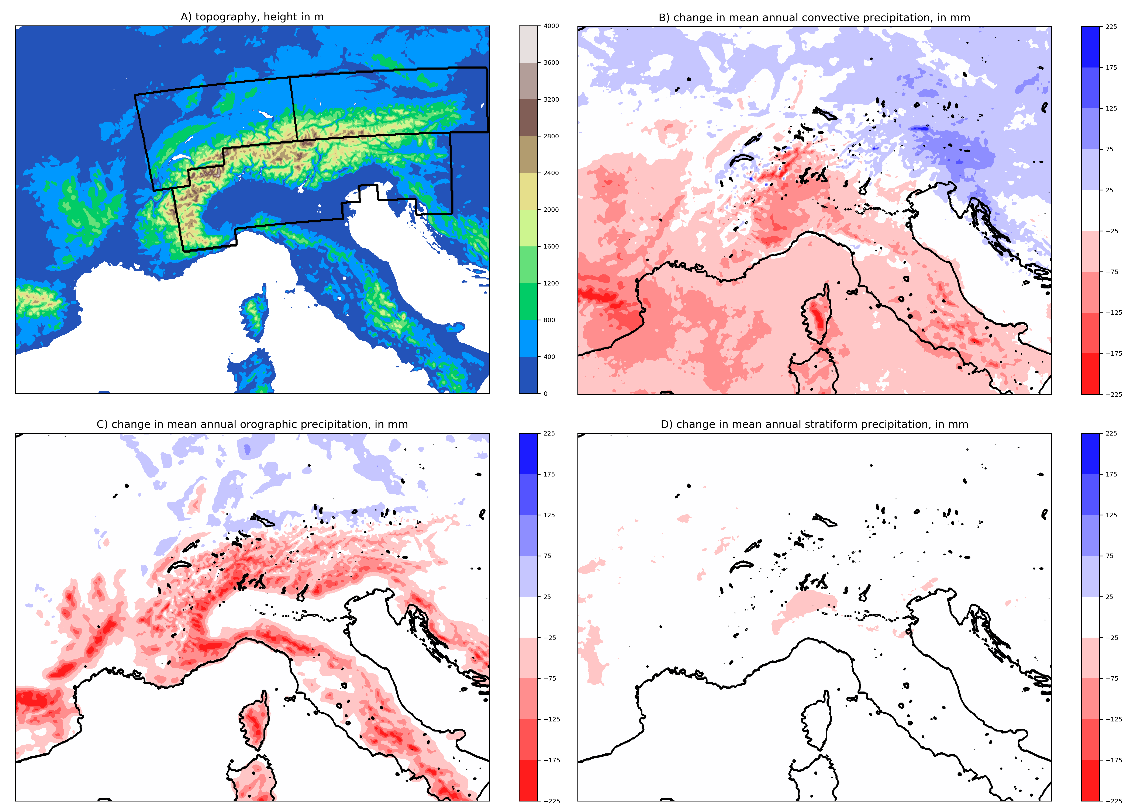
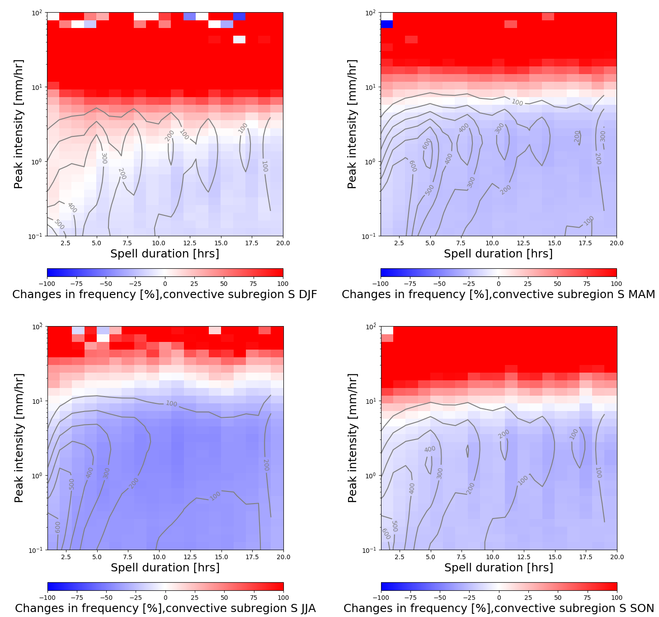
Despite strong overall drying, convective extremes increase significantly across the Alpine region
DJF
MAM
CONV
JJA
SON
ORO
STRAT
Seasonal IDF changes in convective precipitation fover the southern Alps (n.b. patterns are the same for other Alpine regions)
Mean annual changes in convective (top right), orographic (bottom left) and stratiform (bottom right) precipitation
Sobolowski et al., in-prep
Notes:
Using a physically-based algorithm to separate precipitation types we show that, despite strong overall drying in the greater Alpine region (most pronounced in the summer months), there are singificant increasess in convective extremes (intensity, duration, frequency). Although present in all seasons this shift is most pronounced in the summer -> fall months. We surther show that the largests contributions, across all scales, to the total precipitation changes in the Apline region come from convective preciptation and not orographic or stratiform.

Slide 11
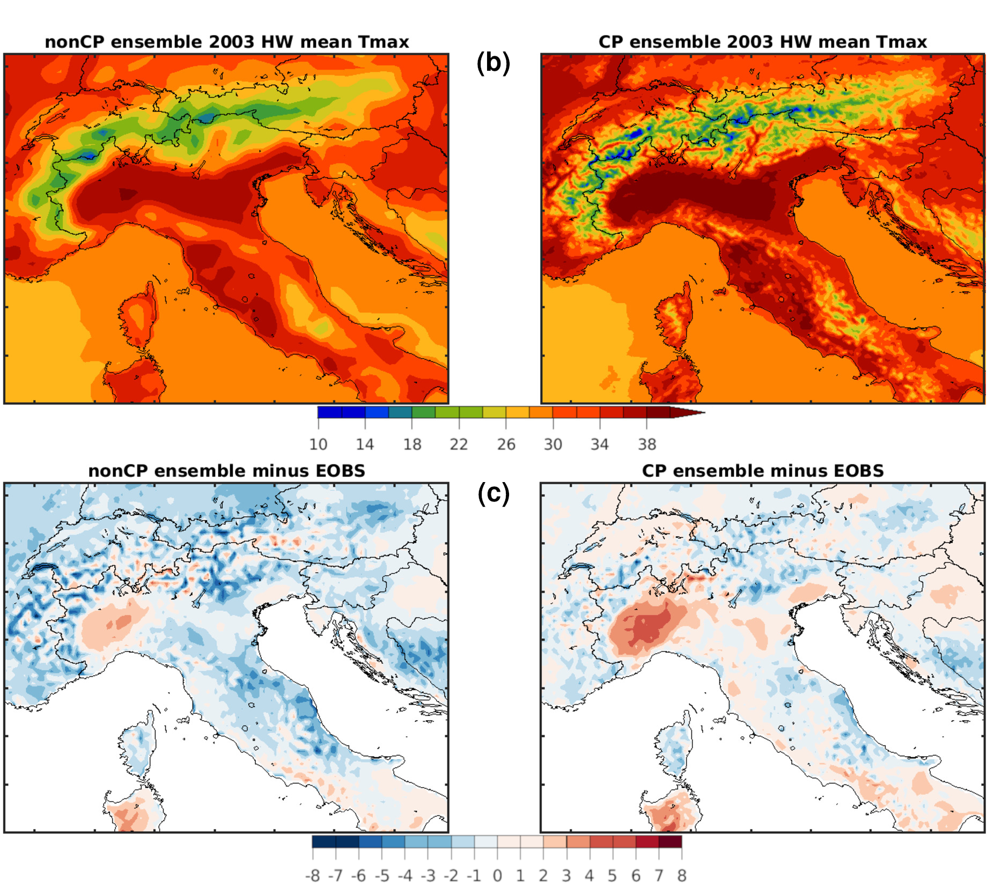
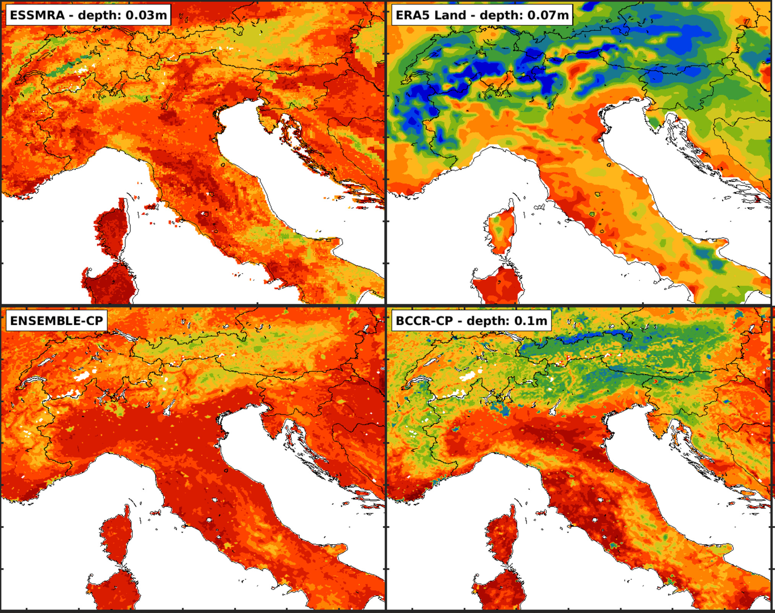
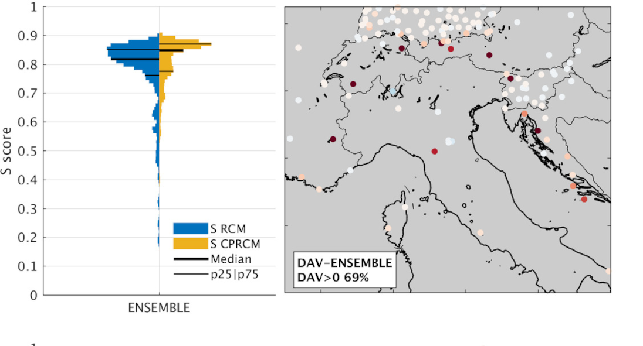
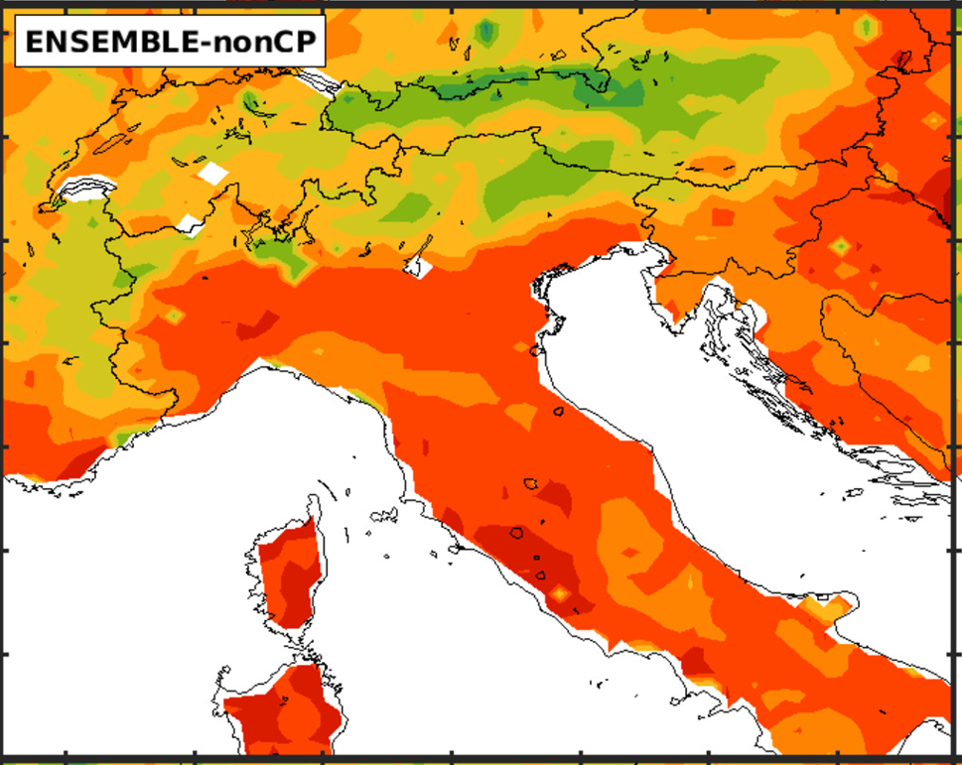
Heat waves are heavily modified by fine scale processes in the FPS ensemble
General considerations for all the HW metrics.
Heat waves systematically intensified at CP scale
Driven by drier soil conditions and higher latent heat fluxes
CP ensemble also exhibits longer dry spell lengths
This behavior appears to be more realistic, with caveats
Soil moisture is more accurately represented (near left)
Distributional Added Value is enhanced (far left)
Sangelantoni et al., submitted

Slide 12
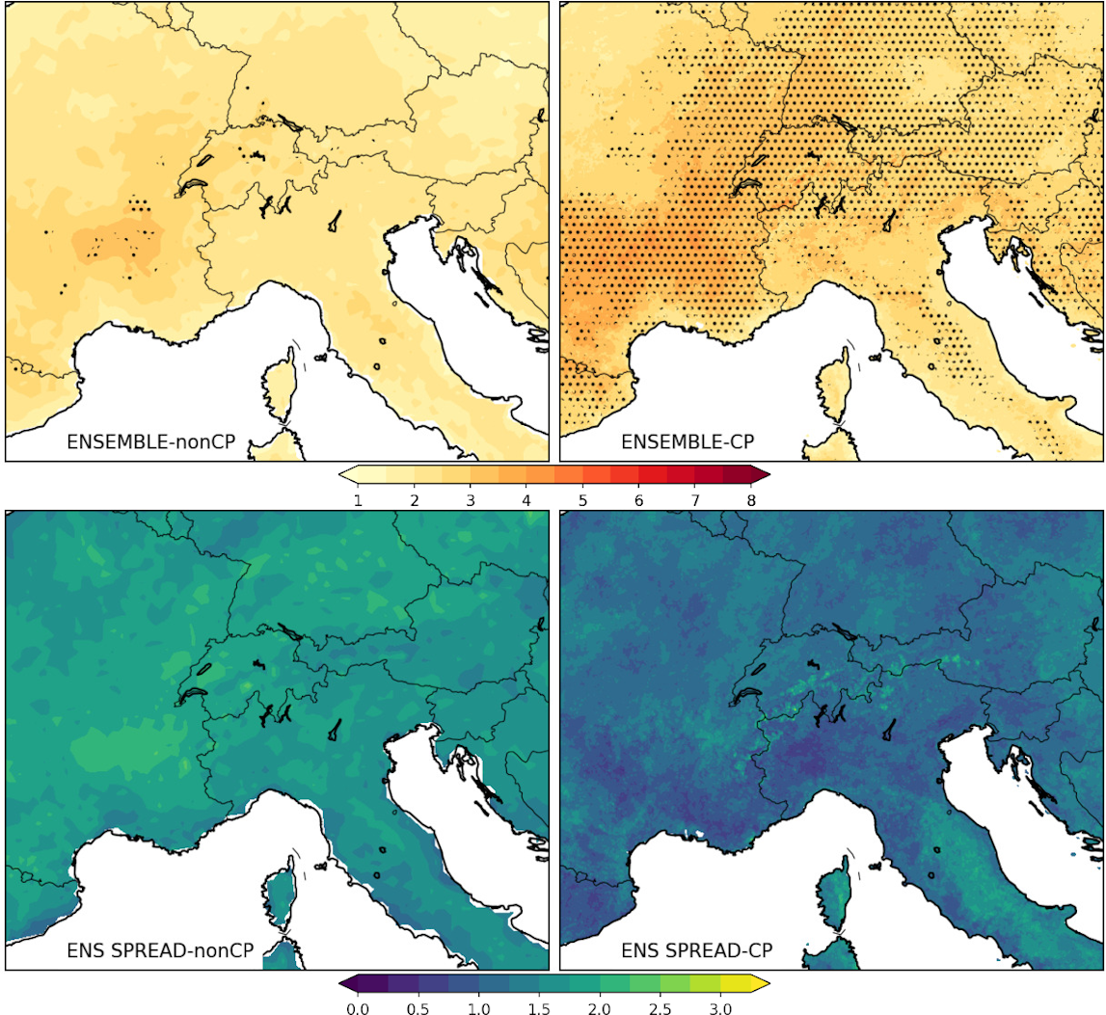
Future Heat Waves more intense and robust at CP-scale
Mean HWs mean temperature
Stipples: >= ¾ of models with statistically significant changes (t-test, alpha=0.05), Tebaldi et al., 2011
General considerations for all the HW metrics CCS.
CP ensemble tends to produce a larger CCS, spatially extending related inter-model agreement on statistically significant changes.
CP ensemble is also characterized by a lower CCS inter-model spread (ensemble CCS standard deviation).
Sangelantoni et al., in-prep

Slide 13
Take home messages
Hypothesis that uncertainty/spread is reduced at km scales seems to hold for many (but not all) phenonmena
  More comprehensive work is needed
Heat waves are strongly modified at km scales with severe implications for future change
  Better understanding of land-atmosphere coupling in these sims is needed
Not shown here but mean/median precipitation amounts are still heavily biased and we don’t really know why
  As a corrollorary: are we getting the right answers for the right reasons?

