Slide 1






VI Convection-Permitting Climate Modeling Workshop
September 7-9 2022, Buenos Aires
Predictability of a supercell using convection-permitting ensemble simulations in Argentina
Milagros Alvarez Imaz, Paola Salio,
María Eugenia Dillon, Lluís Fita and Diego Saúl Carrió Carrió

Slide 2
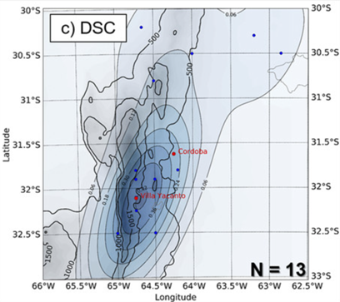
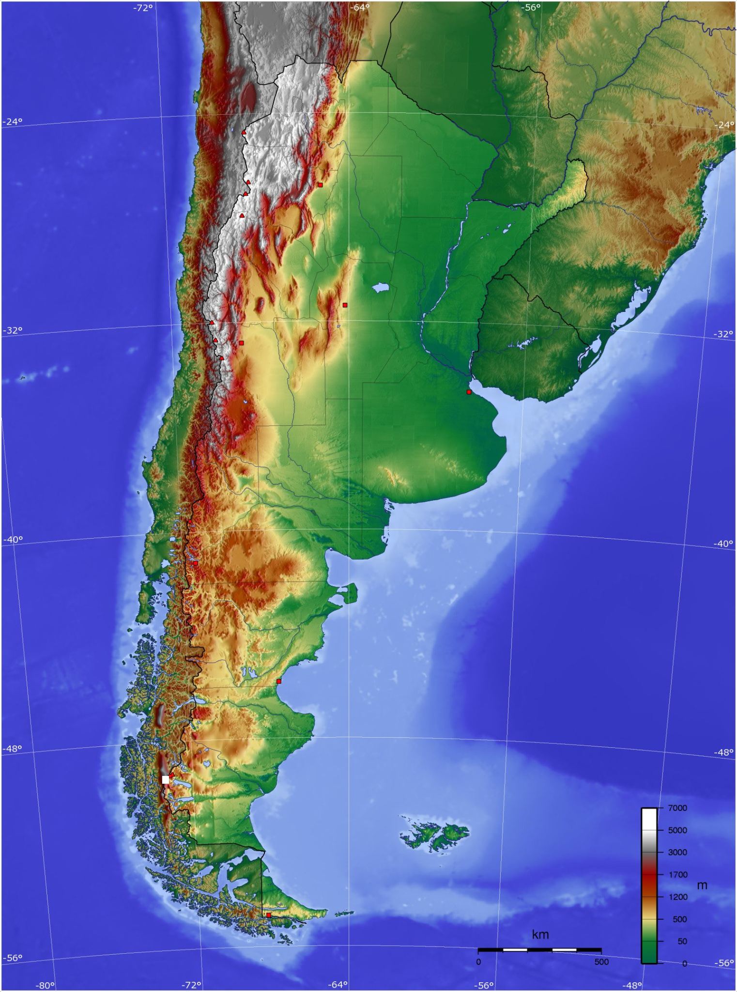
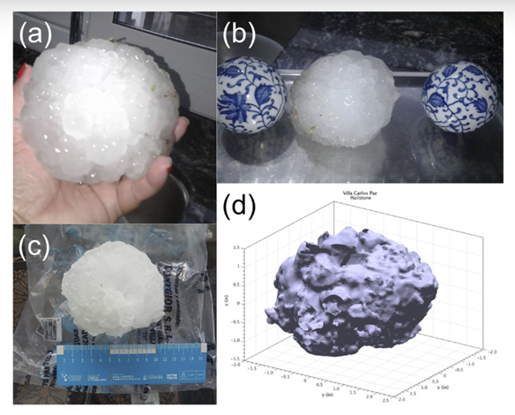
Motivation
Spatial distribution of supercell initiations identified with Cordoba radar data (Mulholland et al., 2018).
Kumjian et al., 2020

Slide 3
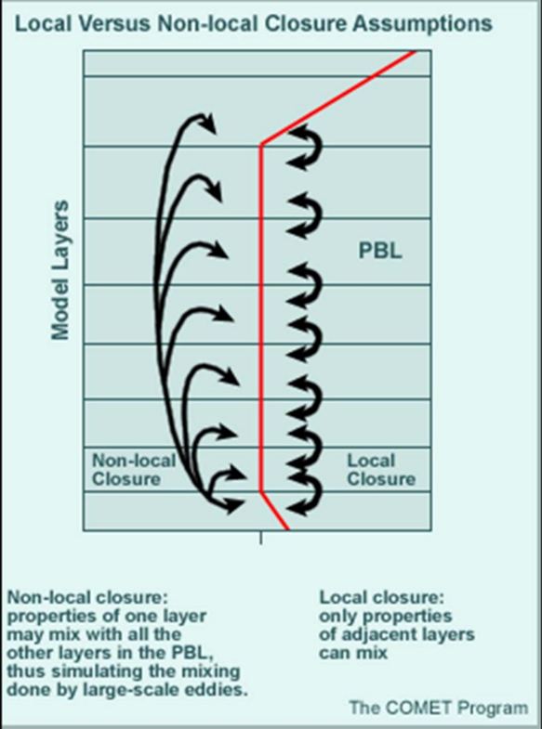
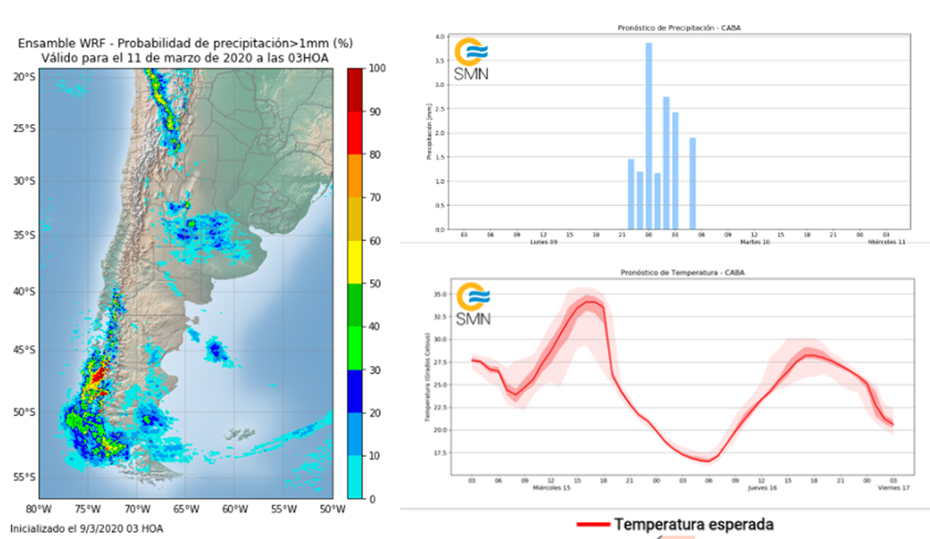
Motivation
Microphysics (MP)
Planetary Boundary Layer (PBL)
No-local
Local
The National Meteorological Service of Argentina runs a 20-member operative ensemble initialized with the GFS/GEFS
(Dillon et al., 2020).

Slide 4
Objective
To study the predictability of the environment, CI and supercell organization of a case study using GEFS and ECMWF ensemble forecasts as initial and boundary conditions.

Slide 5
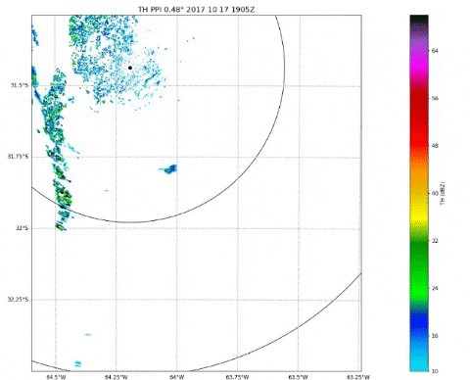
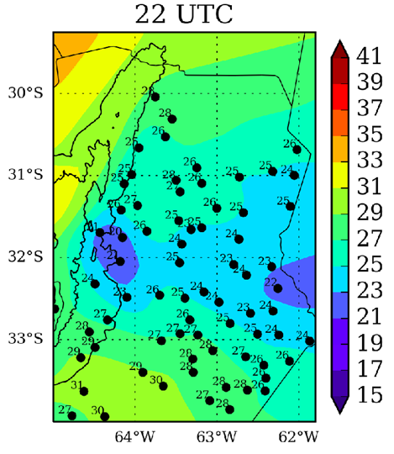
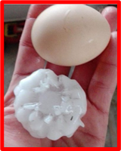
Case of study - Supercell convective initiation (CI)
Córdoba radar - RMA1 Surface Stations
CI → 17/10/2017 19:26 UTC
Supercell: two splittings
One severe report from social media
Cold pool detected with surface stations
Main mechanism → s urface warm front

Slide 6
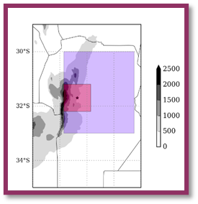
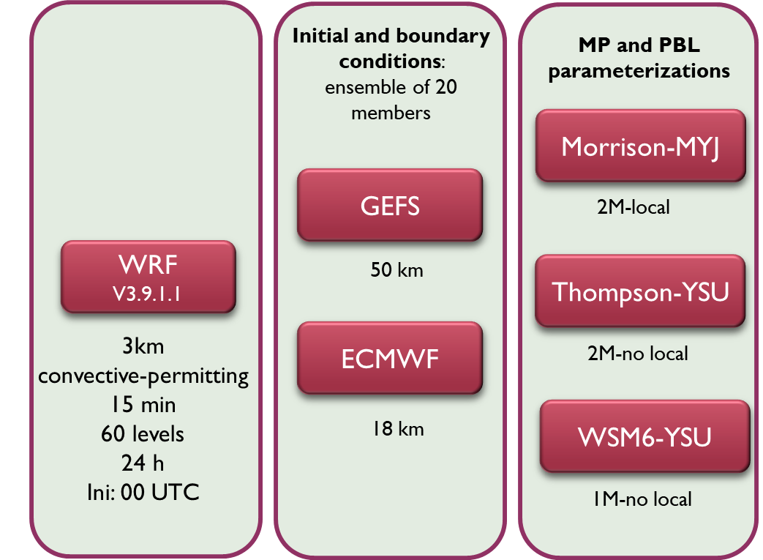
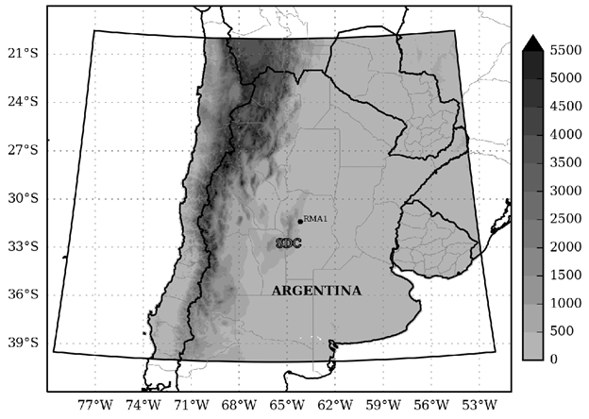
Experimental Set-Up
Lambert Conformal: 800 x 750 (WE x NS)
The selected parameterizations had a good performance for this case study in deterministic experiments (Alvarez Imaz et al., 2020).
EMM | ETY | EWY
GMM | GTY | GWY
Notes:
Tabla 4.1

Slide 7
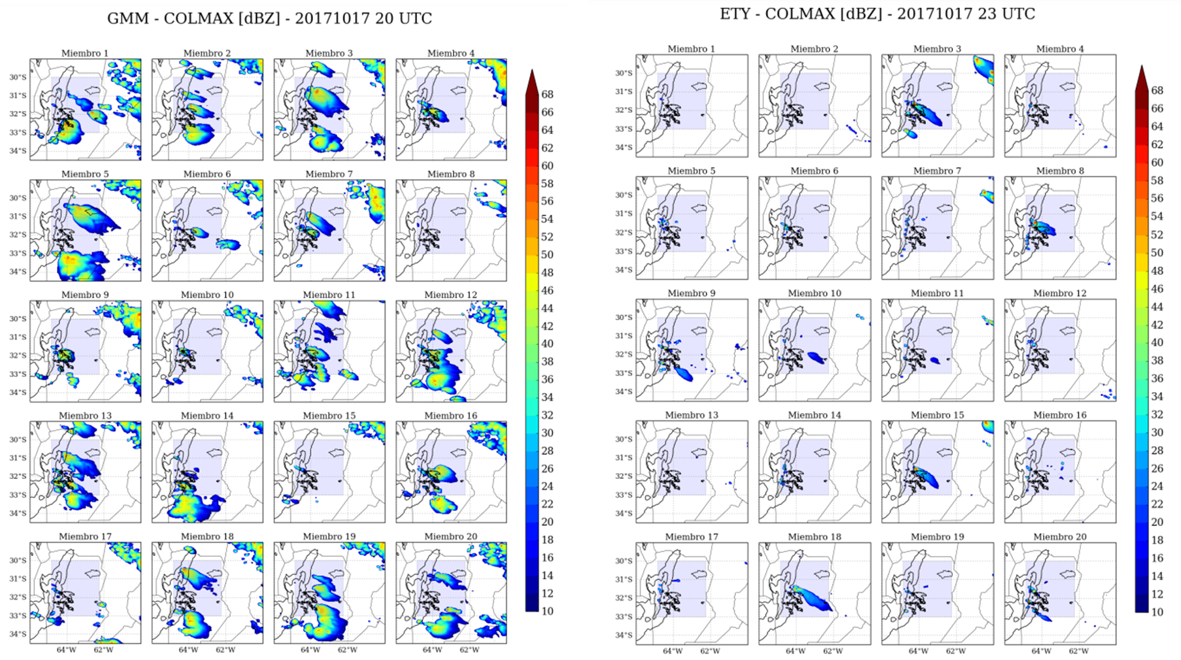

Slide 8
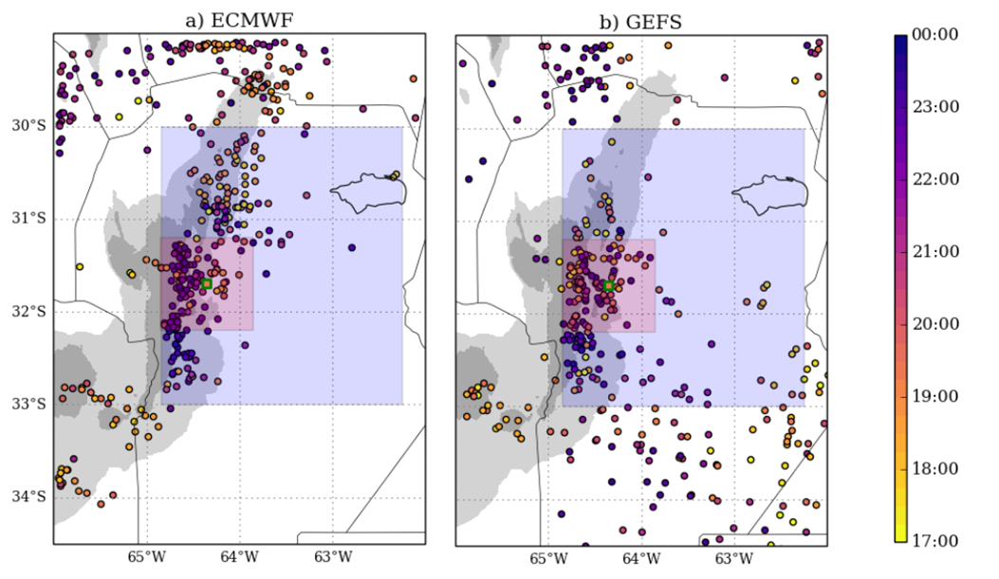
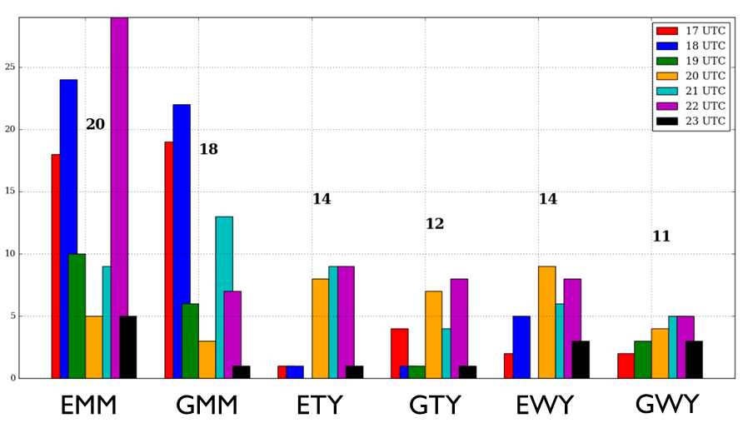
Results
MYJ CI in most members and before observation
YSU CI in less members than MYJ and after observation
Blue area
Based ond BAB3T algorithm of Cancelada et al., 2020
ECMWF CI over topography
GEFS CI over topography and plains
Notes:
Tabla 4.1

Slide 9
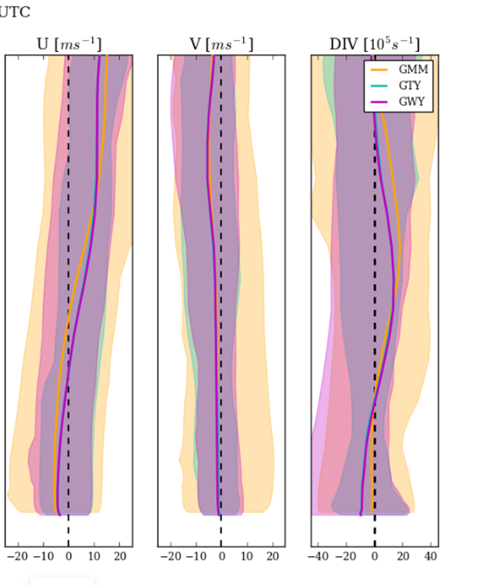
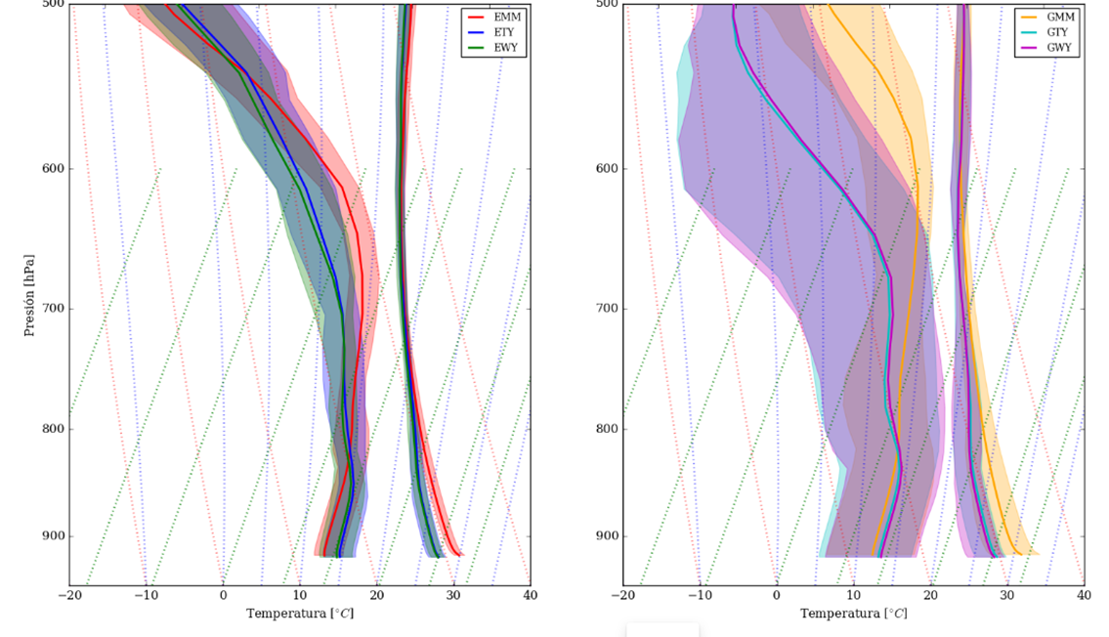
Results
Red area
Most difference in Td
High spread for GEFS ensembles
Convergence due to eastern wind
Notes:
Tabla 4.1

Slide 10
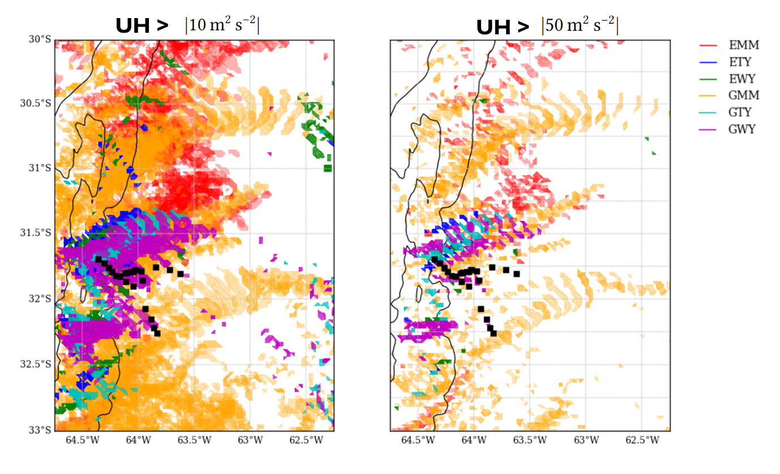
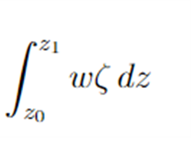
Results
Between 15 and 00 UTC
Updraft helicity (UH) between 2-5 km
High predictability of the supercell’s trajectory specially for YSU configurations
Notes:
Tabla 4.1

Slide 11
Summary
A large number of CIs were resolved in the topography for the ECMWF ensembles and in the topography and plains for the GEFS ensembles. As for the CI times, they were later than the observed time, with the exception of the Morrison-MYJ configuration where members resolved a large number of CIs prior to 19 UTC.
With some differences between the sets of simulations, the ensembles show a high predictability of the environment resolving high values of MUCAPE and low values of NCL to the east and over the SDCs, which favors the CI. The biggest challenge is at the local scale, where mesoscale circulations and small differences in the vertical profile of T and Td are determinant for CI in the region. Members with horizontal convergence at low levels due to a predominantly easterly wind and a moist and mixed T and Td profile are those that facilitated CI similar to the observation.
Regarding the study of the predictability of the supercell trajectory, the UH fields over time are a great tool to see the location and type of convective organization, indicating that in the area near the observation there is a high probability of CI of a supercell with propagation similar to the observed one.
Future studies
PBL parameterizations.
Visualization of ensemble products.
Notes:
In terms of organization, the high values of vertical wind shear between surface and 6 km and low values of SRH at low levels indicate the high probability of organized convection in supercellular mode.

Slide 12
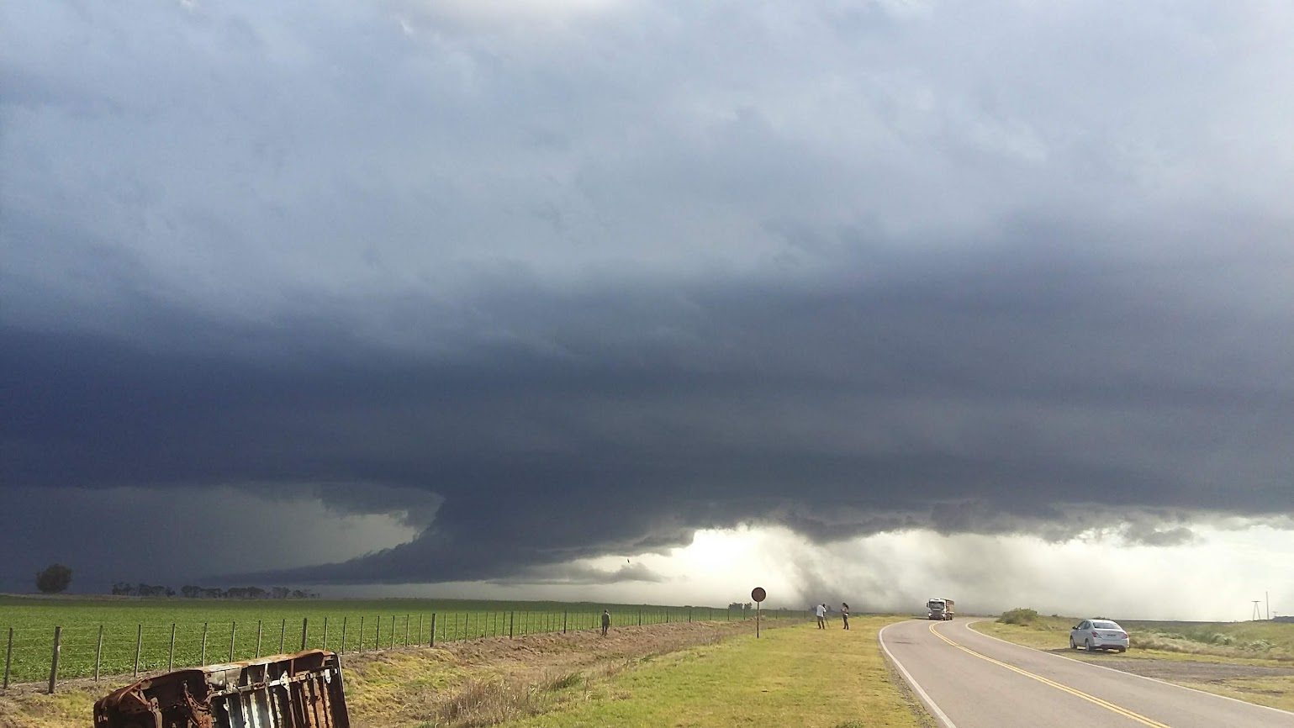
Thank you!
malvarezimaz@smn.gob.ar
Notes:
In terms of organization, the high values of vertical wind shear between surface and 6 km and low values of SRH at low levels indicate the high probability of organized convection in supercellular mode.

