Slide 1

Climate services in Southern South America: the Argentine National Meteorological Service Perspective
Lorena J. Ferreira
Directorate of Sectoral Services
National Meteorological Services Argentina
VI Convection-Permitting Climate Modeling Workshop
7-9 September 2022
C. A. Buenos Aires, Argentina

Slide 2















The Global Framework for Climate Services is a one of the major WMO-led international initiative launched in 2009
Health
DRR
Food
Security
Energy
Water
Achieving successful adaptation requires greater investment in climate services
Notes:
is a one of the major WMO-led international initiative launched in 2009.
Over 100 countries have designated representatives
10 international organizations are members of the Partners Advisory Committee
Implementation plan designed over 4 years by dozens of experts, backed by initial financing

Slide 3
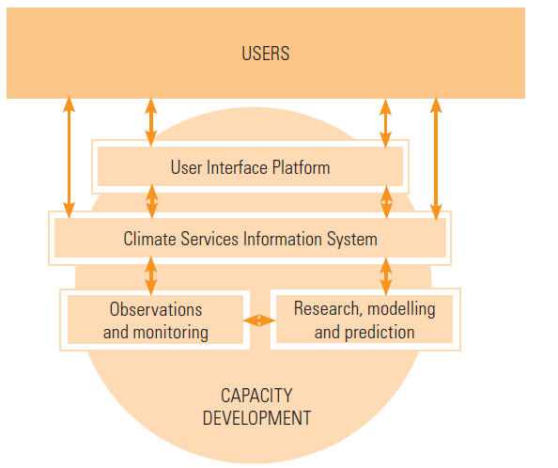


The WMO Strategy for Service Delivery and Its Implementation Plan
The Global Framework for climate Service
include five components

Slide 4
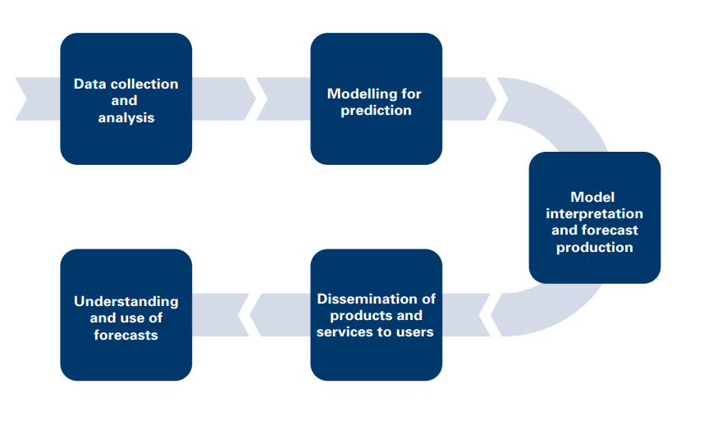
The WMO Strategy for Service Delivery
User engagement & developing partnerships
identifying users
understanding their needs
understanding the role of weather-, climate-, water and environment in different sectors.
Service design and development
the process, involving users, providers, suppliers and partners, of creating, designing and developing services and ensuring that user needs are met.
Delivery – producing, disseminating and communicating data, products and information (i.e., services) that are fit for purpose and relevant to user needs.
Evaluation and improvement – collecting user feedback and performance metrics to continuously evaluate and improve products and services.

Slide 6
To provide Climate Service at the NMS we use Weekly and Seasonal Outlooks |Statistical Forecast Model |Dynamic-Statistical Forecast Model |Dynamic Forecast Model |National/Regional and Global Domain |Temperature and Precipitation

Slide 7
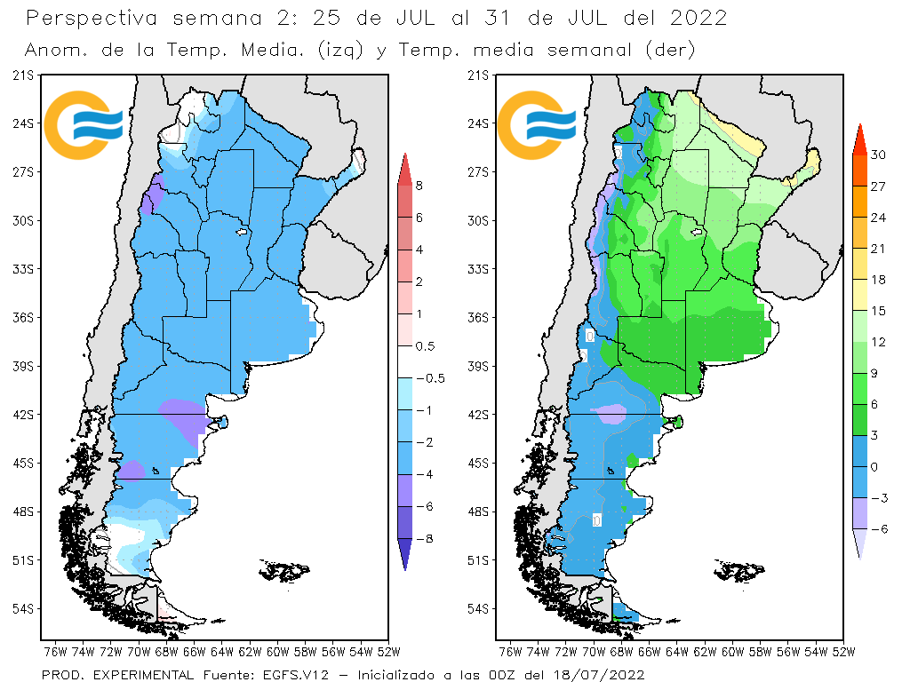
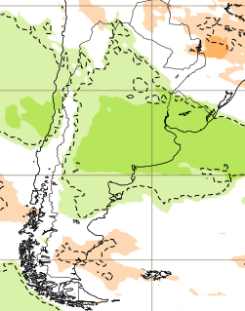
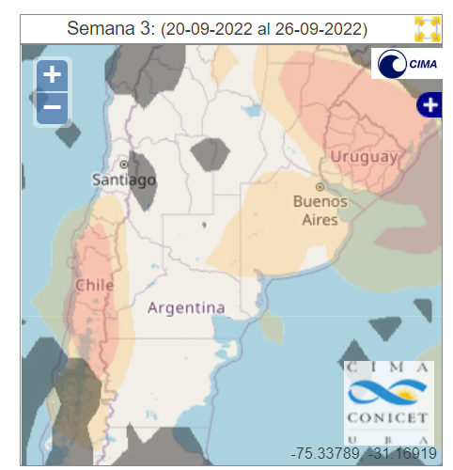
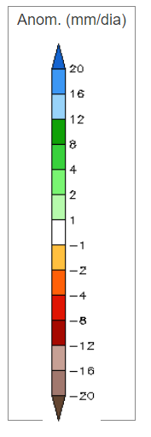
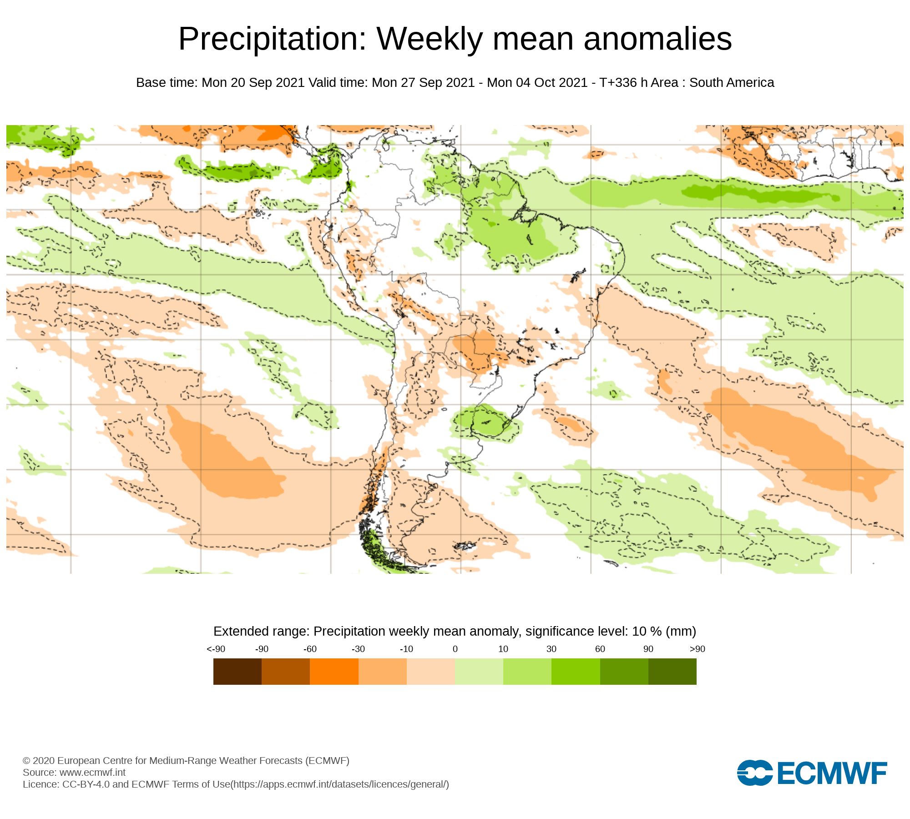
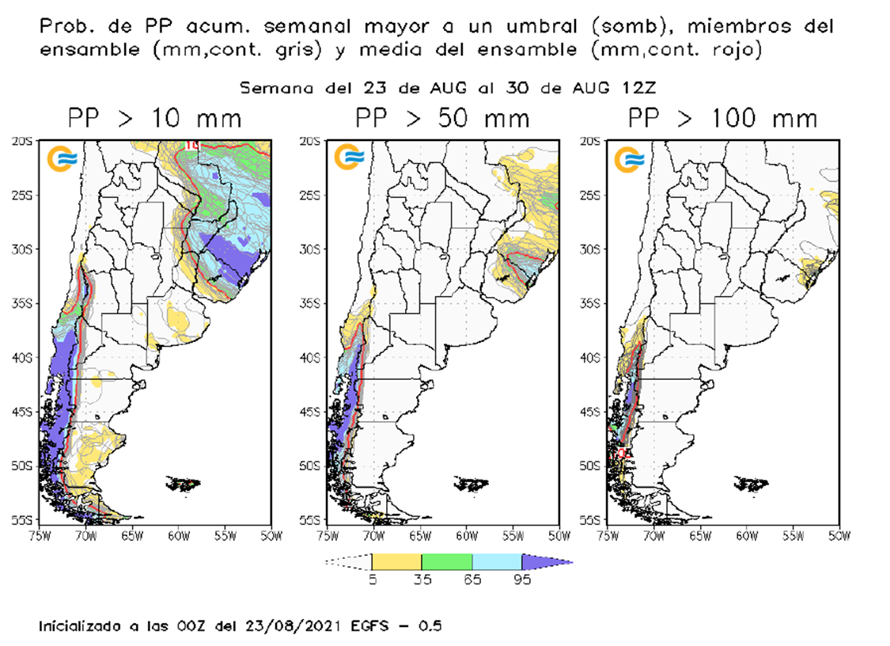
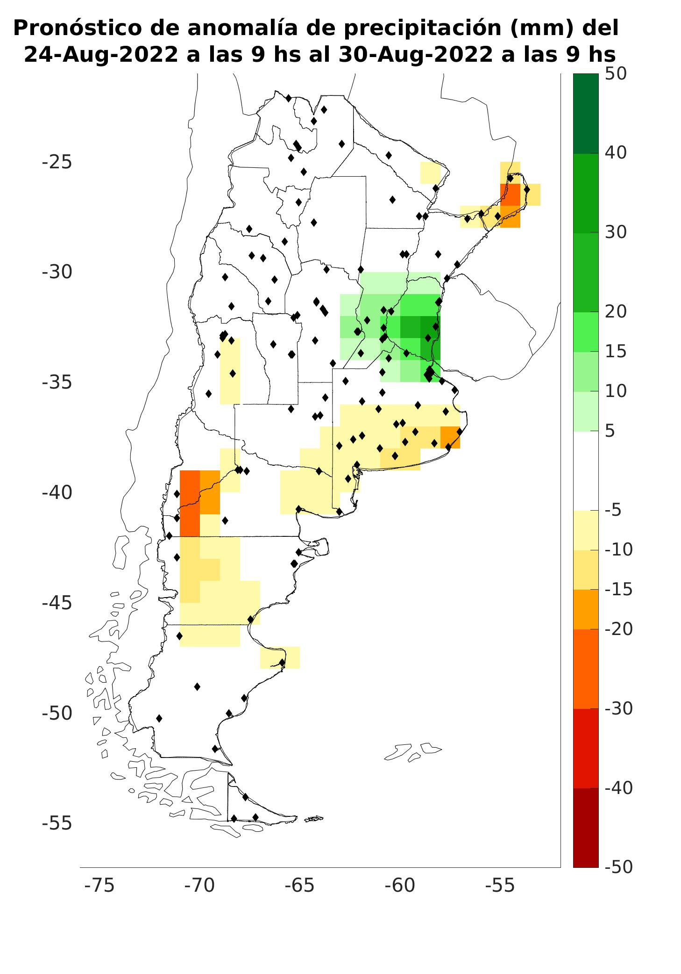
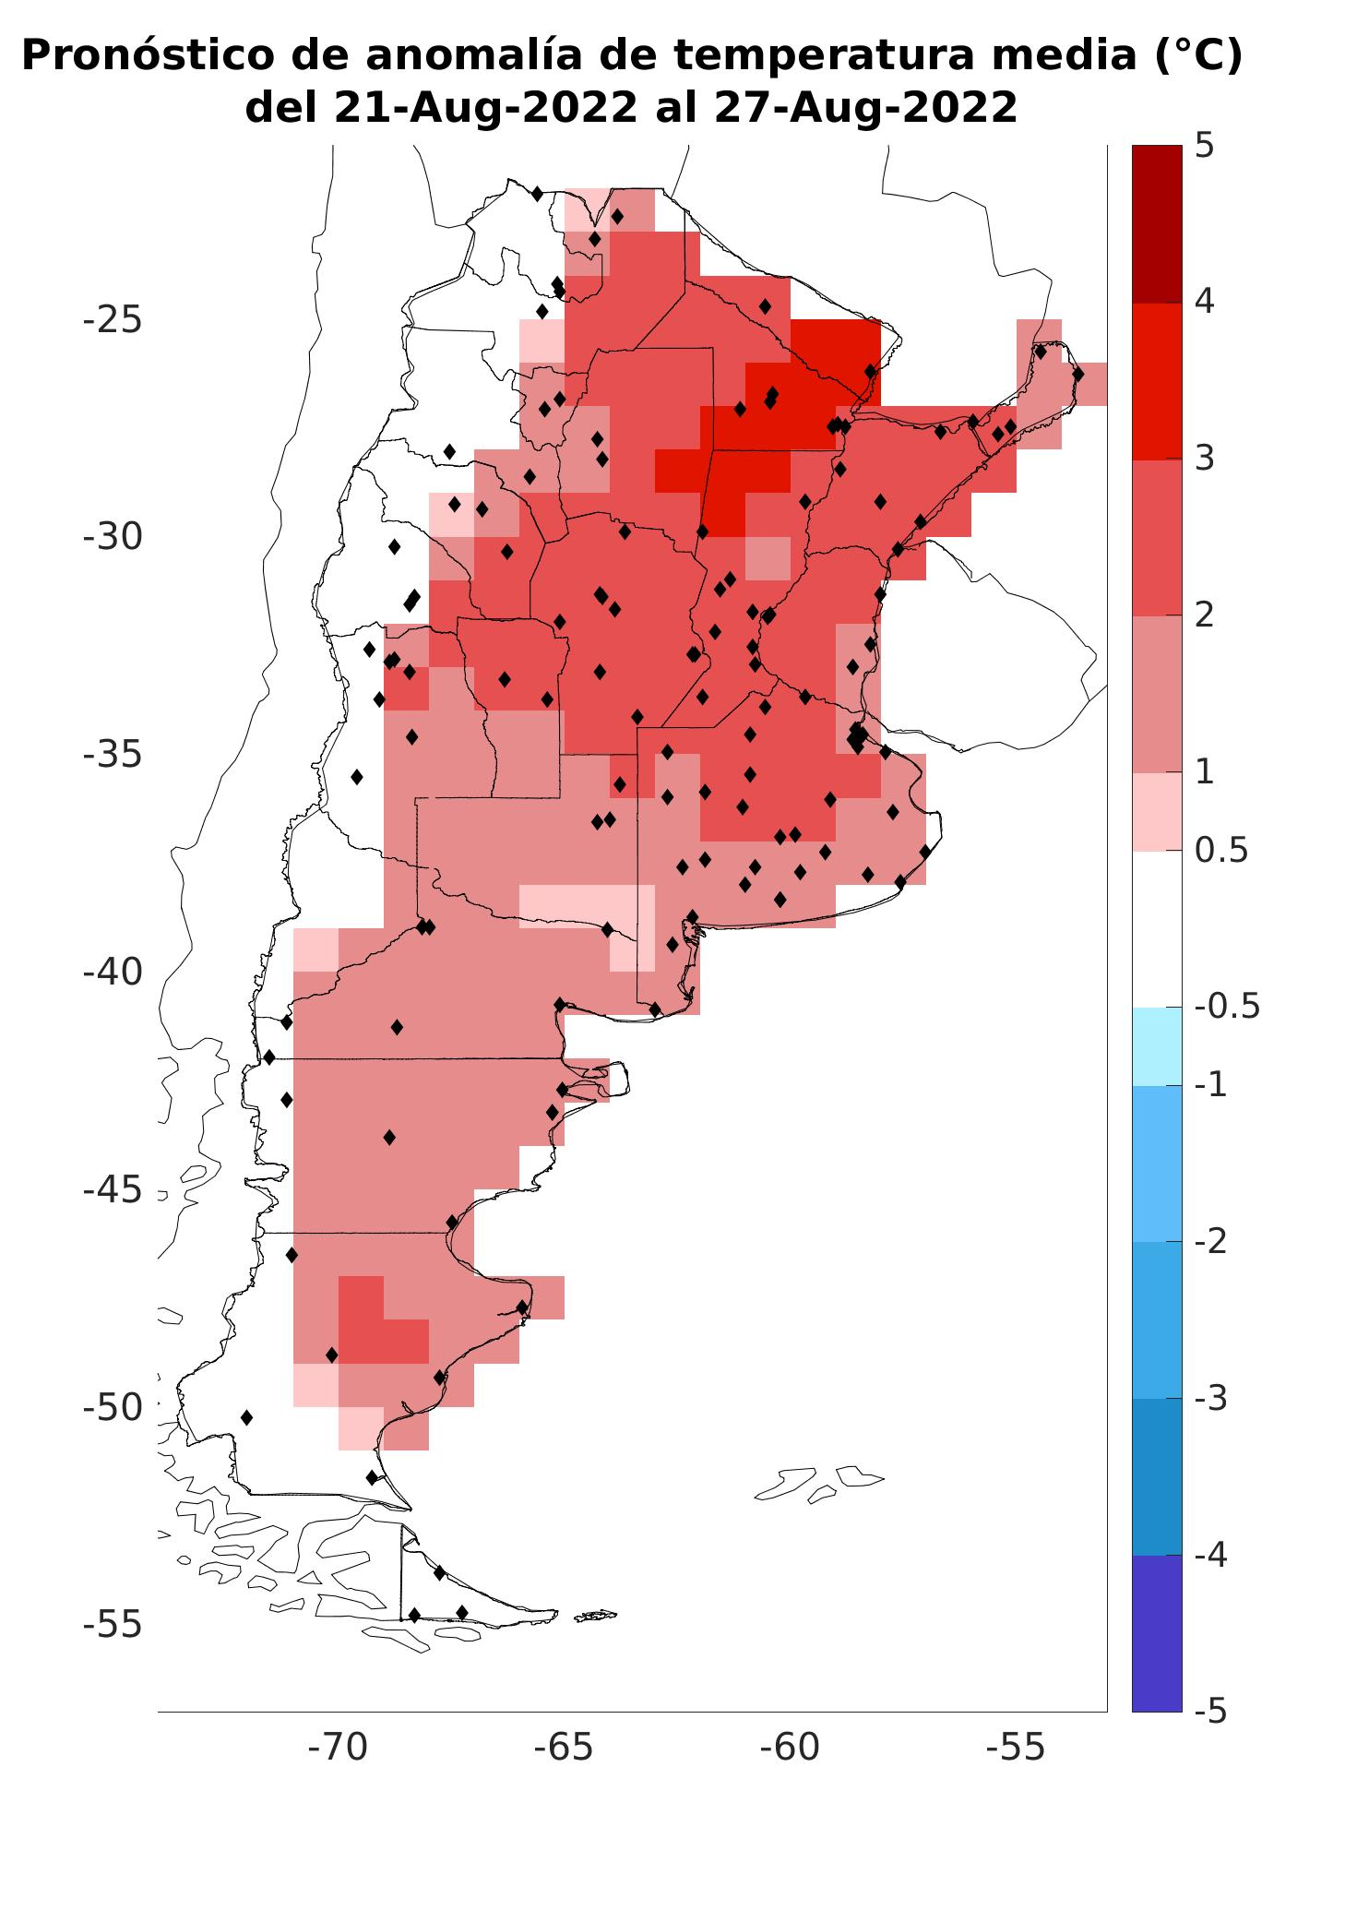
| WEEKLY OUTLOOKS
Anomalies
Week2 -Temp
Week2 -Precip
Week3 -Precip
Global weekly Forecasts
GEFS (Bias corrected)
CFS ( from CIMA webpage)
ECMWF (opencharts)
SUBX (IRI): SubSeasonal predict. eXperiment.
GEFS-BC-NMS
NOAA-NCEP-CFSv2
ECMWF
National weekly Forecasts
Analog technique
http://climar.cima.fcen.uba.ar/CFS
Weekly Precip -Temp. Anomalies
Probabilities (precip> threshold) Week 2
GEFS
https://www.smn.gob.ar/clima/perspectiva

Slide 8
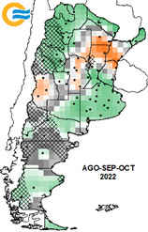
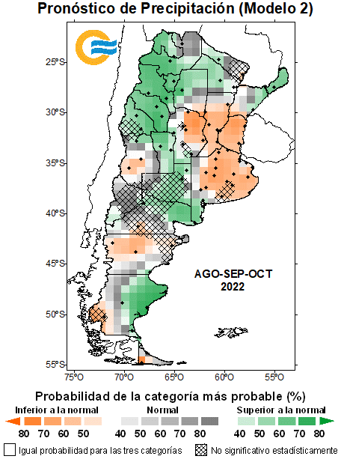
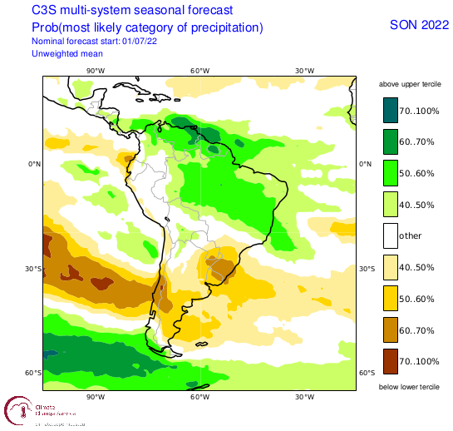
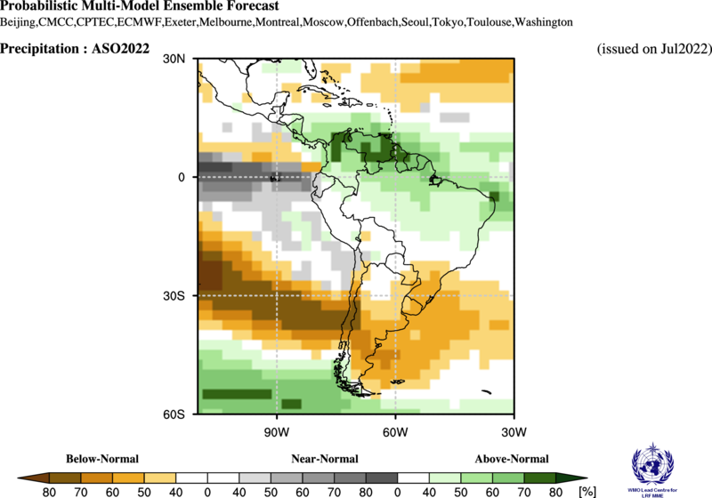
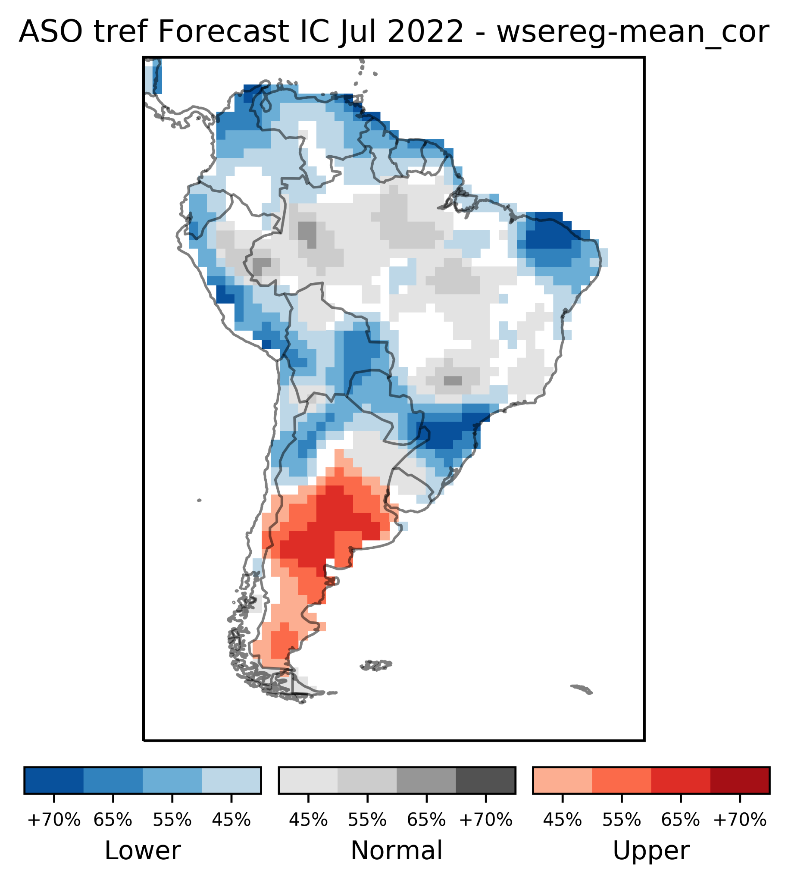

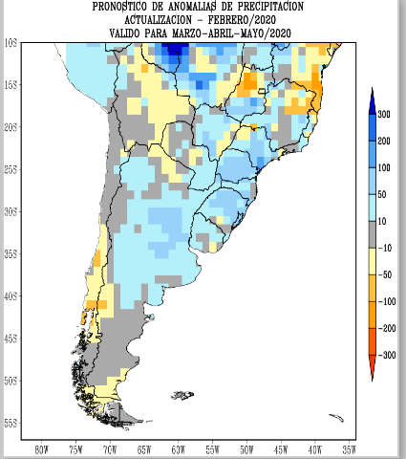
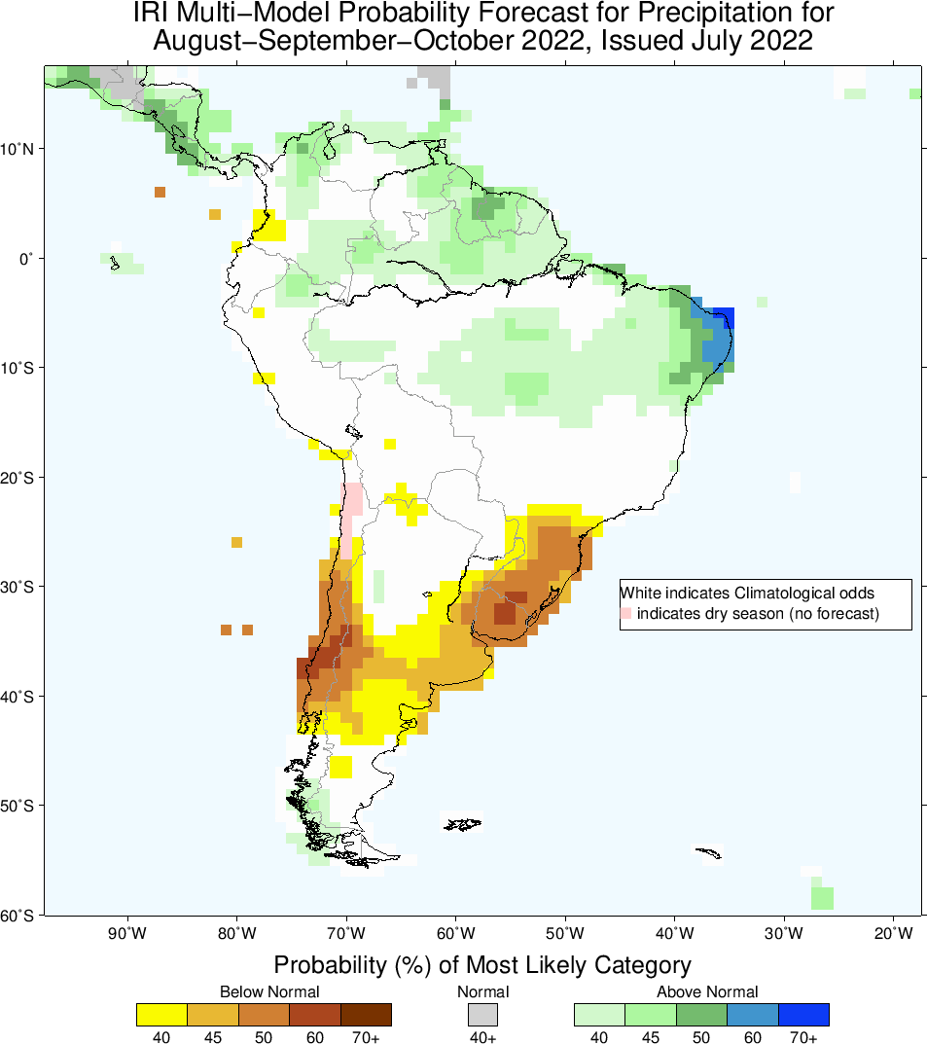
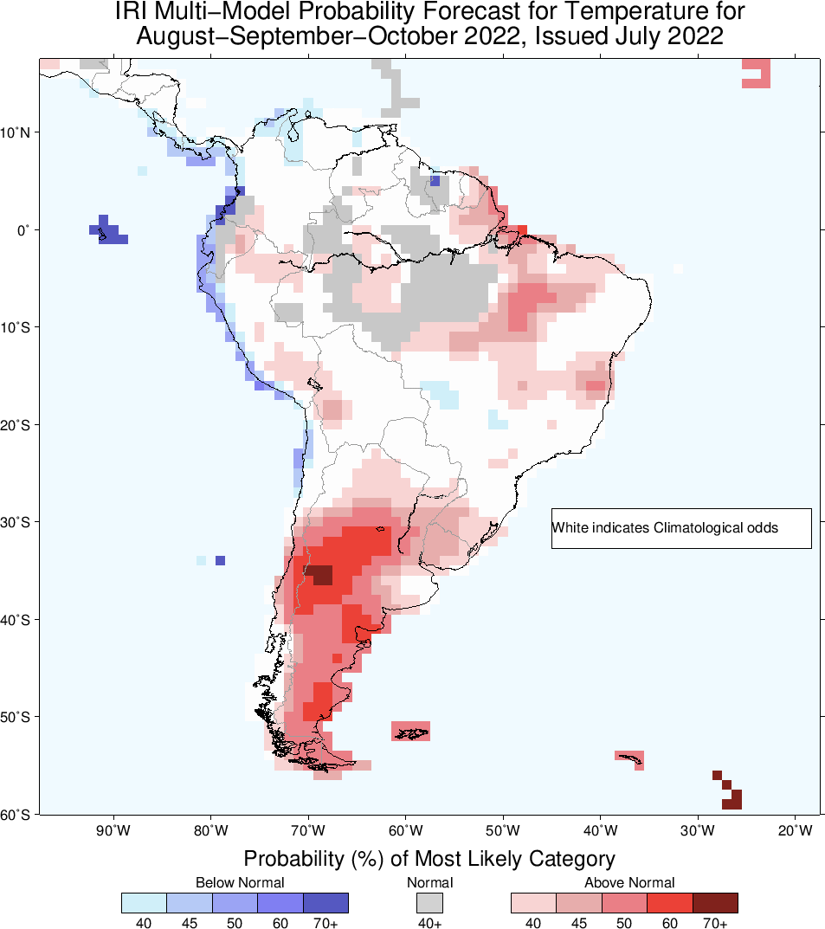
| SEASONAL OUTLOOKS
Global Ensemble Seasonal Forecasts
C3S - Copernicus
NMME-IRI
WMO
National/Regional Seasonal Forecasts
Eurobrisa/CPTEC-INPE
RRC-SAS (CPT)
CPT/CPT+NMME (NMS)
CLIMAX's multimodel Project
NMS(CPT+NMME)
NMS (CPT)
C3S
PP
PP
CLIMAX's multimodel Project
WMO
NMME-IRI
T
PP
Probability of most likely category of precipitation or temperature in the next 3 months.
RRC-SAS (CPT)

Slide 9
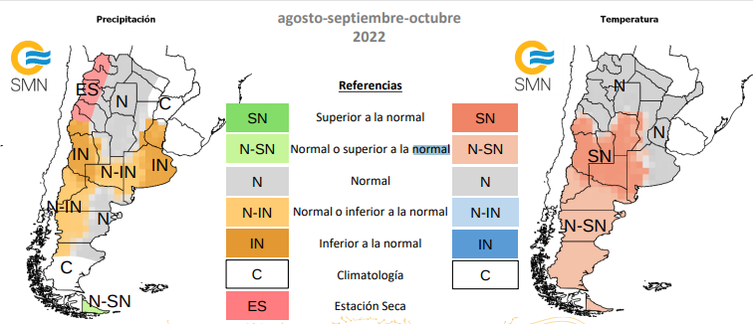
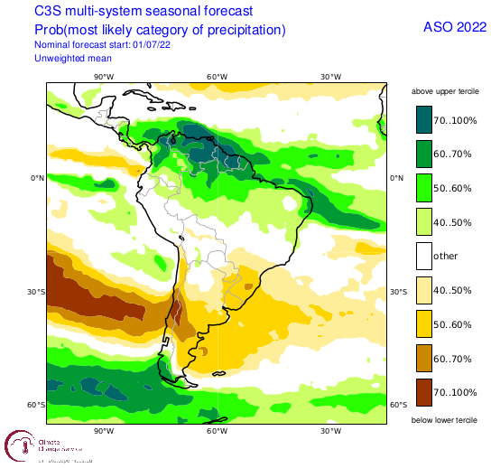
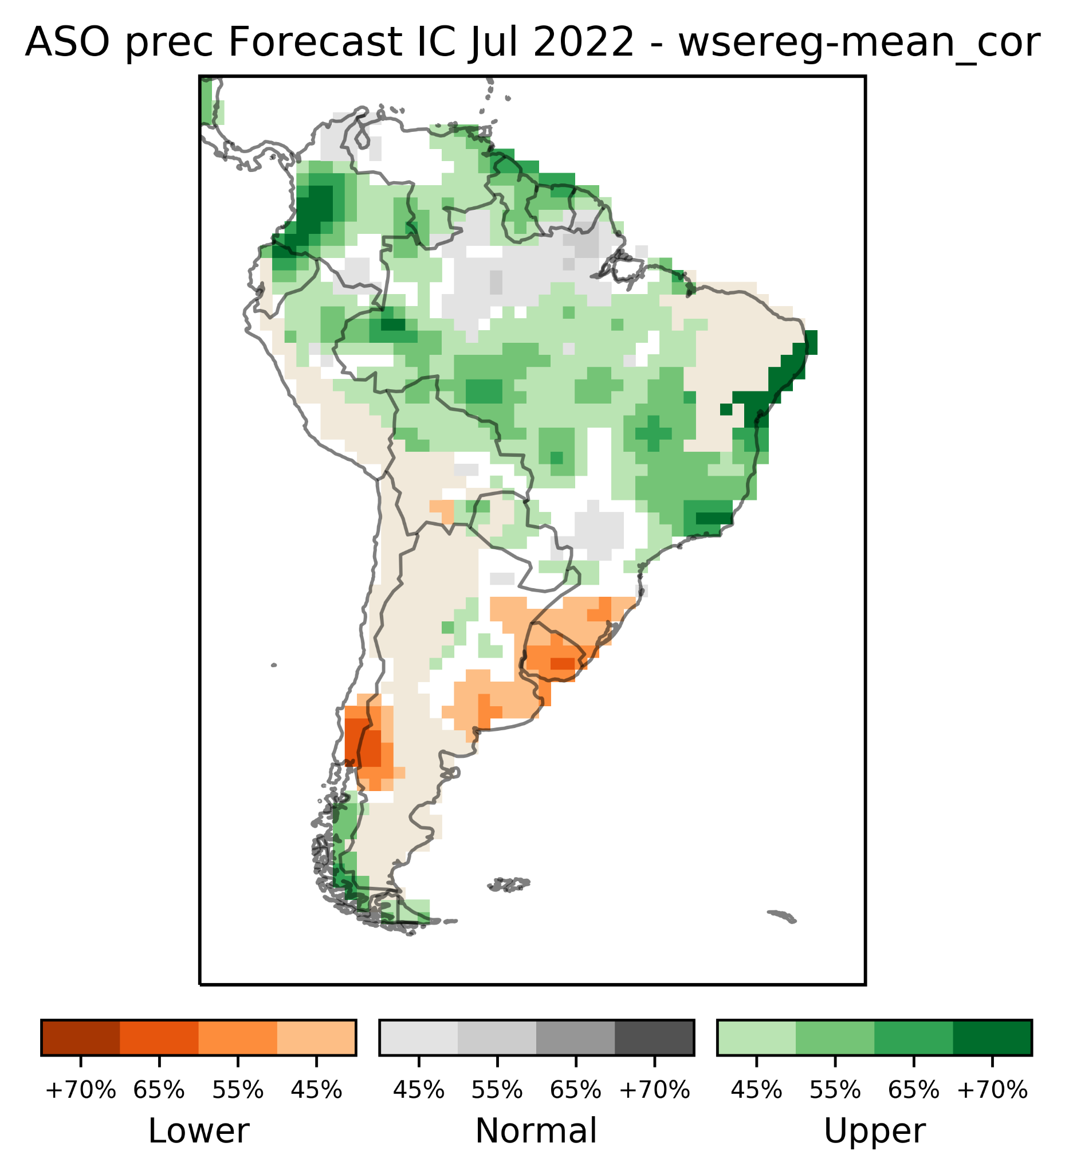
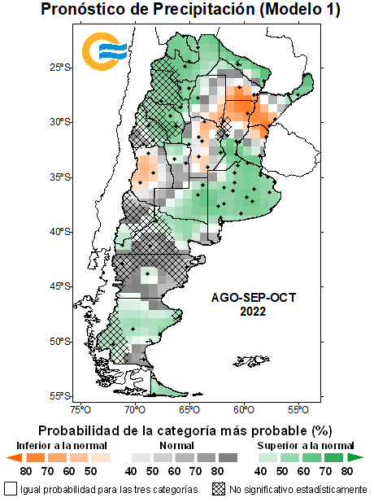
| CONSENSUS SEASONAL FORECAST FOR PRECIPITATION AND TEMPERATURE
August-September-October 2022
Precipitation
Temperature
The consensus seasonal forecast is made by climate experts(NMS and Researchers), on the basis of the analysis of the forecasts
of dynamic, statistical and dynamic-statistical models, added to the analysis
of the evolution of oceanic and atmospheric conditions.
References:
Above normal
Normal or above normal
Normal
Normal or below normal
Below normal
Climatology
Dry season

Slide 10
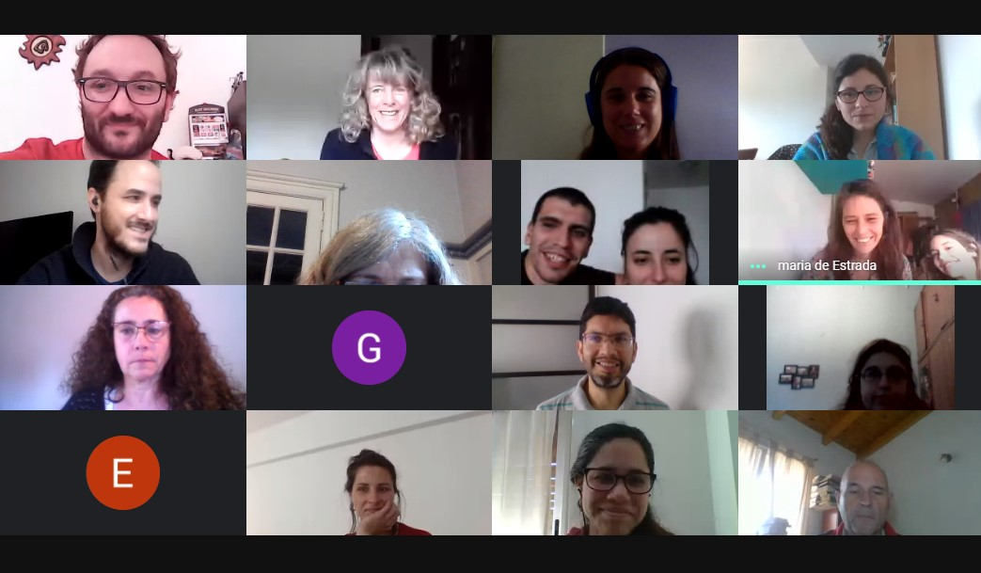
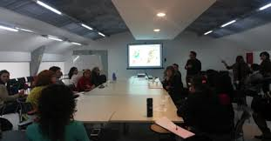

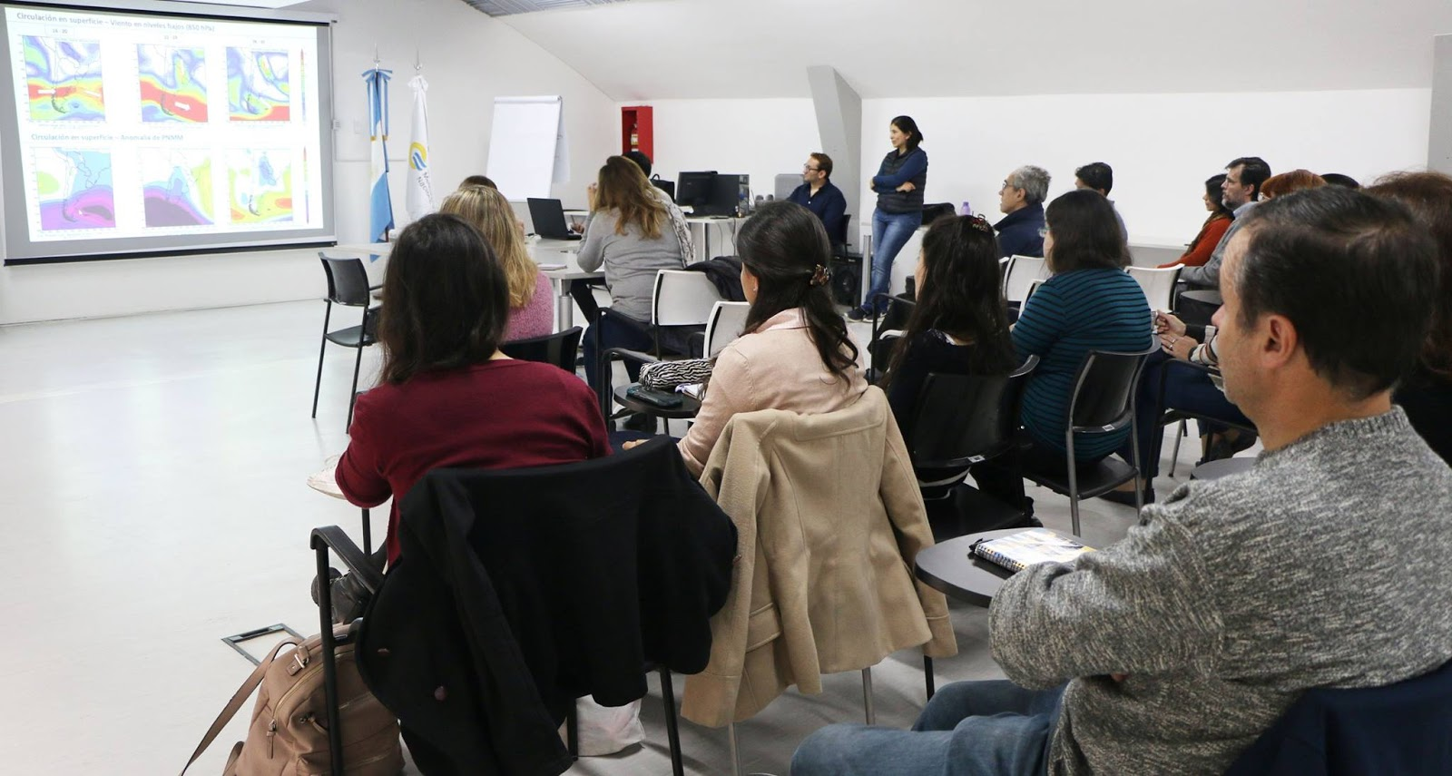
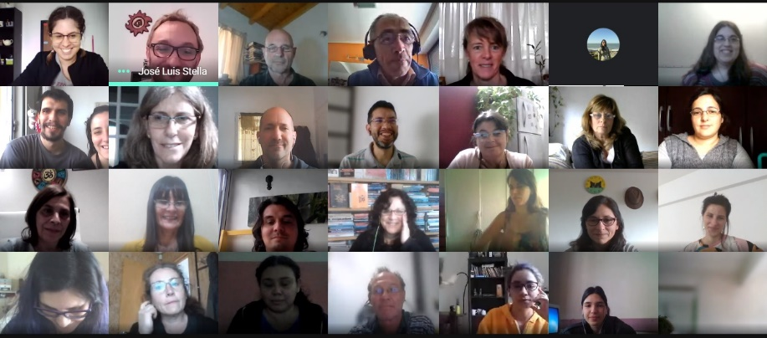


| THE PRESENTATION OF THE SEASONAL FORECAST CONSENSUS TEMPERATURE TO DIFFERENT USERS ( Technological – Academic-Research Institutes and government)

Slide 11

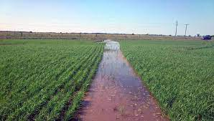
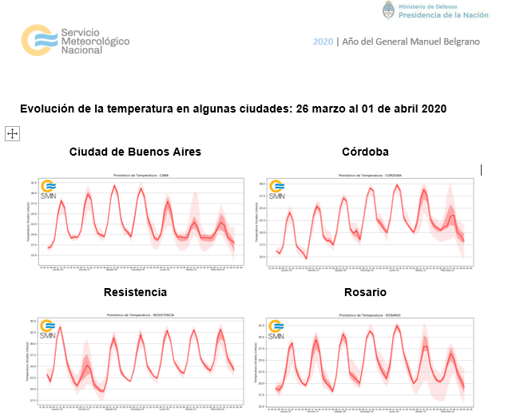
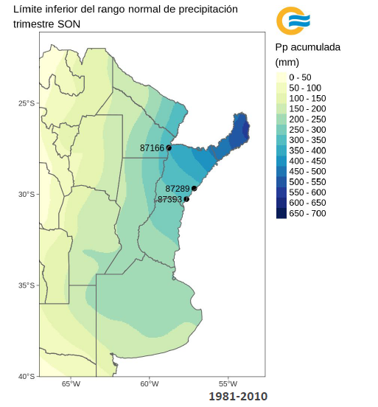
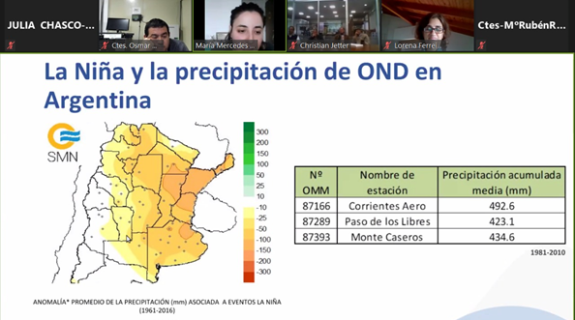
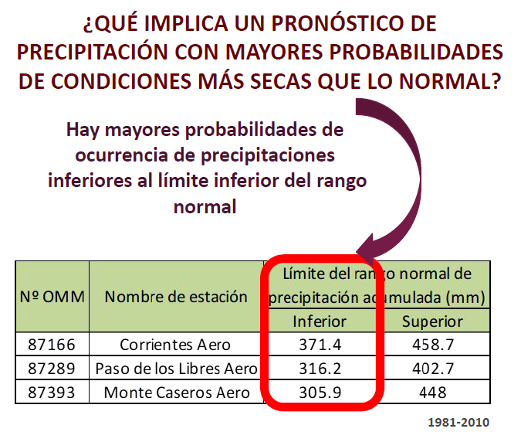
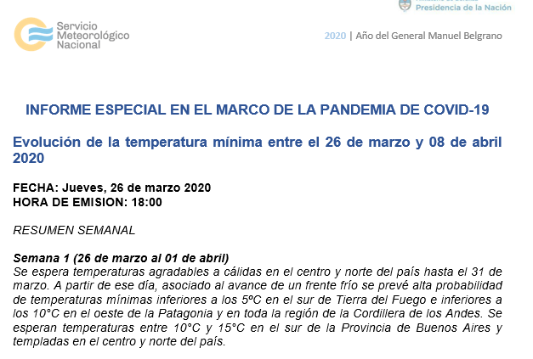
| SOME OF OUR USERS, NEEDS AND SERVICES
HEALTH SECTOR
Health Ministry request Weekly Reports with the Temperature Perspective during COVID-19
AGRICULTURE SECTOR
Rice Farmers associations From Corrientes request the 3-month precipitation climate perspective to discuss the water management
CPT
CONSENSUS

Slide 12
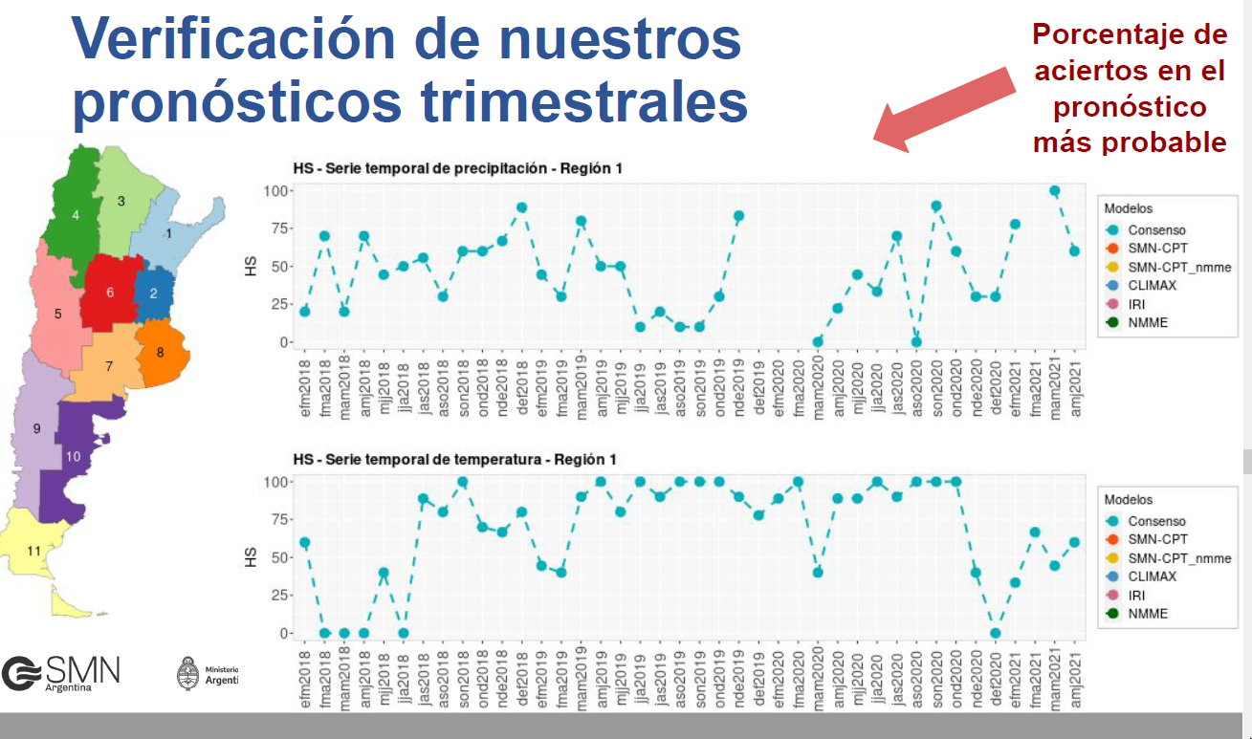
Verificación of Seasonal Consensus
% Hits

Slide 13

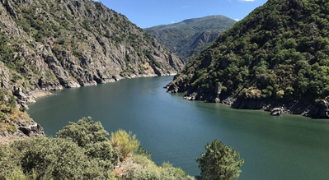

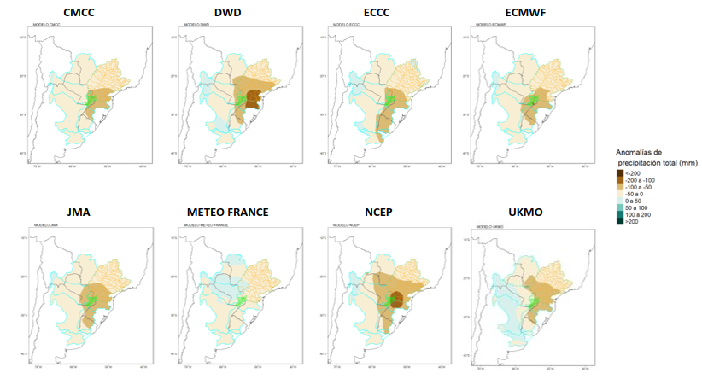
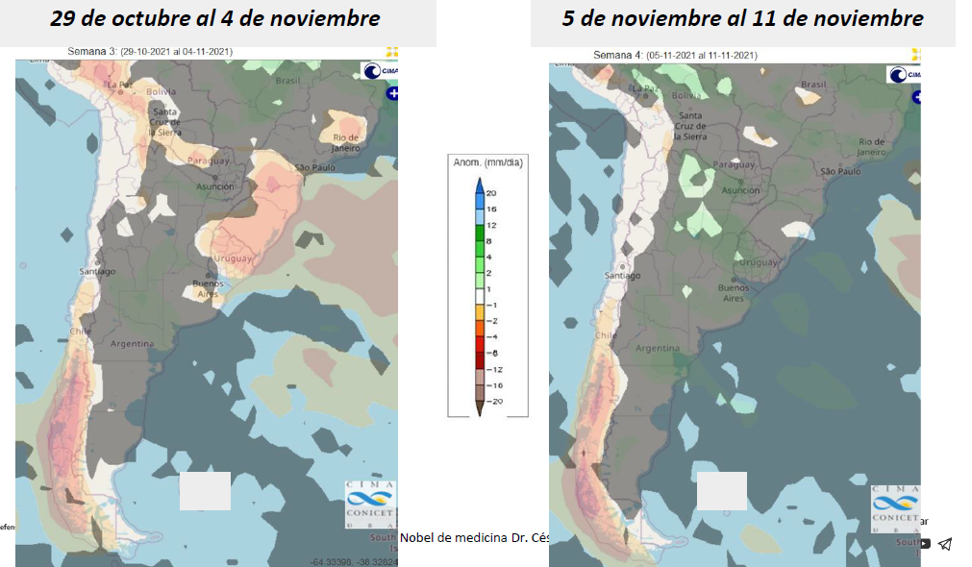
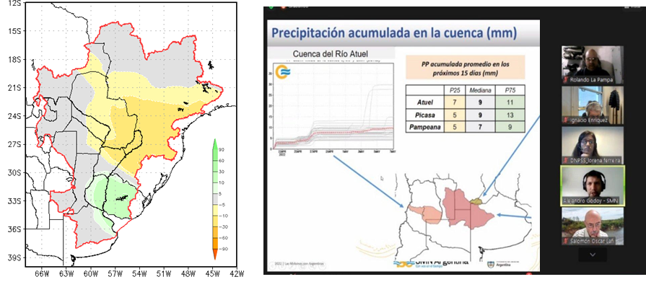
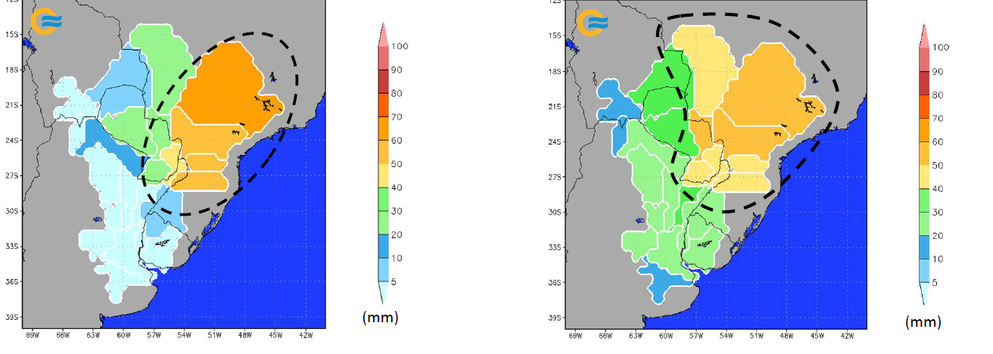
| SOME OF OUR USERS, NEEDS AND SERVICES
3 monthTotal precipitation anomaly
WATER RESOURCES SECTORS
Monthly meetings with the Federal water council and hydroelectric authorities
Weekly Precipitation perspective (w1 to w4)
3 month precipitations perspective
Adapted to the basin domain
Week 3 CFS
Week 4 CFS
Week1 EGFS
Week 2 EGFS
Basin weekly areal Precipitation

Slide 14

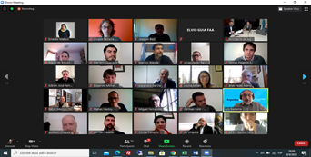
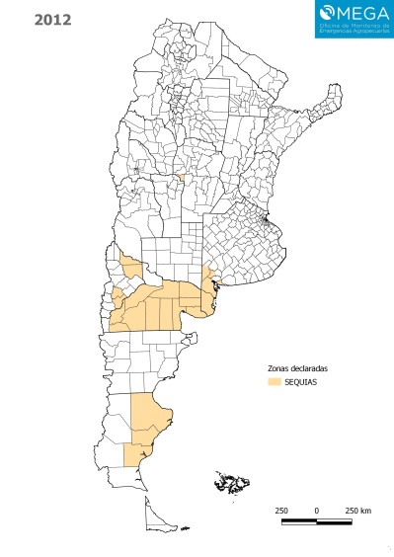
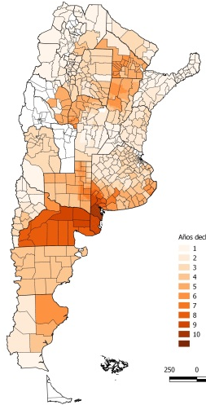
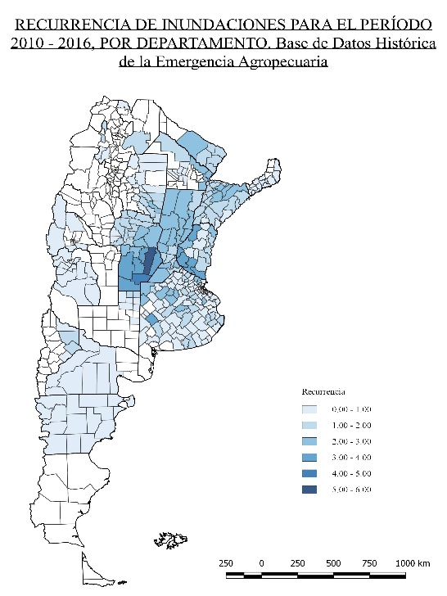
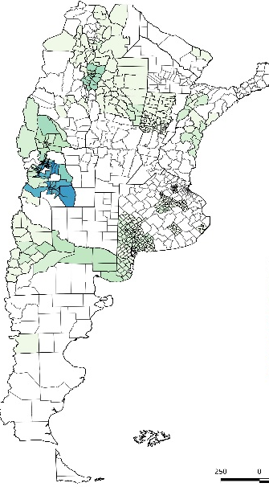
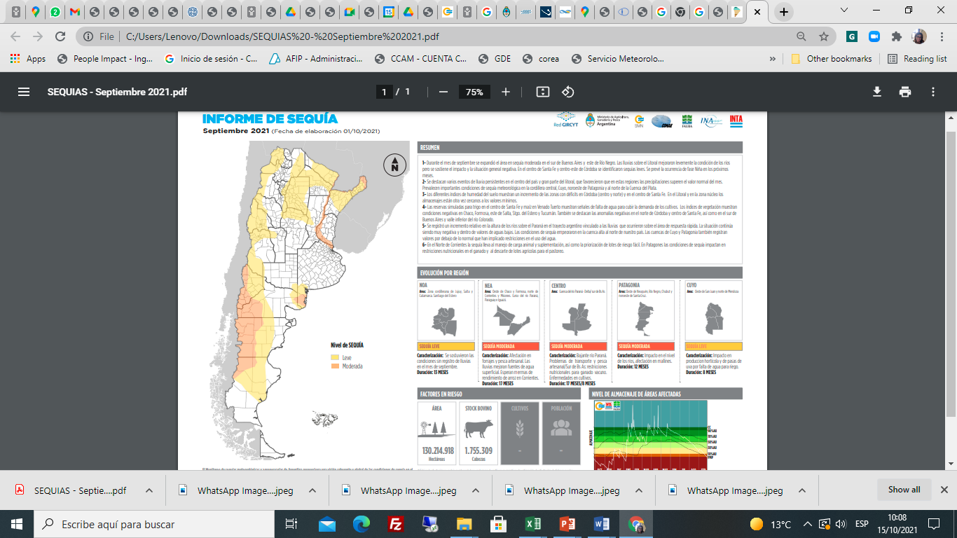

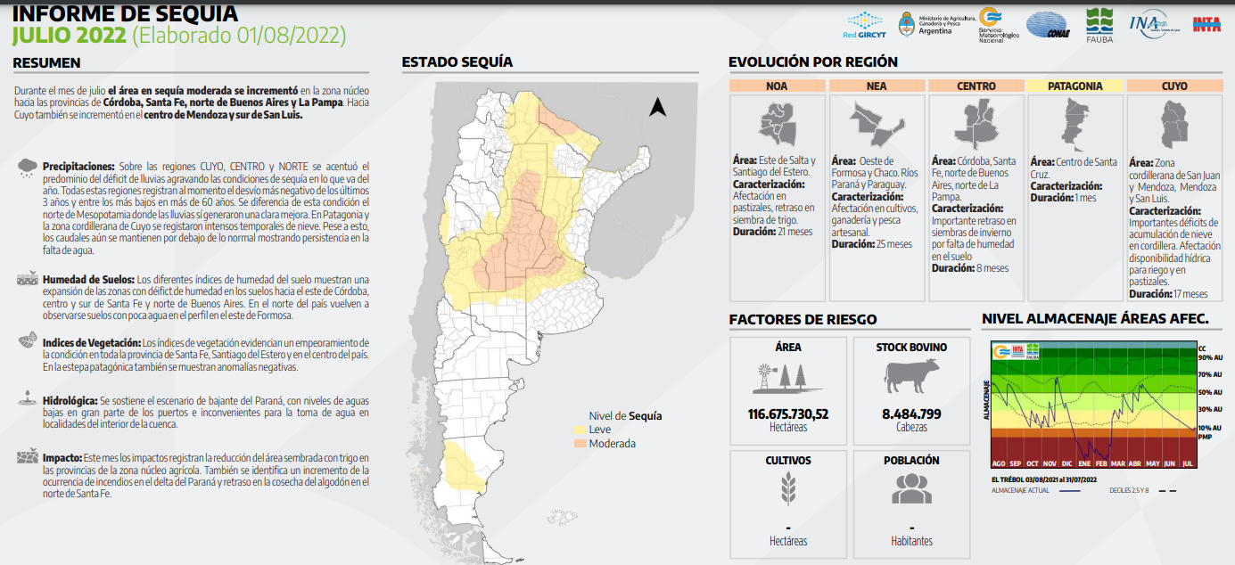
| SOME OF OUR USERS, NEEDS AND SERVICES
AGRICULTURAL MINISTRY EMERGENCY REQUESTS APROVED BY GOVERNMENT 2004-2017
DROUGHT
FLOOD
FROST
National Drought Board
Status to SEP-2021
CP Consensus 3-Month Precipitation -OND2021-

Slide 15
THE LAST DROUGHT REPORT

Slide 16
Challenges
Incorporate the CPM in sectoral models (e.g.: crop models, hydrological Models).
Extent Climatic Outlook from 6 months to a year or more.
Improve in the communication/ interpretation of forecasts (from 6 months to a year or more).
Expand or deepen the provision of climate services to other sectors where Climate Model prediction plays an important role (Demands of energy, Tourism, Industry, Retail, among others)

Slide 17
Thank you!!

Slide 18


