Slide 1
Storyline Simulations for Informing Decision Making
L. Ruby Leung
Pacific Northwest National Laboratory
7 September 2022
VI Convection-Permitting Regional Climate Modeling Workshop
Buenos Aires, Argentina

Slide 2
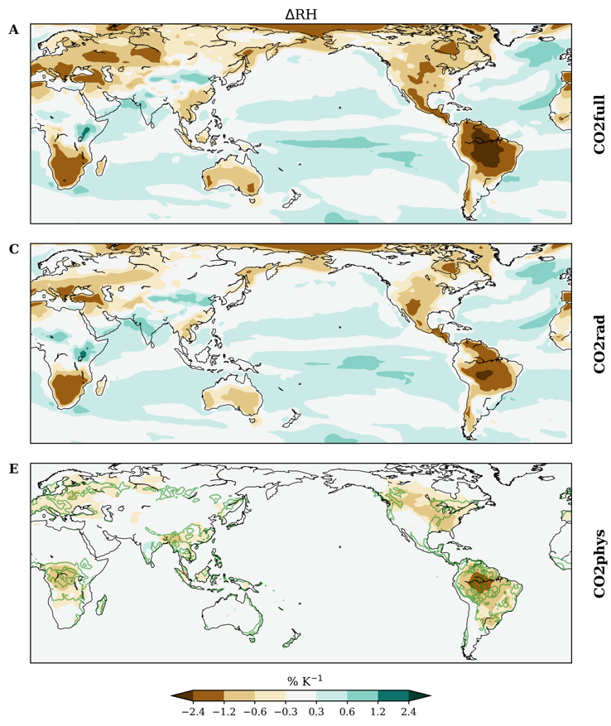

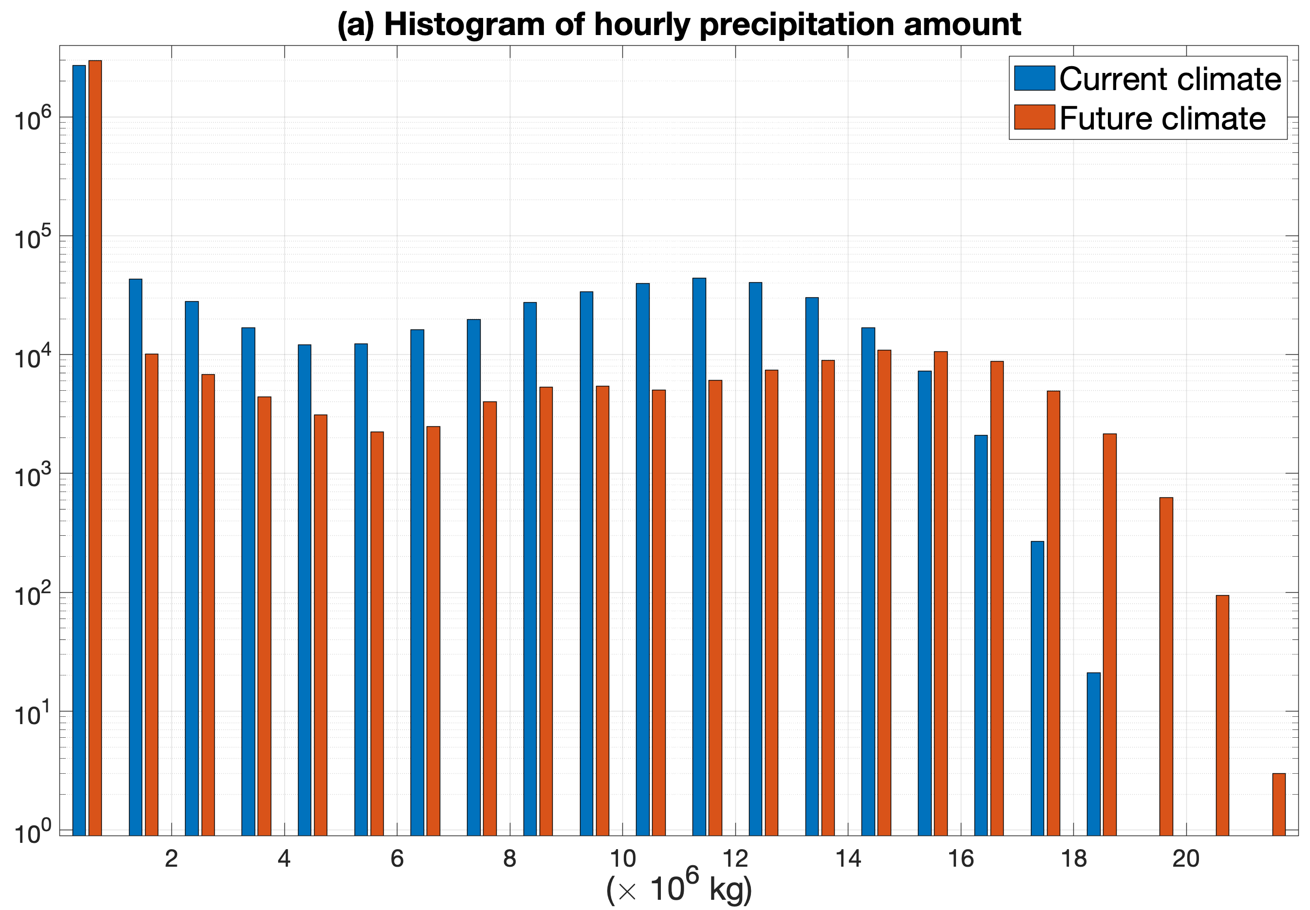
Reduced RH over land with warming – implications for convection
A simple Lagrangian parcel model shows that under warming, increased moisture increases CAPE while reduced RH increases CIN
Reduced frequency of light-to-medium rain rates but increased frequency of heavy rainfall
Change in RH projected by CMIP6 models
Total
Radiative
Physiological
(Zhou et al. in prep)
(Yang et al. 2021 JAS; 2022 in review)

Slide 3
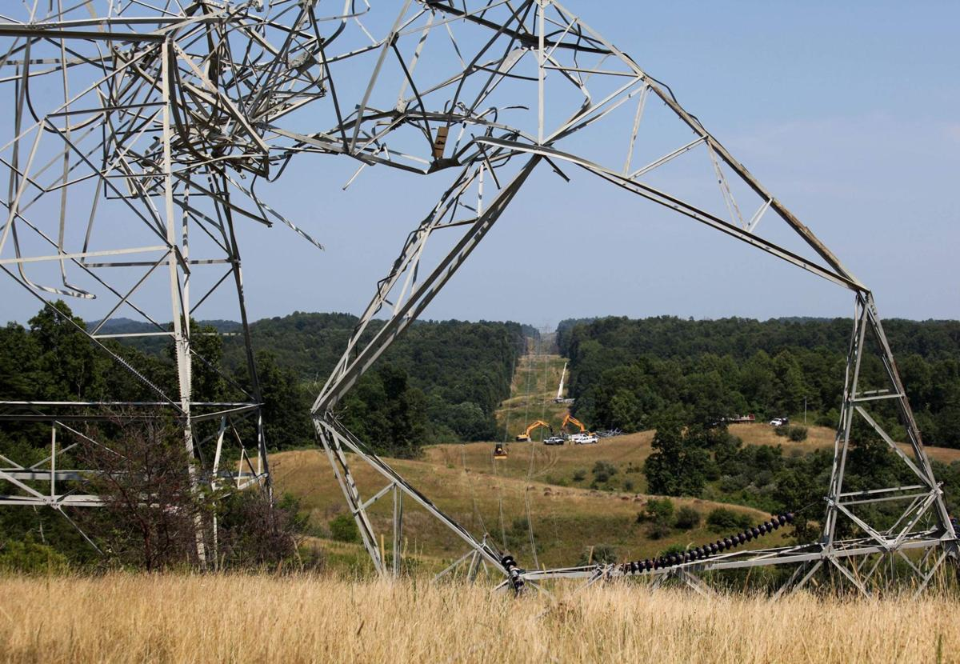
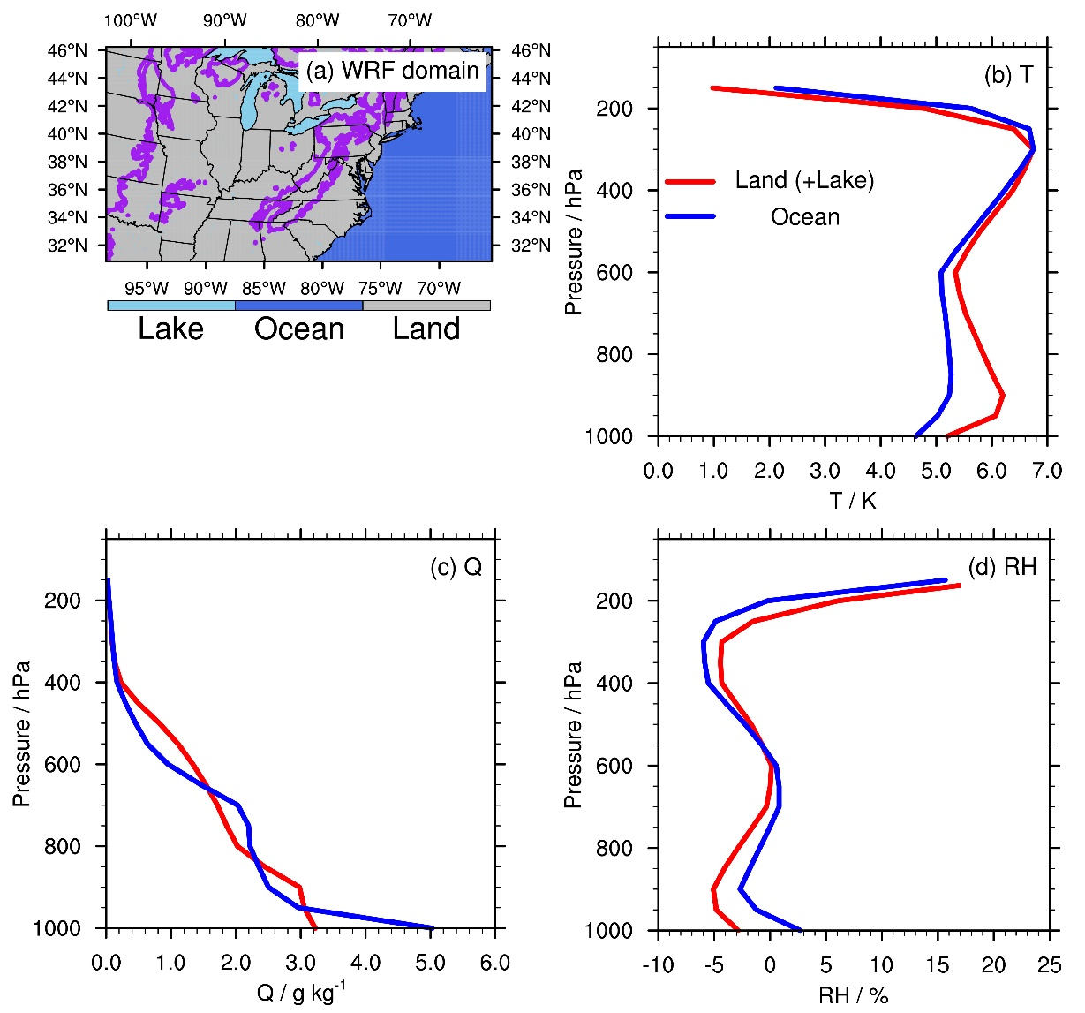
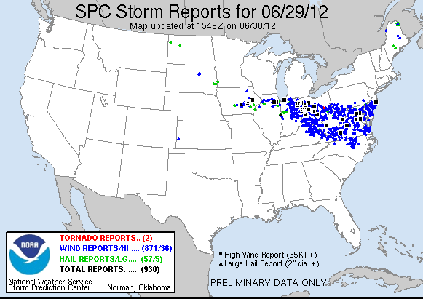
The 2012 North America derecho: a storyline simulation
Pseudo-global warming simulations using WRF at 4 km
June 2012 derecho in West Virginia: Power transmission infrastructure damages exceeded $170 million
Larger warming and reduced RH over land
Smaller warming and increased RH over ocean
(Li et al. in review)

Slide 4
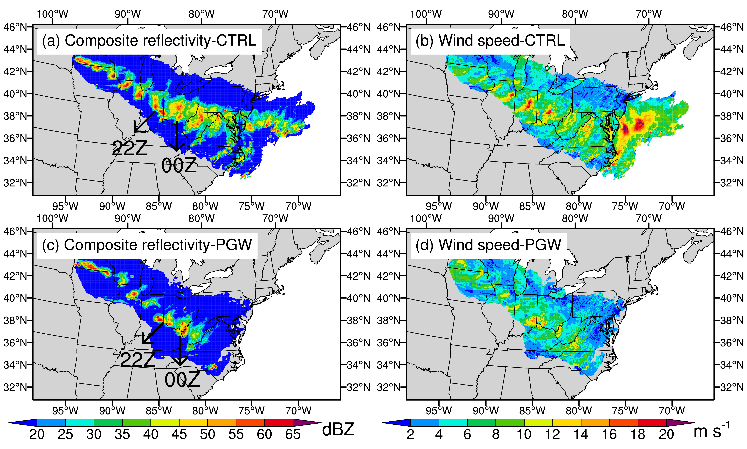
The derecho weakens with future warming
Smaller areas with high reflectivity and surface wind
Dissipate when approaching the mid-Atlantic region

Slide 5
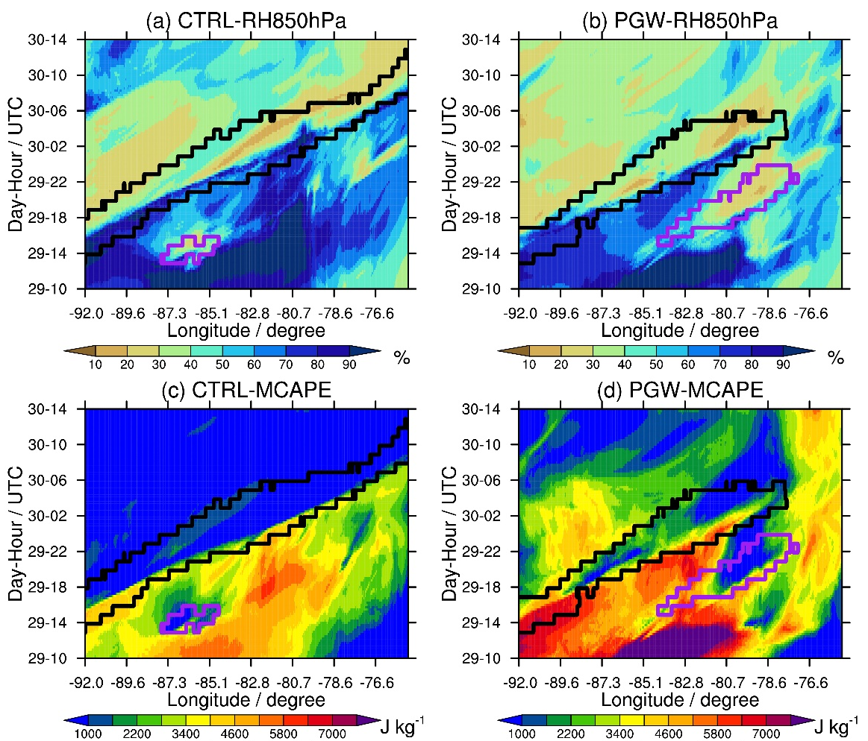
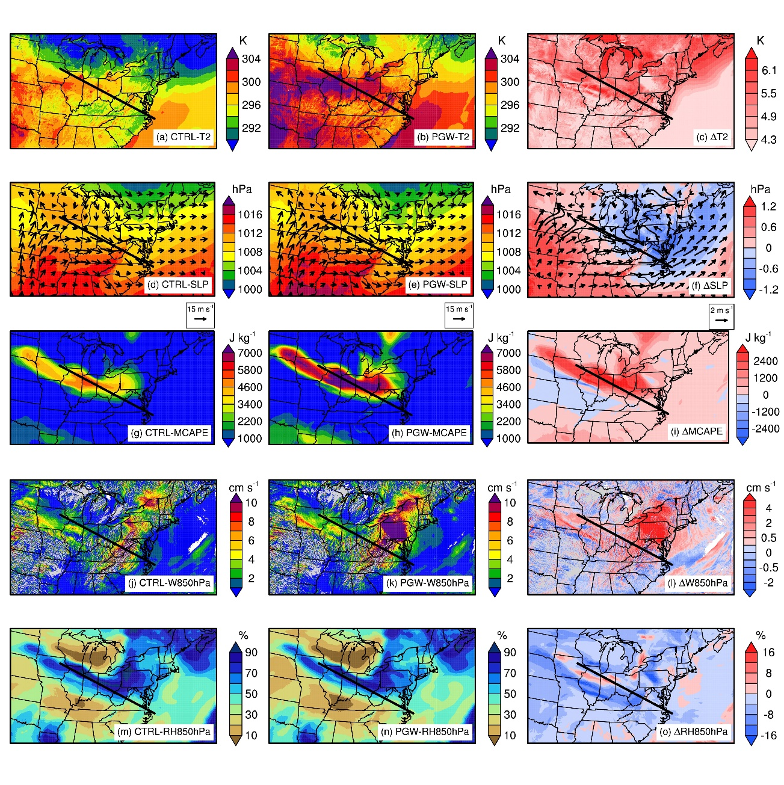
Processes weakening the derecho during two phases
On 2012-06-29 between 06Z and 10Z
2012-06-29 10Z and 2012-06-30 14Z
Larger warming poleward and increased moisture with warming enhance moisture convergence towards the derecho center
A general reduction of RH over land suppresses convection away from the derecho center, reducing the width of the derecho path
Moisture from the Great Lakes enhances an isolated deep convective cell ahead of the derecho
Rapid growth of the isolated deep convective cell consumes CAPE, leading to the demise of the derecho

Slide 6
Summary
Reduced RH over land is a robust response under warming
  Increased moisture under warming increases CAPE but reduced RH over land increases CIN – suppresses weak convection (moderate-to-light rain) and intensifies strong convection (extreme rain)
The 2012 North America derecho storyline
  The derecho path shrinks because of reduced RH over land
  Rapid growth of an isolated deep convection event fueled by increased moisture from the Great Lakes consumes CAPE ahead of the derecho, leading to premature decay
Lessons toward best practices
  Ensemble modeling is important for determining the robustness of results
  Storyline simulations must be accompanied by process analysis
  Simple models are useful for interpreting the results (e.g., Lagrangian parcel models)

Slide 7
A simple single column and multi-column Lagrangian parcel model of convection
Introduce cold-pool interaction mechanisms:
Strong lifting effects due to cold pool collision
Weak lifting effects due to gust front spreading
Weak subsidence effect
Based on Romps and Kuang (JAS 2010), the Lagrangian parcel model describes the ascent trajectory of a buoyancy-driven parcel from the surface to the upper troposphere.
(Yang et al. 2021 JAS; Yang et al. 2022 in review)

Slide 8
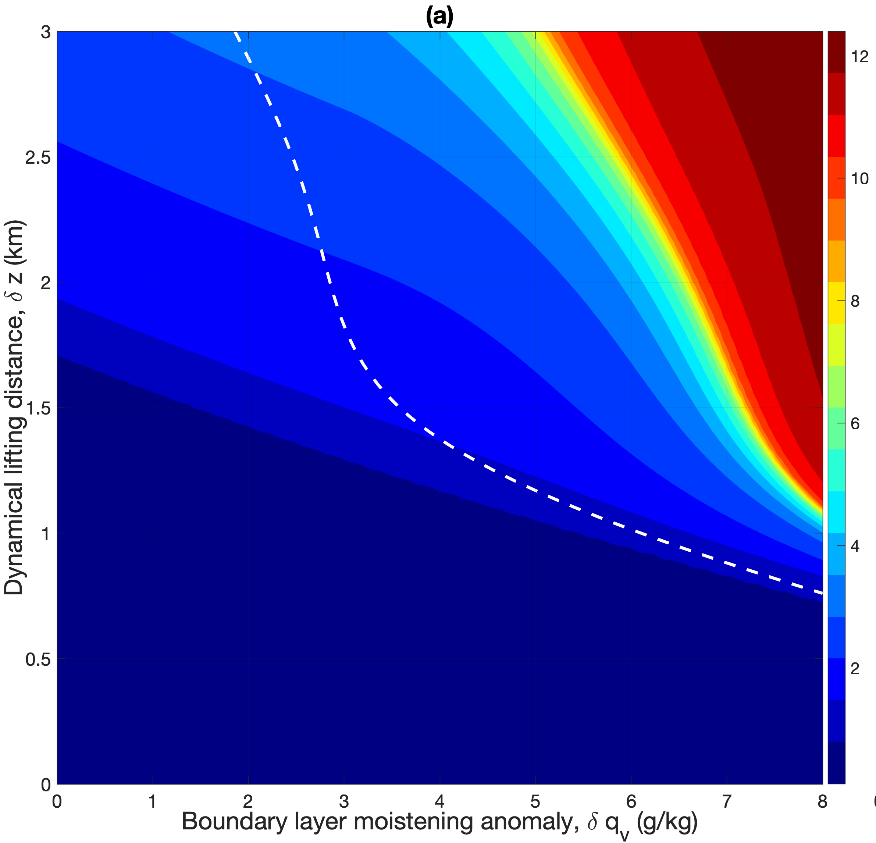
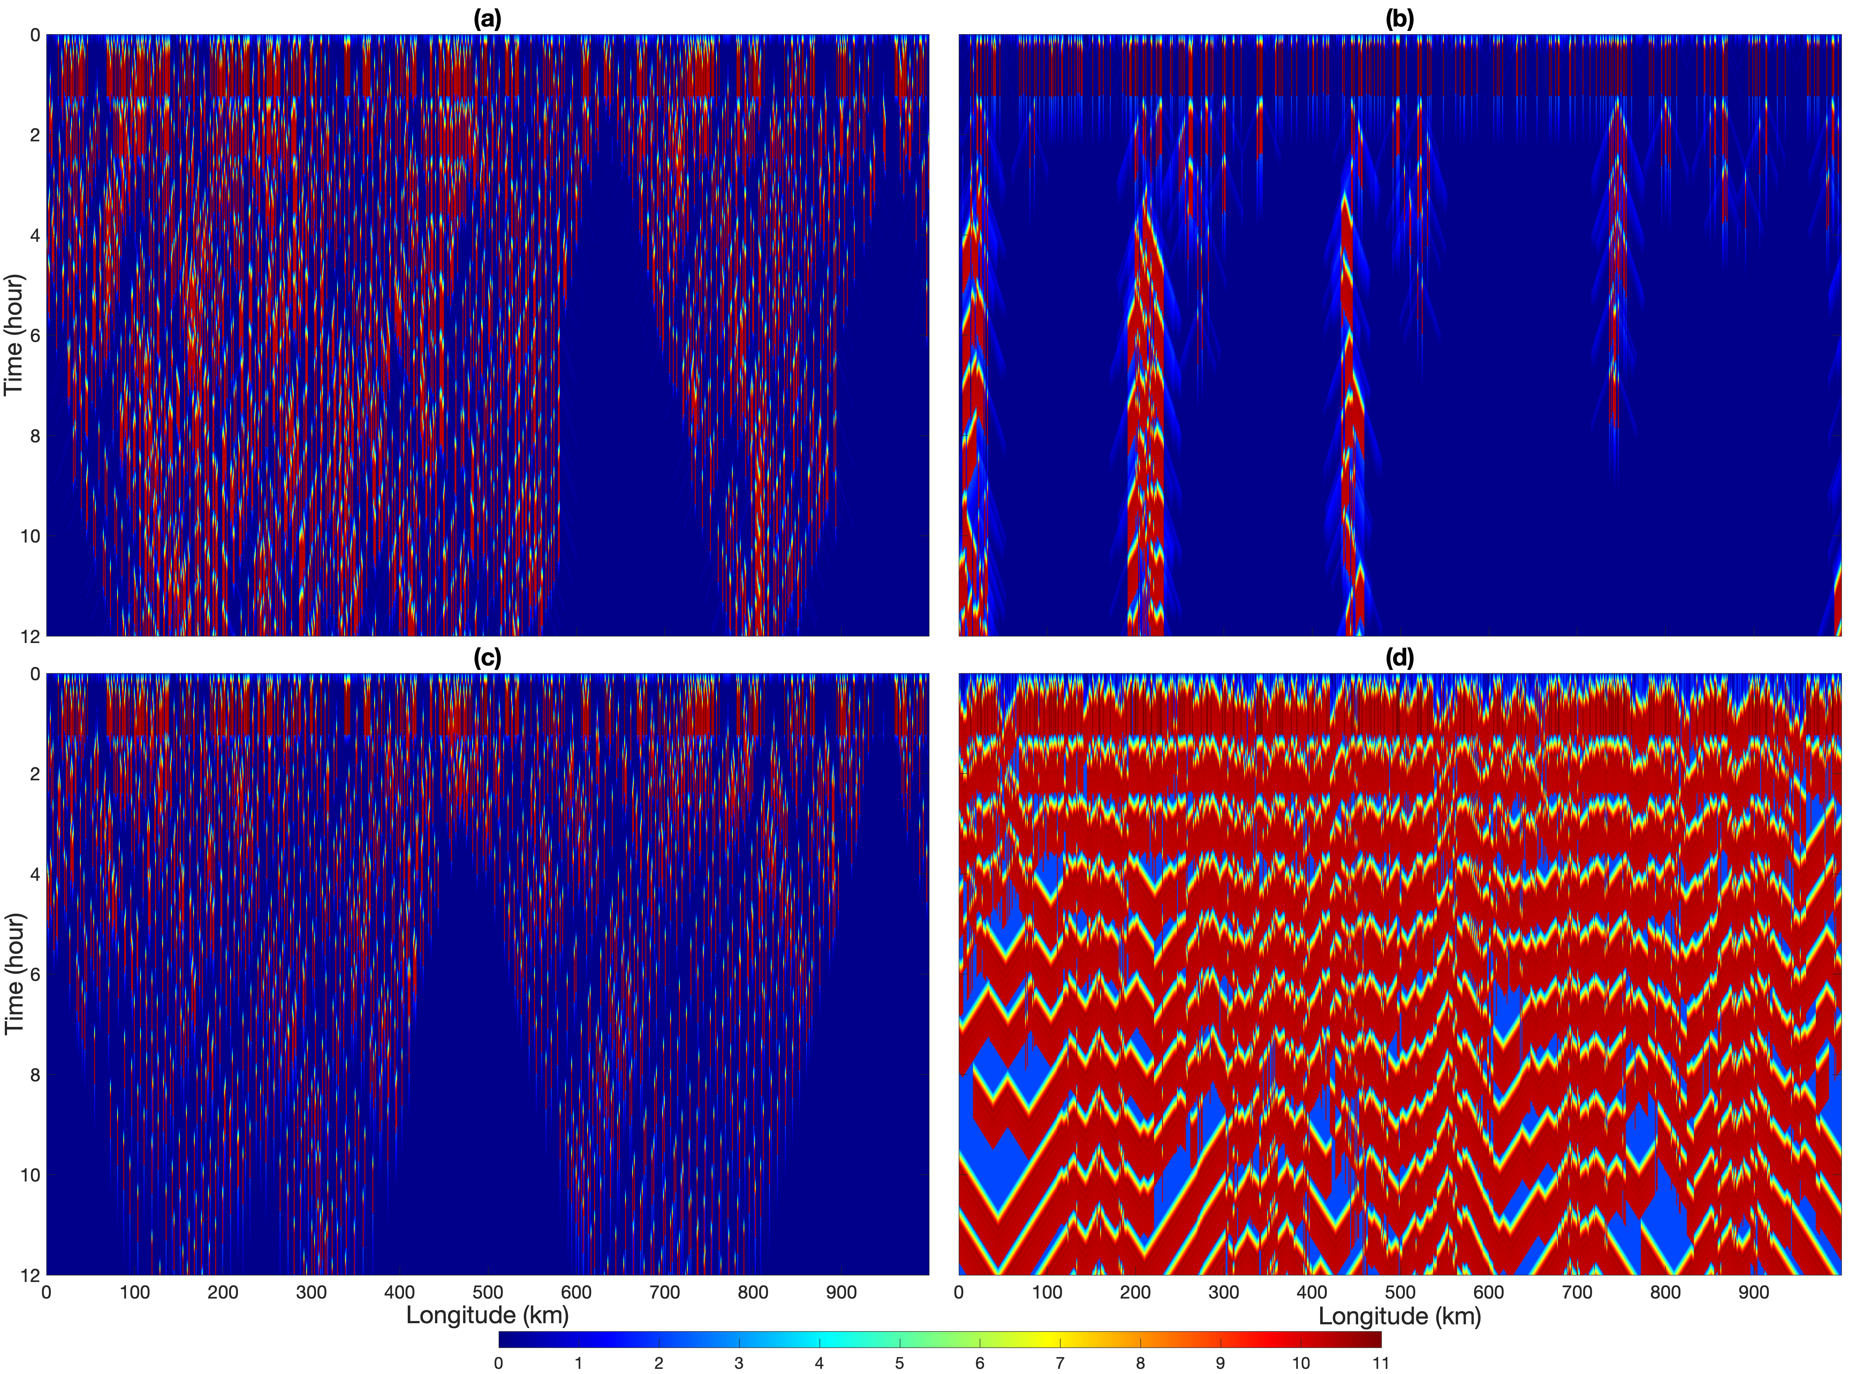
Parcel models simulate isolated and organized convection
Single column model simulates the effects of boundary layer moistening and dynamical uplift on convective initiation
Multi-column model simulates self-aggregation behavior
Final height (km) of the parcel
Parcel height in the multi-column model

Slide 9
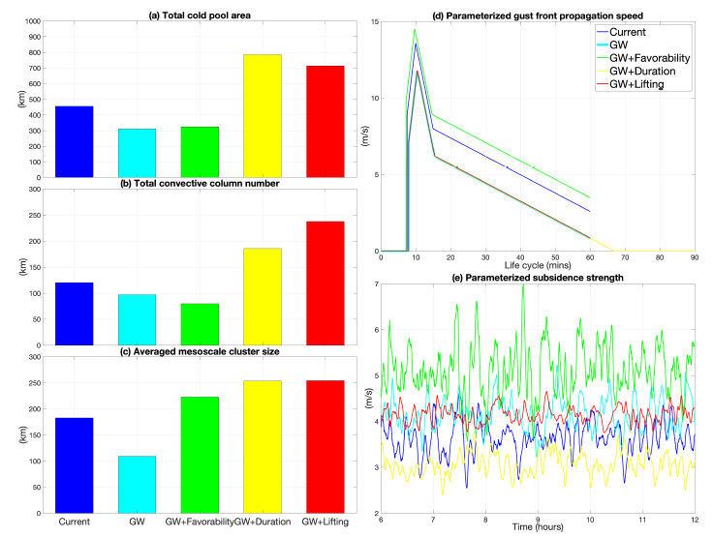
Response of isolated deep convection and organized convection to warming
Reduced RH over land reduces convective self-aggregation based on three metrics
Increased moisture increases CAPE
Reduced RH increases CIN
Favorability: increase initial moisture anomaly
Duration: extend parcel lifetime
Lifting: double the lifting strength by cold pool collision and spreading
Reduced frequency of light-to-medium rain rates but increased frequency of heavy rainfall

Slide 10
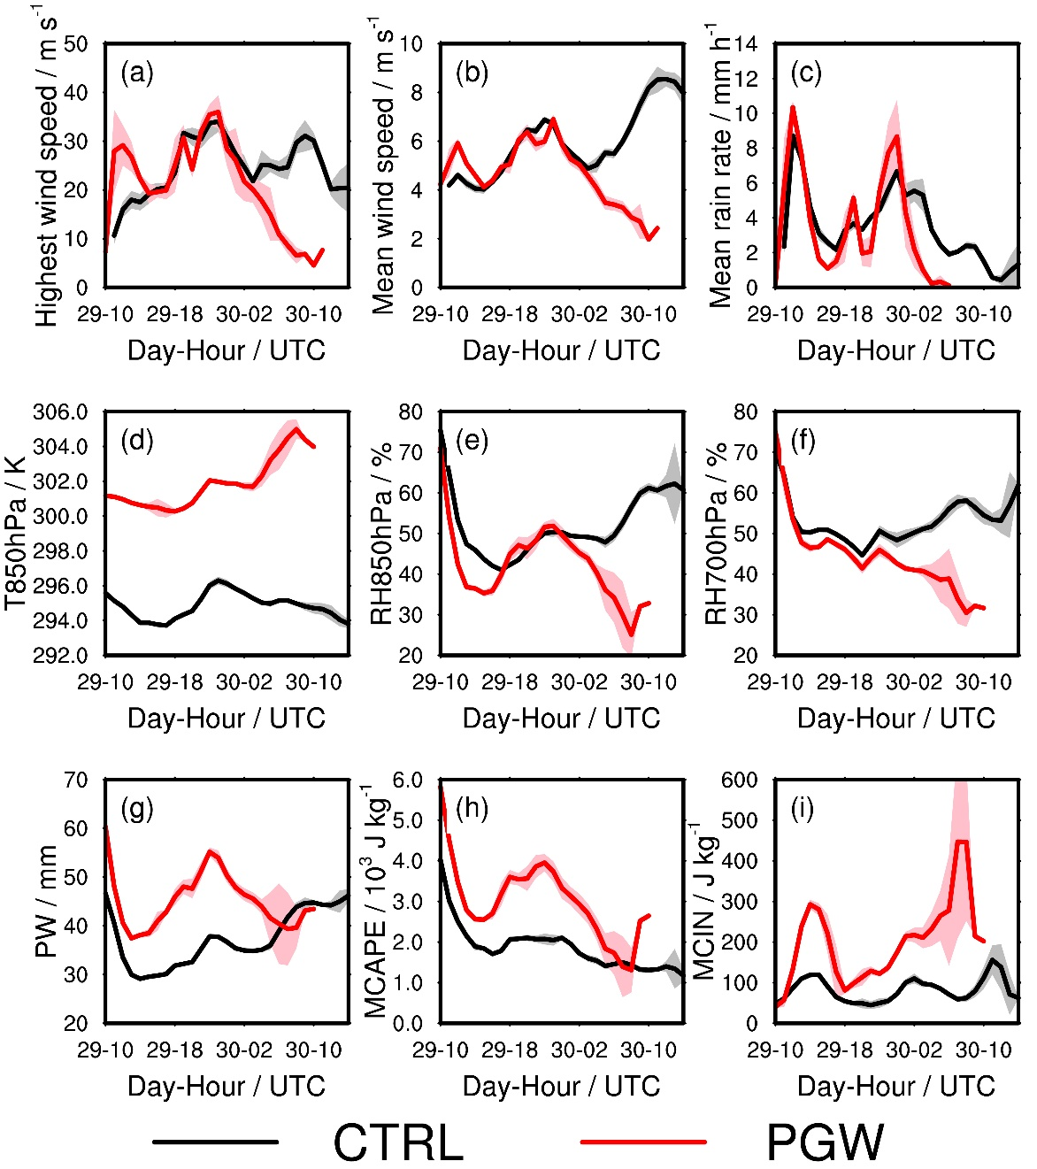
The derecho weakens with future warming
Smaller areas with high reflectivity and surface wind
Dissipate when approaching the mid-Atlantic region

