Slide 1



Modeling the impacts of Amazon deforestation on the Andes-Amazonas hydroclimatic connection
Jhan-Carlo Espinoza
Clémentine Junquas
IGE/IRD

Slide 2

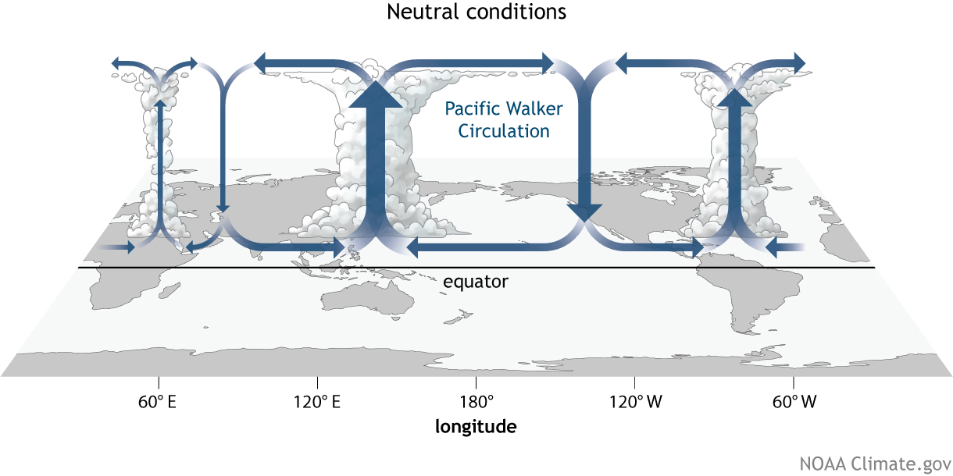
The Amazon River Basin:
One of the most critical elements of the Earth’s climate system
P=2200 mm/yr
Aerial rivers : 6,400 km³/year of water to the atmosphere
6400 km³/yr
6600 km³/yr
Water contribution from the forest
20% of the total freshwater discharged to global oceans
Sediments, nutrients
A critical source of energy to the atmosphere
Key conditions for the global energy and water balance

Slide 3
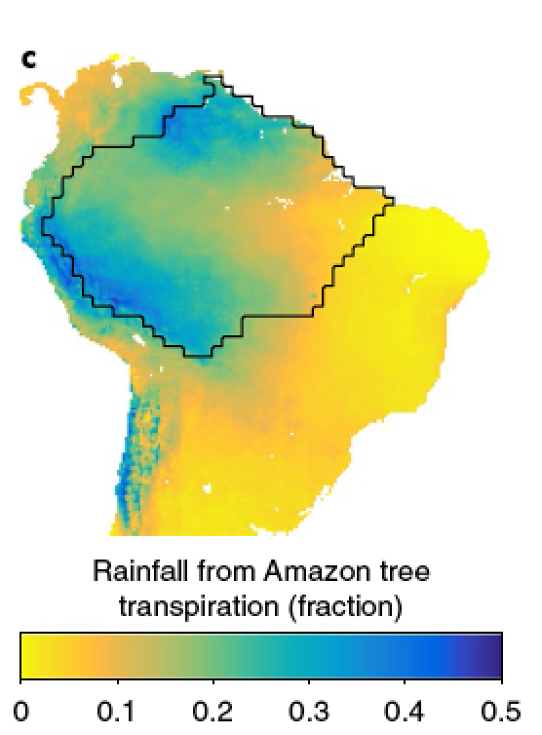
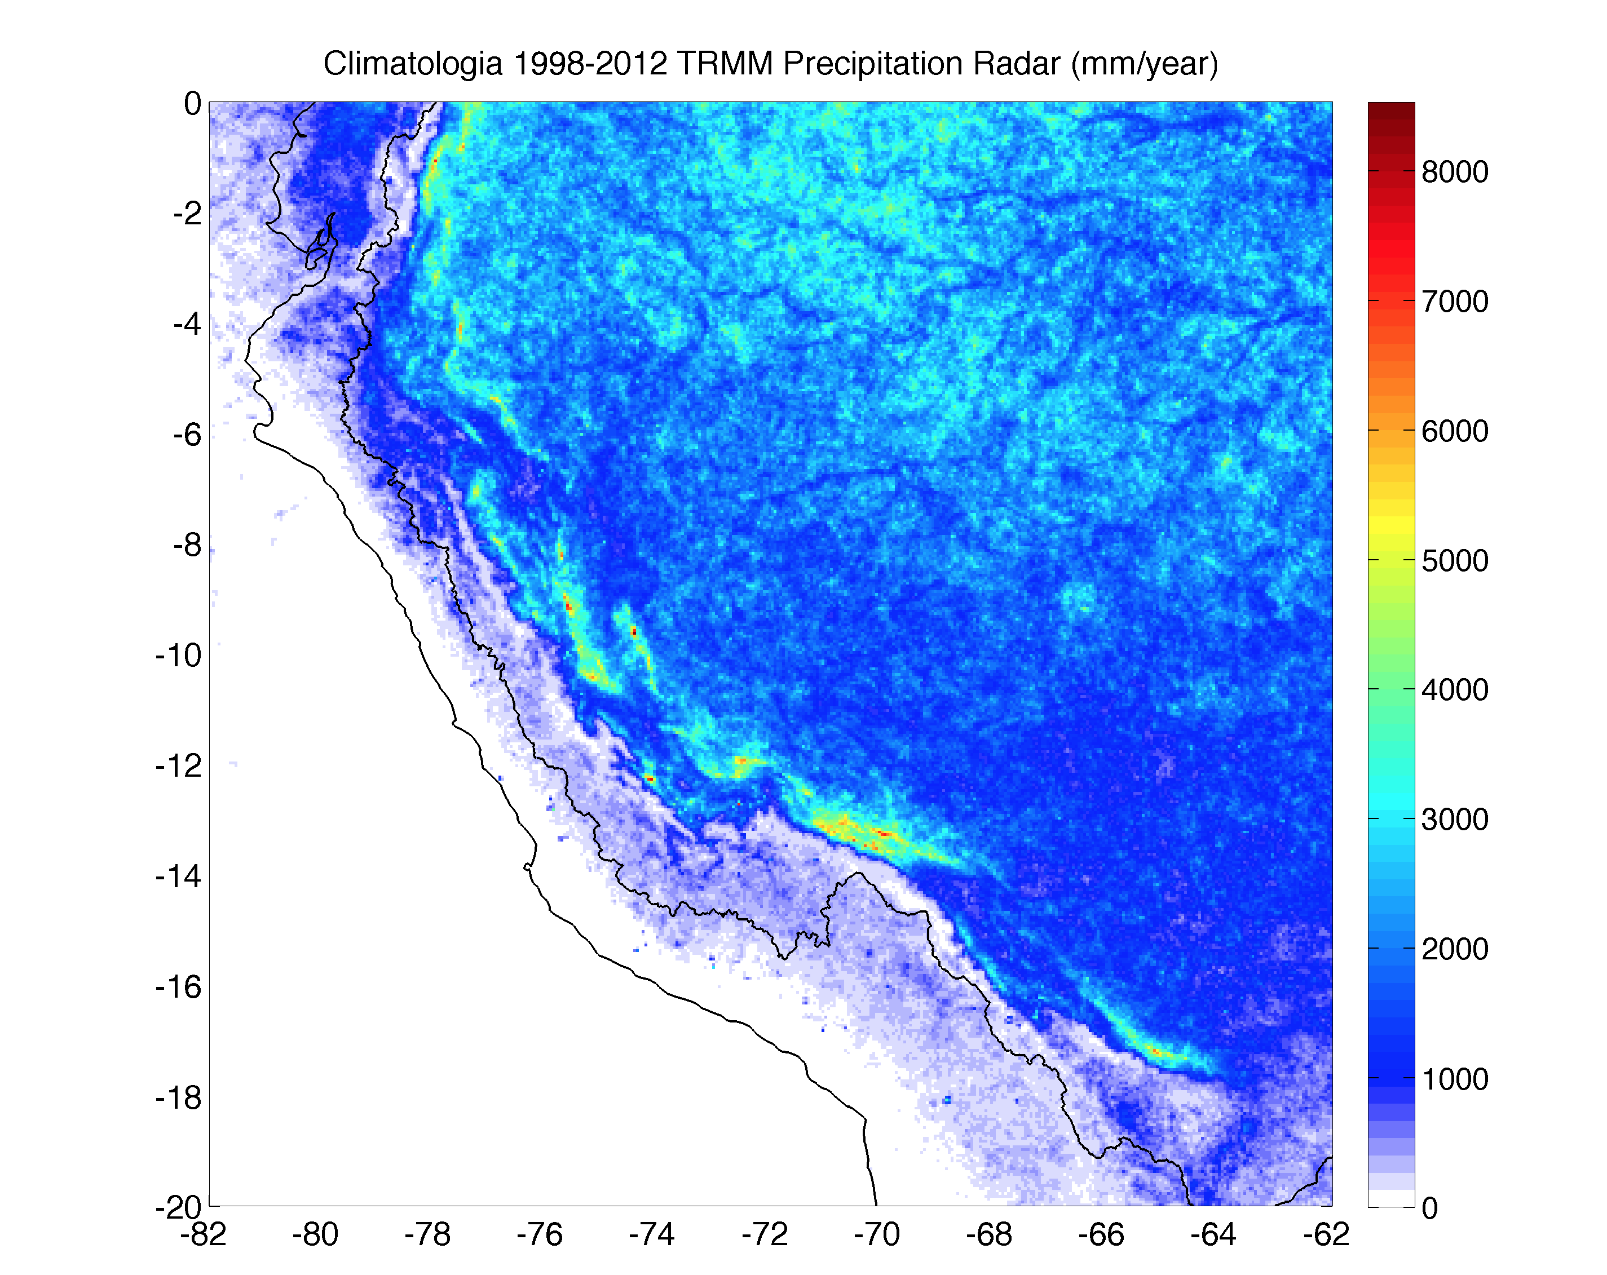
The Amazon-Andes Connectivity
Fraction of mean annual rainfall that has been transpired by trees in the Amazon basin
Precipitation (mm/yr) TRMM-PR 2A25 (5km)
Espinoza et al., 2015
Staal et al., 2018
The rainiest zones of the Amazon basin are situated in the East flank of the Andes (500-1000 masl)
One of the biodiversity hotspots of the world

Slide 4
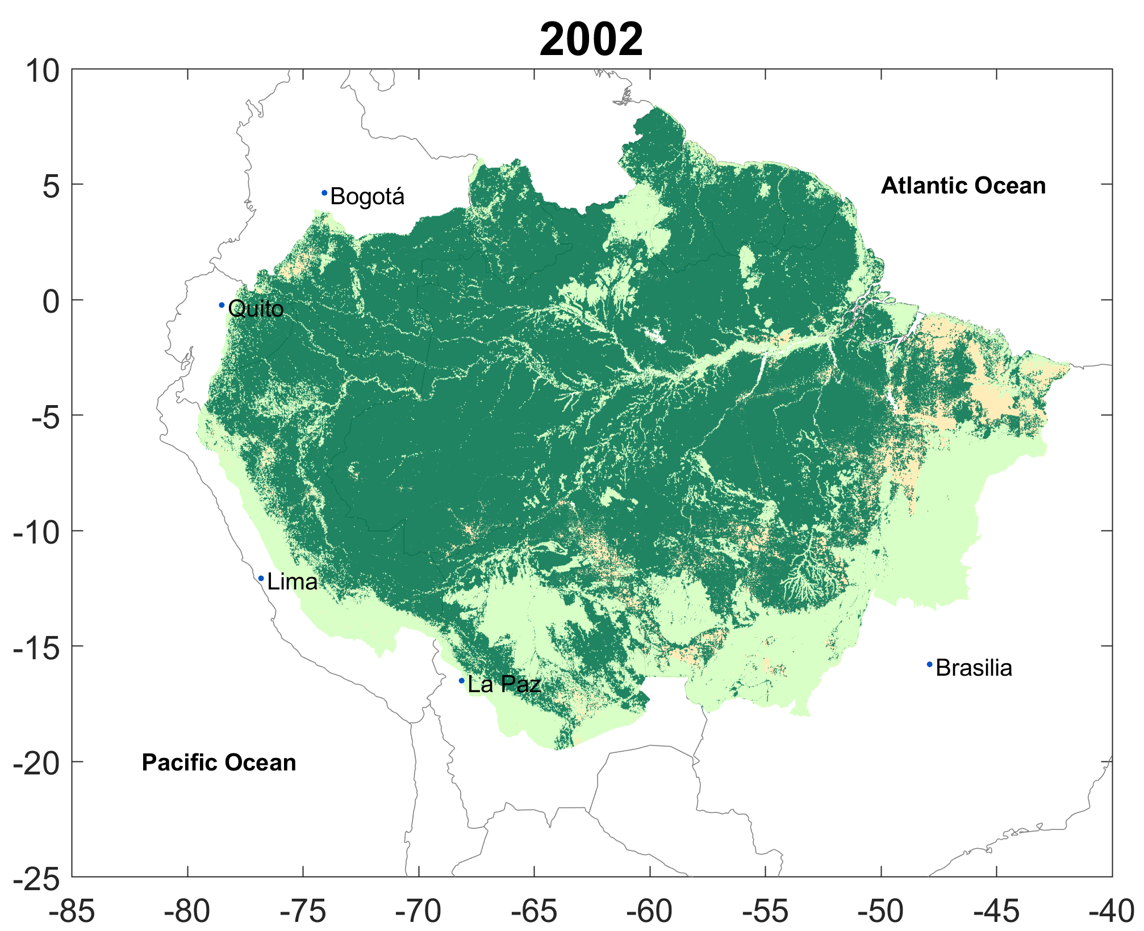
A biophysical system in transition due to climate change and deforestation
How global warming and regional modification of land cover could affect the regional water cycle ?
How will connectivity between the Andes and the Amazon be affected?
-Sediments and nutrients fluxes
-Water resources for the Andes
Deforestation: Approximately 17% of total Amazonian area

Slide 5
High-resolution modelling ; experiments with deforested landuse forcing data
10-years (2000-2010) of DJF simulations (WRF model) over the tropical South America
- present landuse (control)
- Amazon deforestation projected by the year 2050
Sierra et al, 2021

Slide 6
High-resolution modelling ; experiments with deforested landuse forcing data
3 nesting domains, D1(9km), D2 (3km), D3(1km) in a Bolivian Valley (Zongo)
WRF-1km rainfall transect
mm/mes
control
DJF 2001-2002
deforested
Sierra et al, 2021
Cross-section along the Zongo valley, Bolivia

Slide 7
High-resolution modelling ; experiments with deforested landuse forcing data
Possibility of analysis of the changes of valley wind circulation associated with the Amazon deforestation
Interactions of scales : local processes (day), regional processes (night)
Model performance validated at local scale with in-situ stations, but…
Are convection-permitting simulations able to reproduce processes depending on scale interactions ?
Sierra et al, 2021

